Slide 1
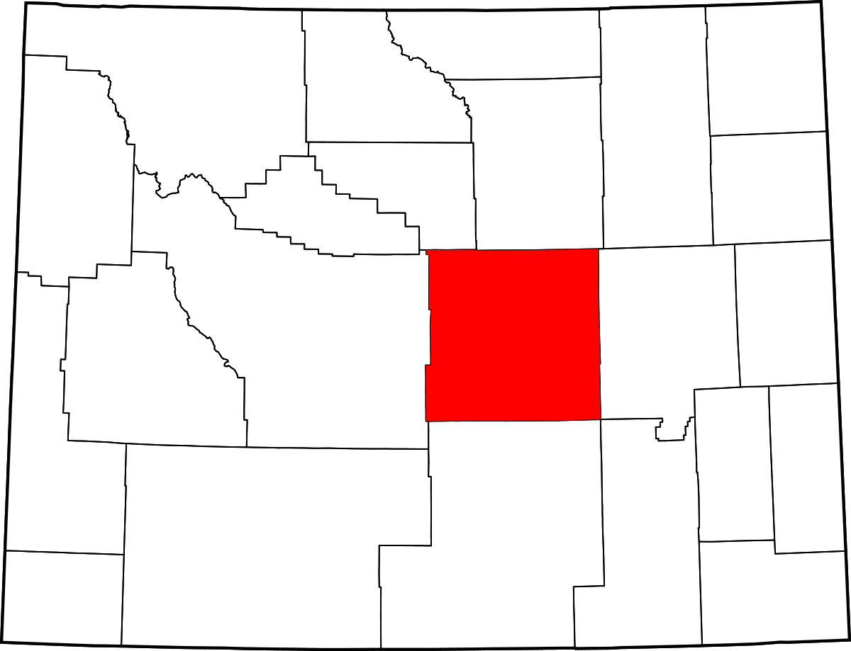
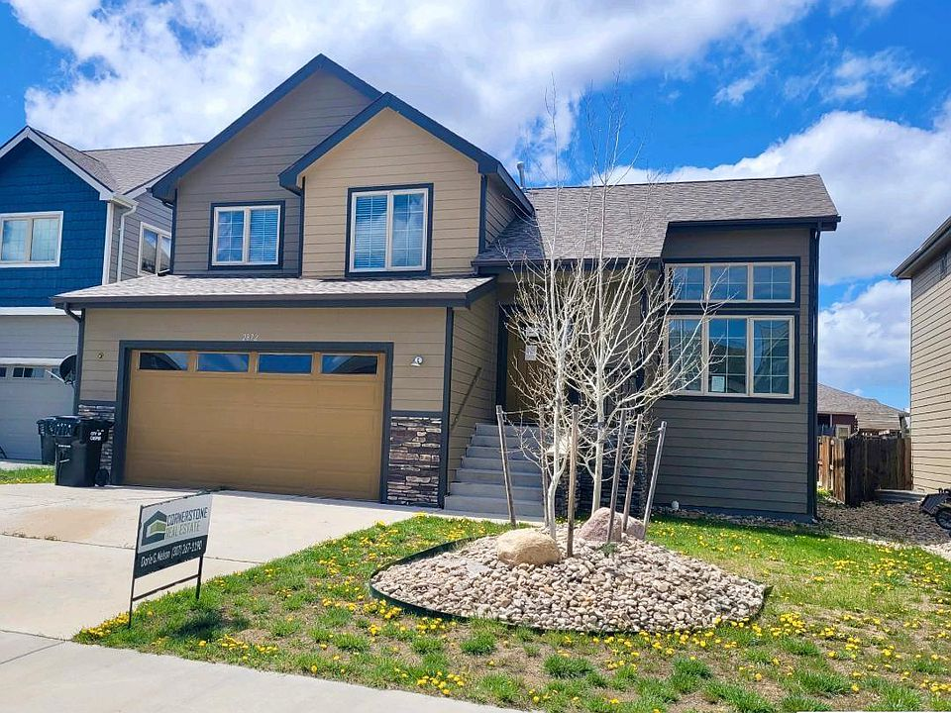
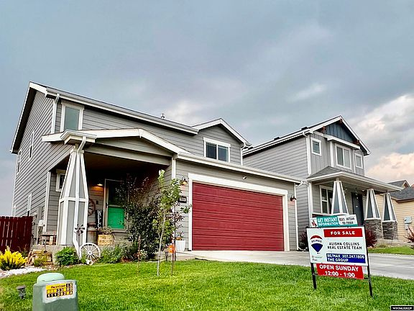
A Teacher’s Life by the Numbers!
3
Natrona County, WY
1st Year Teacher with a B.A.
15th Year Teacher with a M.A.+
Teacher Salaries
$47,202-$49,282*
$65,685- $72,388*
*Data from 2022-2023
Plus extra duty pay for coaching and club sponsorship
What does that mean for a professional in this area?
The average annual wage is $47,736
Median home value is $282,620
Fair Market rent for a two-bedroom apartment is $868
A salary of $48,242 can buy a home like this*:
A salary of $69,037 can buy a home like this*:
$170,000
$305,000
*With a 5% down payment for 1st year teachers and 20% down for mid-career and while spending 36% of their income on housing
Visit our Website! GettheFactsOut.org
This material is based upon work supported by the National Science Foundation under Grant Nos. 1821710 & 1821462. Any opinions, findings, and conclusions or recommendations expressed in this material are those of the author(s) and do not necessarily reflect the views of NSF.
Created by BA 10.5.22

