Slide 1



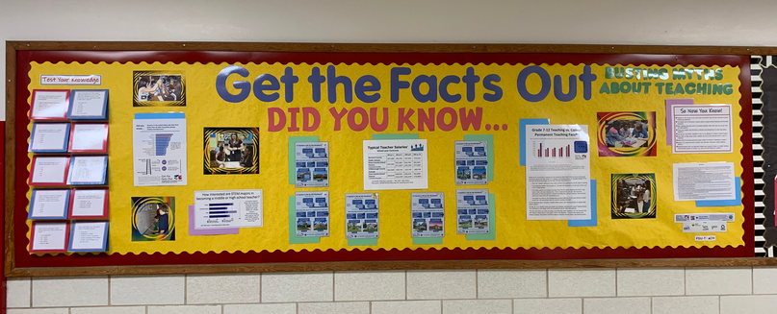
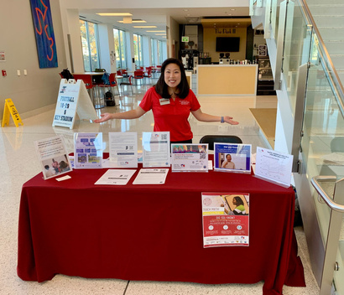
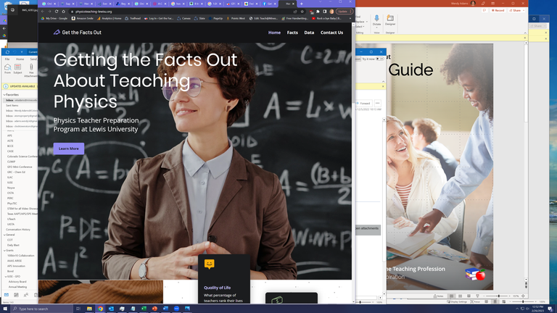









Your journey with GFO continued
Developing
a Teacher Recruitment Plan
Making the most of GFO resources
Planning a full GFO campaign
Craft your strategy
Timeline Stakeholders Materials
A successful GFO campaign includes presen-tations, posters, flyers, social media, and visits to a range of campus events including admissions events, student life activities, clubs, and classes.
GFO User Guide
Tailor all the GFO resources
Tailor a full suite of GFO resources for your local context. Include local teacher salary data and information on retirement benefits for your state. Add in your branding and contact information. You can even update the colors to match your institution’s branding. Data for your locale can be found on the GFO website.
Robin from FSU created her own large-scale bulletin board spread with posters, infographics and facts for her hallway.
Jean from UIndy displaying her custom, resource-stocked table setup.
Joe from Lewis University incorporated GFO messaging and facts into his local teacher preparation website.
Presentations!
Register your GFO activities and you’re now a 3-star Champion!
The ‘Busting Myths’ student presentation is our most effective tool for improving perceptions about the teaching profession. A successful GFO campaign should include regular presentations to the students your program draws from as well as their peers and faculty whom they interact with.
This material is supported by the National Science Foundation under Grants 1821710 & 1821462. Any opinions, findings, and conclusions or recommendations expressed in this material are those of the author(s) and do not necessarily reflect the views of the National Science Foundation.
Sharing the facts about
the teaching profession
Connect with GFO!
GettheFactsOut.org/
gfo-community/
Share your ideas and connect with other Champions.
Instructions and Inspiration

Slide 2

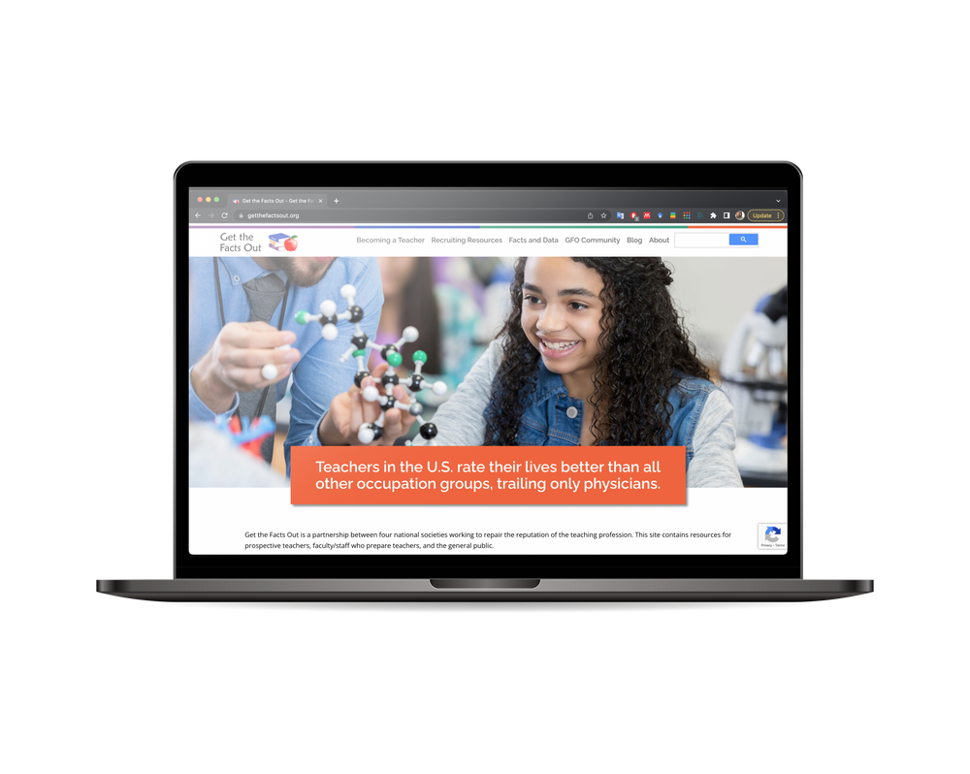
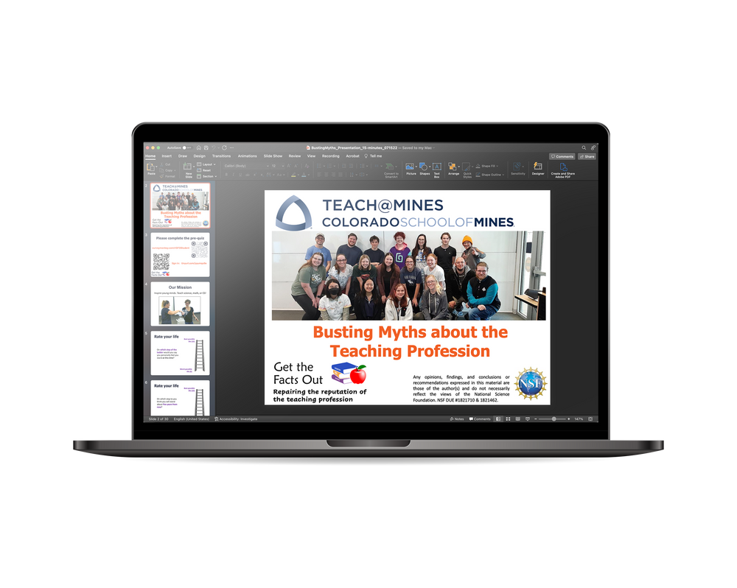


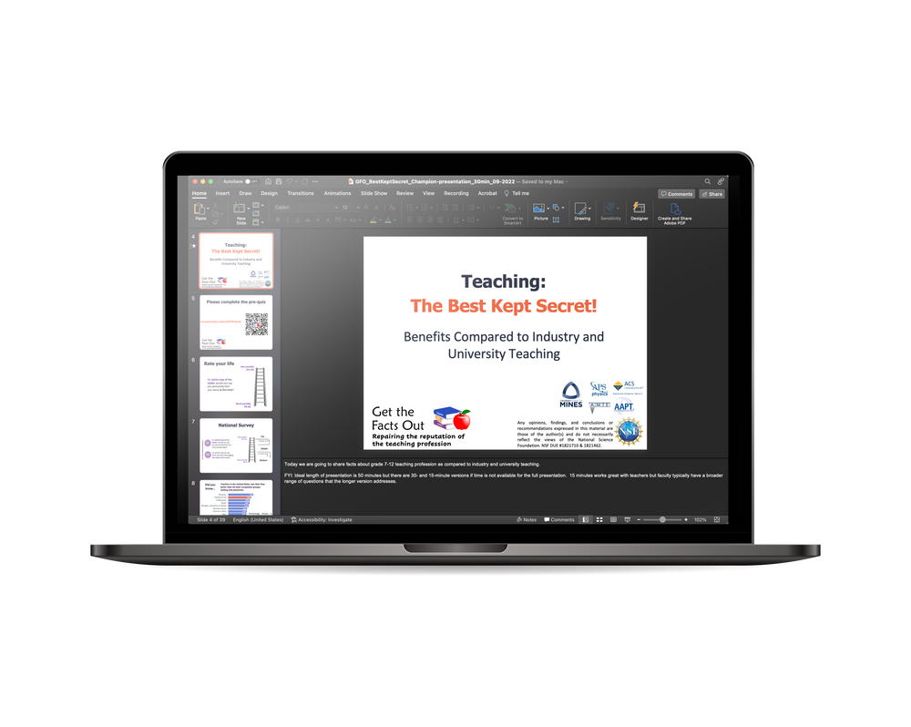






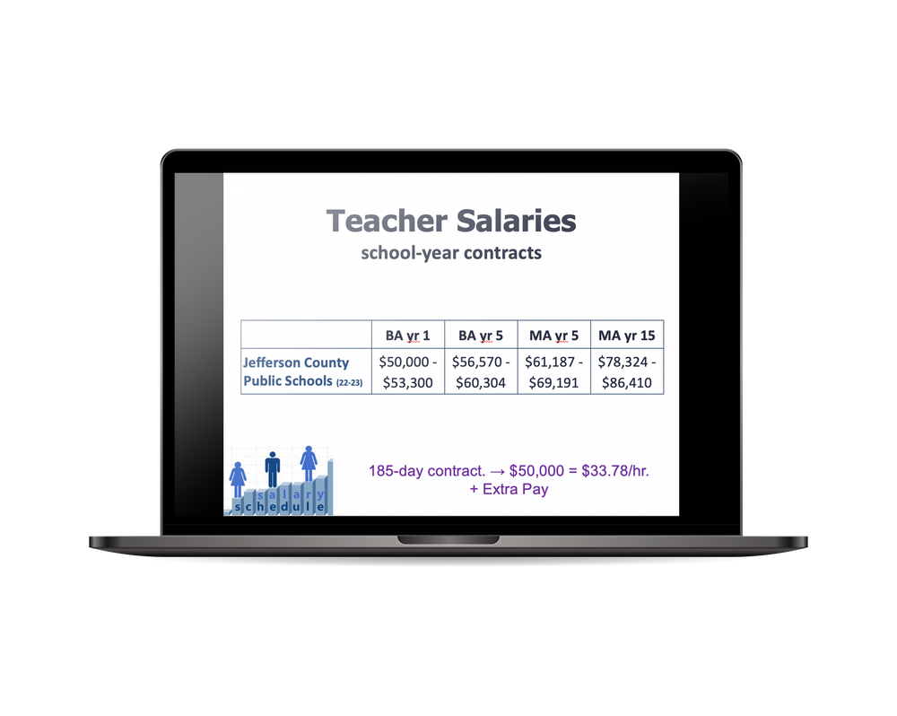


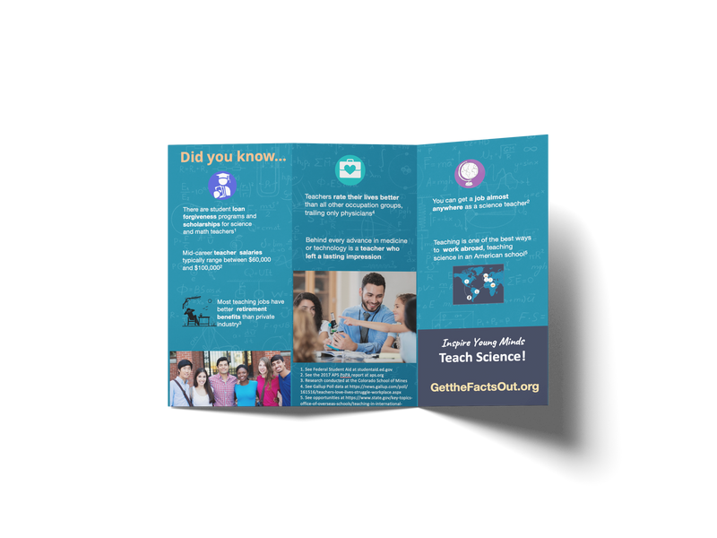









Get the Facts Out Resources
GettheFactsOut.org
Your early journey with GFO
How you can ‘Get the Facts Out’ about the teaching profession
The first steps for using GFO resources to recruit the next generation of STEM teachers
Presentations
Getting started with GFO
Busting Myths about the Teaching Profession
Get to know the facts
STUDENT PRESENTATION · 15-30 mins · PPTX
A good first place to start is to look through the facts that the GFO team has compiled and tested to help recruit STEM teachers.
The Explore Teaching page shares info prospective teachers ask about, while the Facts and Data page shares additional facts that faculty wonder about:
Share the facts one-on-one
Designed to facilitate discussion with students who may or may not be interested in teaching, in a variety of contexts.
Videos
Have brief personal conversations with students or faculty members.
As a conversation starter, use
Teaching: The Best Kept Secret
then
or
FACULTY PRESENTATION · 15-90 mins · PPTX
a brochure
data handouts
Designed to facilitate discussion with faculty/staff who may talk with students about teaching as a career.
Testimonials and inspiration
We have also prepared a
‘First Conversations Guide’ online.
Posters
GetTheFactsOut.org/
prospective-teachers
Register! You’re already a GFO Champion
GettheFactsOut.org/
become-gfo-champion
Data / Handouts
Teacher Salary Data
Now that you’ve started
INFOGRAPHIC + SALARY SLIDE · 1-5 mins · PDF/PPTX
Share the facts more broadly
Find local Teacher Salary data
*tip* You can request help with this data search at
GettheFactsOut.org/
teacher-salary-data
Localized data, including an info-graphic with key salary numbers and housing (A Teacher’s Life by the Numbers) plus slides to be used with the presentations above.
Use as they are or modify for your institution
With some GFO-backed conversations under your belt, you are ready to start sharing facts about the teaching profession with a wider audience.
If you haven’t already, dig into more of the local data on teaching for your area. GFO has data for over 300 locations and can help collect data for your area if it’s not already on the site.
Incorporate GFO messaging about the facts into your program flyers or on your program website. You could also share GFO memes on your Facebook page or on Instagram.
Brochures
Customize posters and data handouts for your institution and local context
Data Handouts
PRINTABLES· 5-15 mins · DOCX/PDF
Share these handouts with students or faculty any time you are having a conversation about the teaching profession or have a stack available outside your door.
Engage with students one-on-one
Effectiveness
GFO standard
University of Indianapolis
When used as designed, GFO resources have been shown to positively impact students’ perceptions of the teaching profession with a third indicating an increased interest in becoming a teacher after a single presentation.
You’re now a
1- or 2-star
Champion!
Give a ‘Busting Myths’ presentation to your class or at an information session for interested students.
GetTheFactsOut.org/
recruiting-resources

