Slide 1
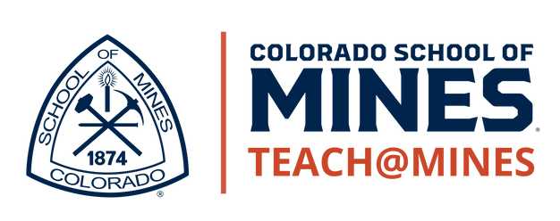
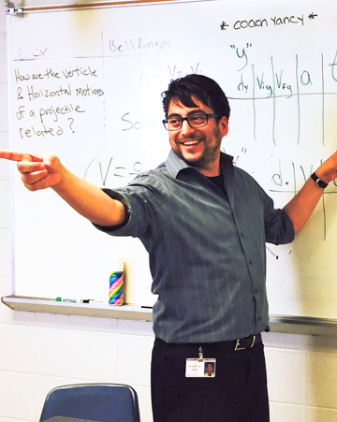
DID YOU
KNOW
Teachers rate their lives better
than all other occupation groups, trailing only physicians.
There are generous student loan
forgiveness programs and scholarships for science and math teachers.
At year 15, the middle 50% of teacher salaries ranges between $65,000 and $110,000 (IQR), nationally.
Teachers earn additional pay of
$1,000 - $8,000 for coaching & clubs.
Most teaching jobs have better retirement benefits than private industry.
You can get a job almost anywhere
in the U.S. or abroad as a science or
math teacher.
Behind every advance in medicine or technology is a teacher who left a lasting impression.
Three Ways to Double Your Career Options
www.mines.edu/teacherprep

Slide 2
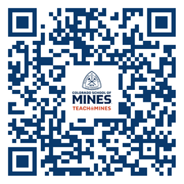
Engineers make Bridges
Artists make Paintings
Scientists make Rockets
Teachers make them all
TEACHING PATHWAYS
Three Ways to Double
Your Career Options
LEARN MORE
DIP YOUR TOE IN THE WATER
Try the K-12 Field Experience
class with just 1 credit hour!
Add SCED 262 to your schedule!
MINOR IN TEACHING:
Earn your teaching license alongside ANY major
GET SOCIAL
Follow Teach@Mines on Instagram for program info and events.
MAJOR IN TEACHING:
BS in Engineering with a STEM Teaching focus
TEACH@MINES IS
CHECK OUT OUR SITE
Find everything you need to know and reach out to our program advisors!
ADD A MASTERS:
BS + MS in STEM Education
= BS, MS, & Licensure
The only program in CO focused exclusively on training STEM teachers
The only CO university offering CS teacher licensure
CONTACT US
CONTACT US
Teach@Mines is part of:
Rated in the top 5 physics teacher prep programs in the US
Wendy Adams, Director
wkadams@mines.edu
Wendy Adams, Director
wkadams@mines.edu
Dawson Lang, Advisor
dawsontlang@mines.edu
Dawson Lang, Advisor
dawsontlang@mines.edu

