Slide 1
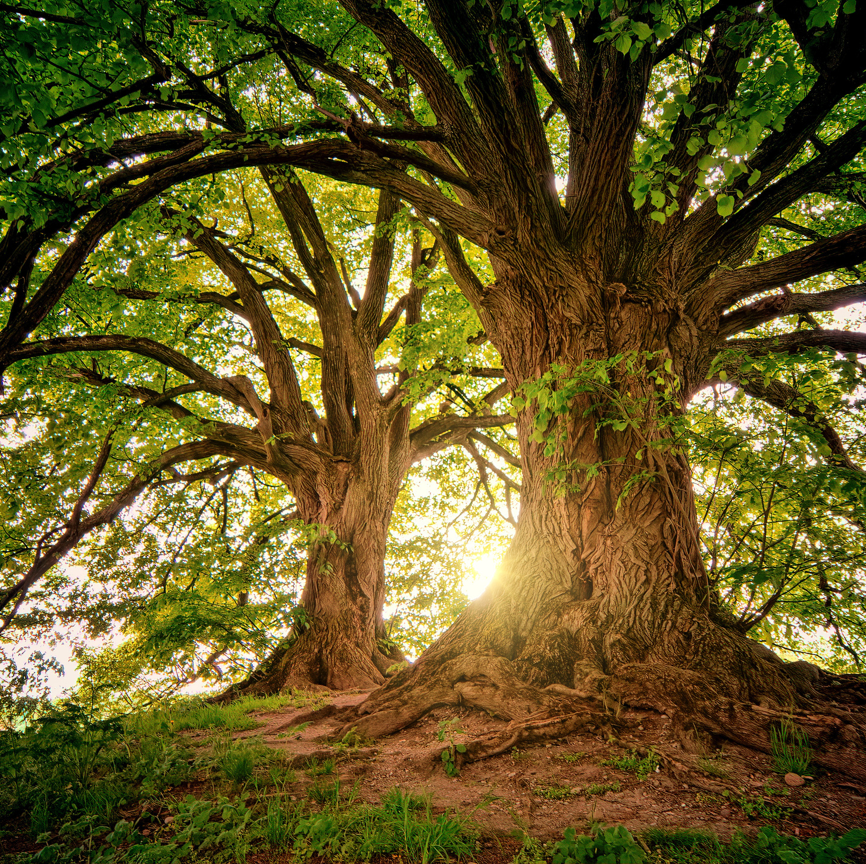
Where does the mass of a tree come from?

