Slide 1
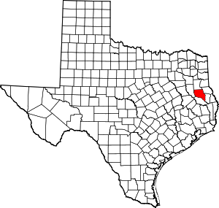


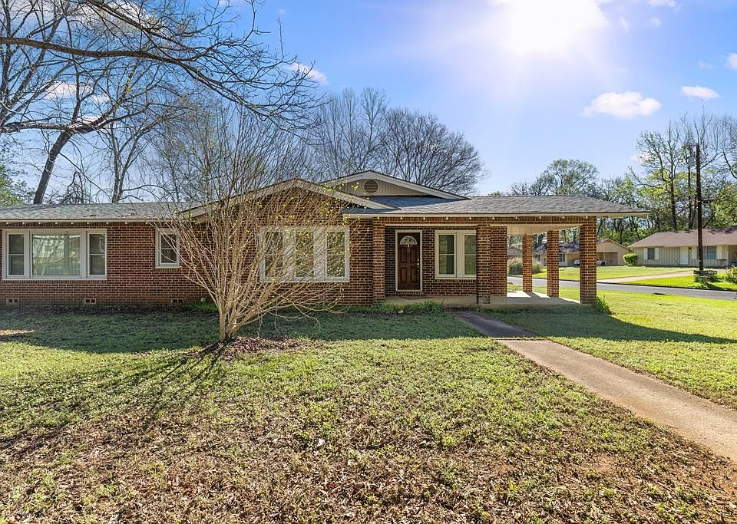
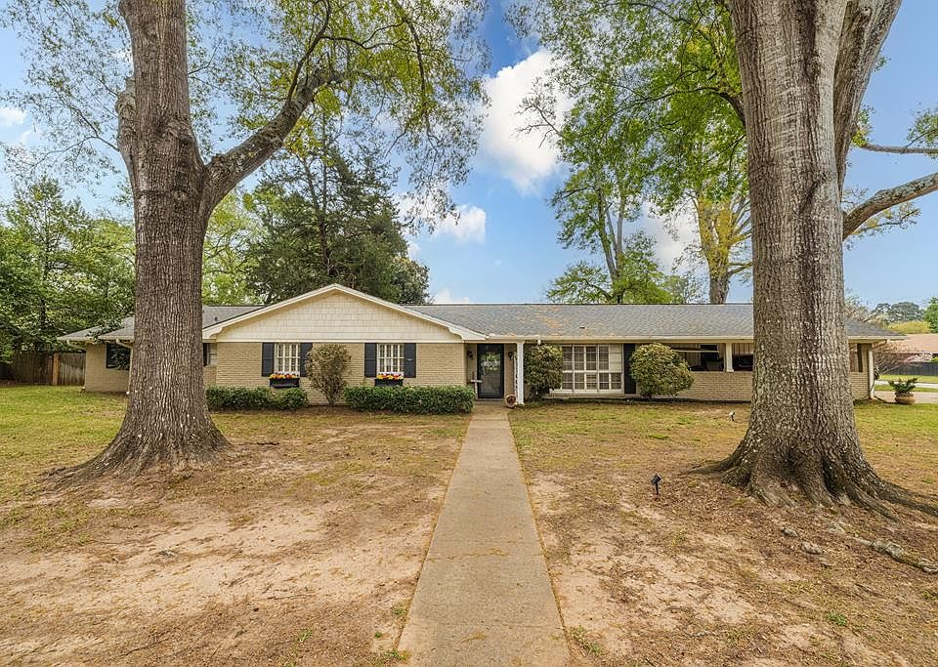
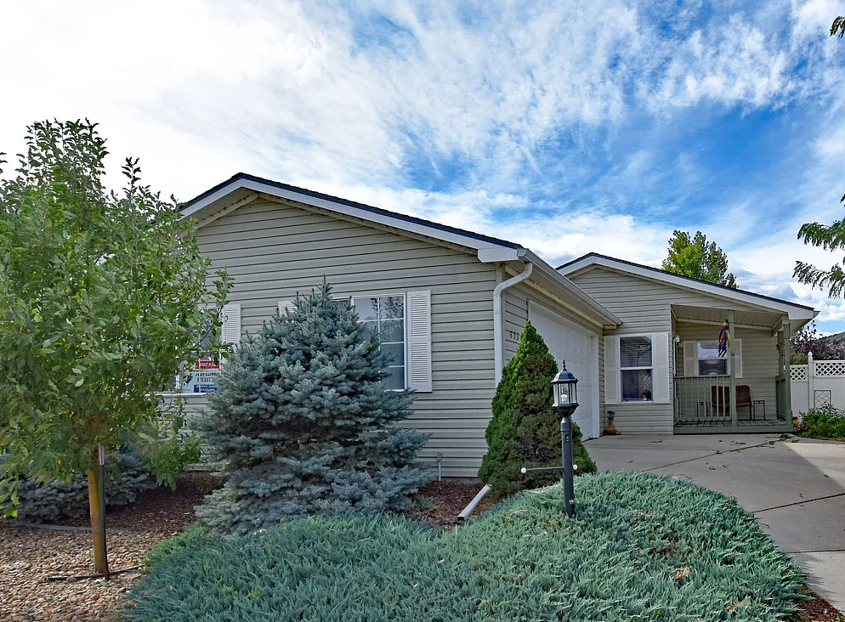
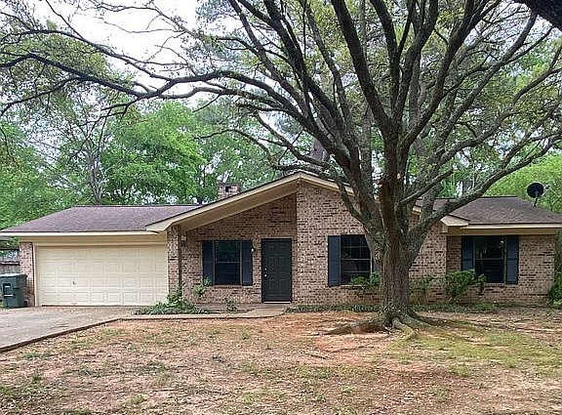








Nacogdoches County, TX
Teachers in the US rate their lives better
than all other occupation groups, trailing only physicians.
SALARY
Base Salary
Plus
The average wage of all full-time workers in the county: $50,284*
1st Year Teacher with a B.A.
15th Year Teacher with a M.A.+
$1,000 -$10,000
FOR COACHING
like head coach or assistant coach
$42,000 -$54,000
$64,368 - $87,907
$500 -$8,000
Data from 2025-2026
FOR CLUBS
like band, robotics, or yearbook
HOUSING
A salary of $48,000 can buy a home like this:
A salary of $76,000 can buy a home like this: 
Median home value: $212,209*
Fair Market rent for a 2-bedroom apartment: $1,009*
$190,000
$299,900
House images are provided as representative homes: these are based on current listing prices, rather than sales prices due to Texas state laws, using a 30-year fixed mortgage, a 6.6% interest rate, a 5% or 20% down payment, and housing costs capped at 36% of income.
Property taxes estimated at county averages. Actual affordability will vary.
RETIREMENT
Created by AMB 4.11.24
Most teaching jobs have better retirement benefits than other jobs you can get with the same degree.
59
Teacher average retirement age
GettheFactsOut.org
4 years earlier
63
All careers average retirement age
Created by CD - 4.6.26
*U.S. Bureau of Labor and Statistics, Zillow, U.S. Department of Housing and Urban Development
Any opinions, findings, and conclusions or recommendations expressed in this material are those of the author(s) and do not necessarily reflect the views of the National Science Foundation. NSF DUE 1821710 & 1821462.

