Slide 1
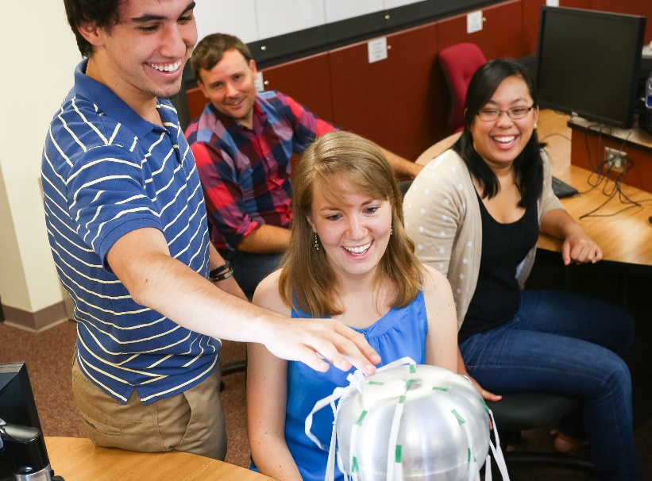
‘THINKING ABOUT
TEACHING
SCIENCE?’
This brochure was brought to you by Get the Facts Out: Repairing the reputation of the teaching profession
Inspire Young Minds
· Engineers make Bridges
Artists make Paintings
Scientists make Rockets
But Teachers make them All.
I want to bring about sustainable positive change that will continue to propagate on its own, and I think teaching is the best way to do that. While my education at Mines has prepared me to be an effective engineer, I believe that my time is better spent giving others the tools to critically evaluate and address the challenges they encounter.
B. O’Brennan,
Colorado School of Mines
This material is based upon work supported by the National Science Foundation under Grant Nos. 1821710 & 1821462. Any opinions, findings, and conclusions or recommendations expressed in this material are those of the author(s) and do not necessarily reflect the views of the National Science Foundation.

Slide 2
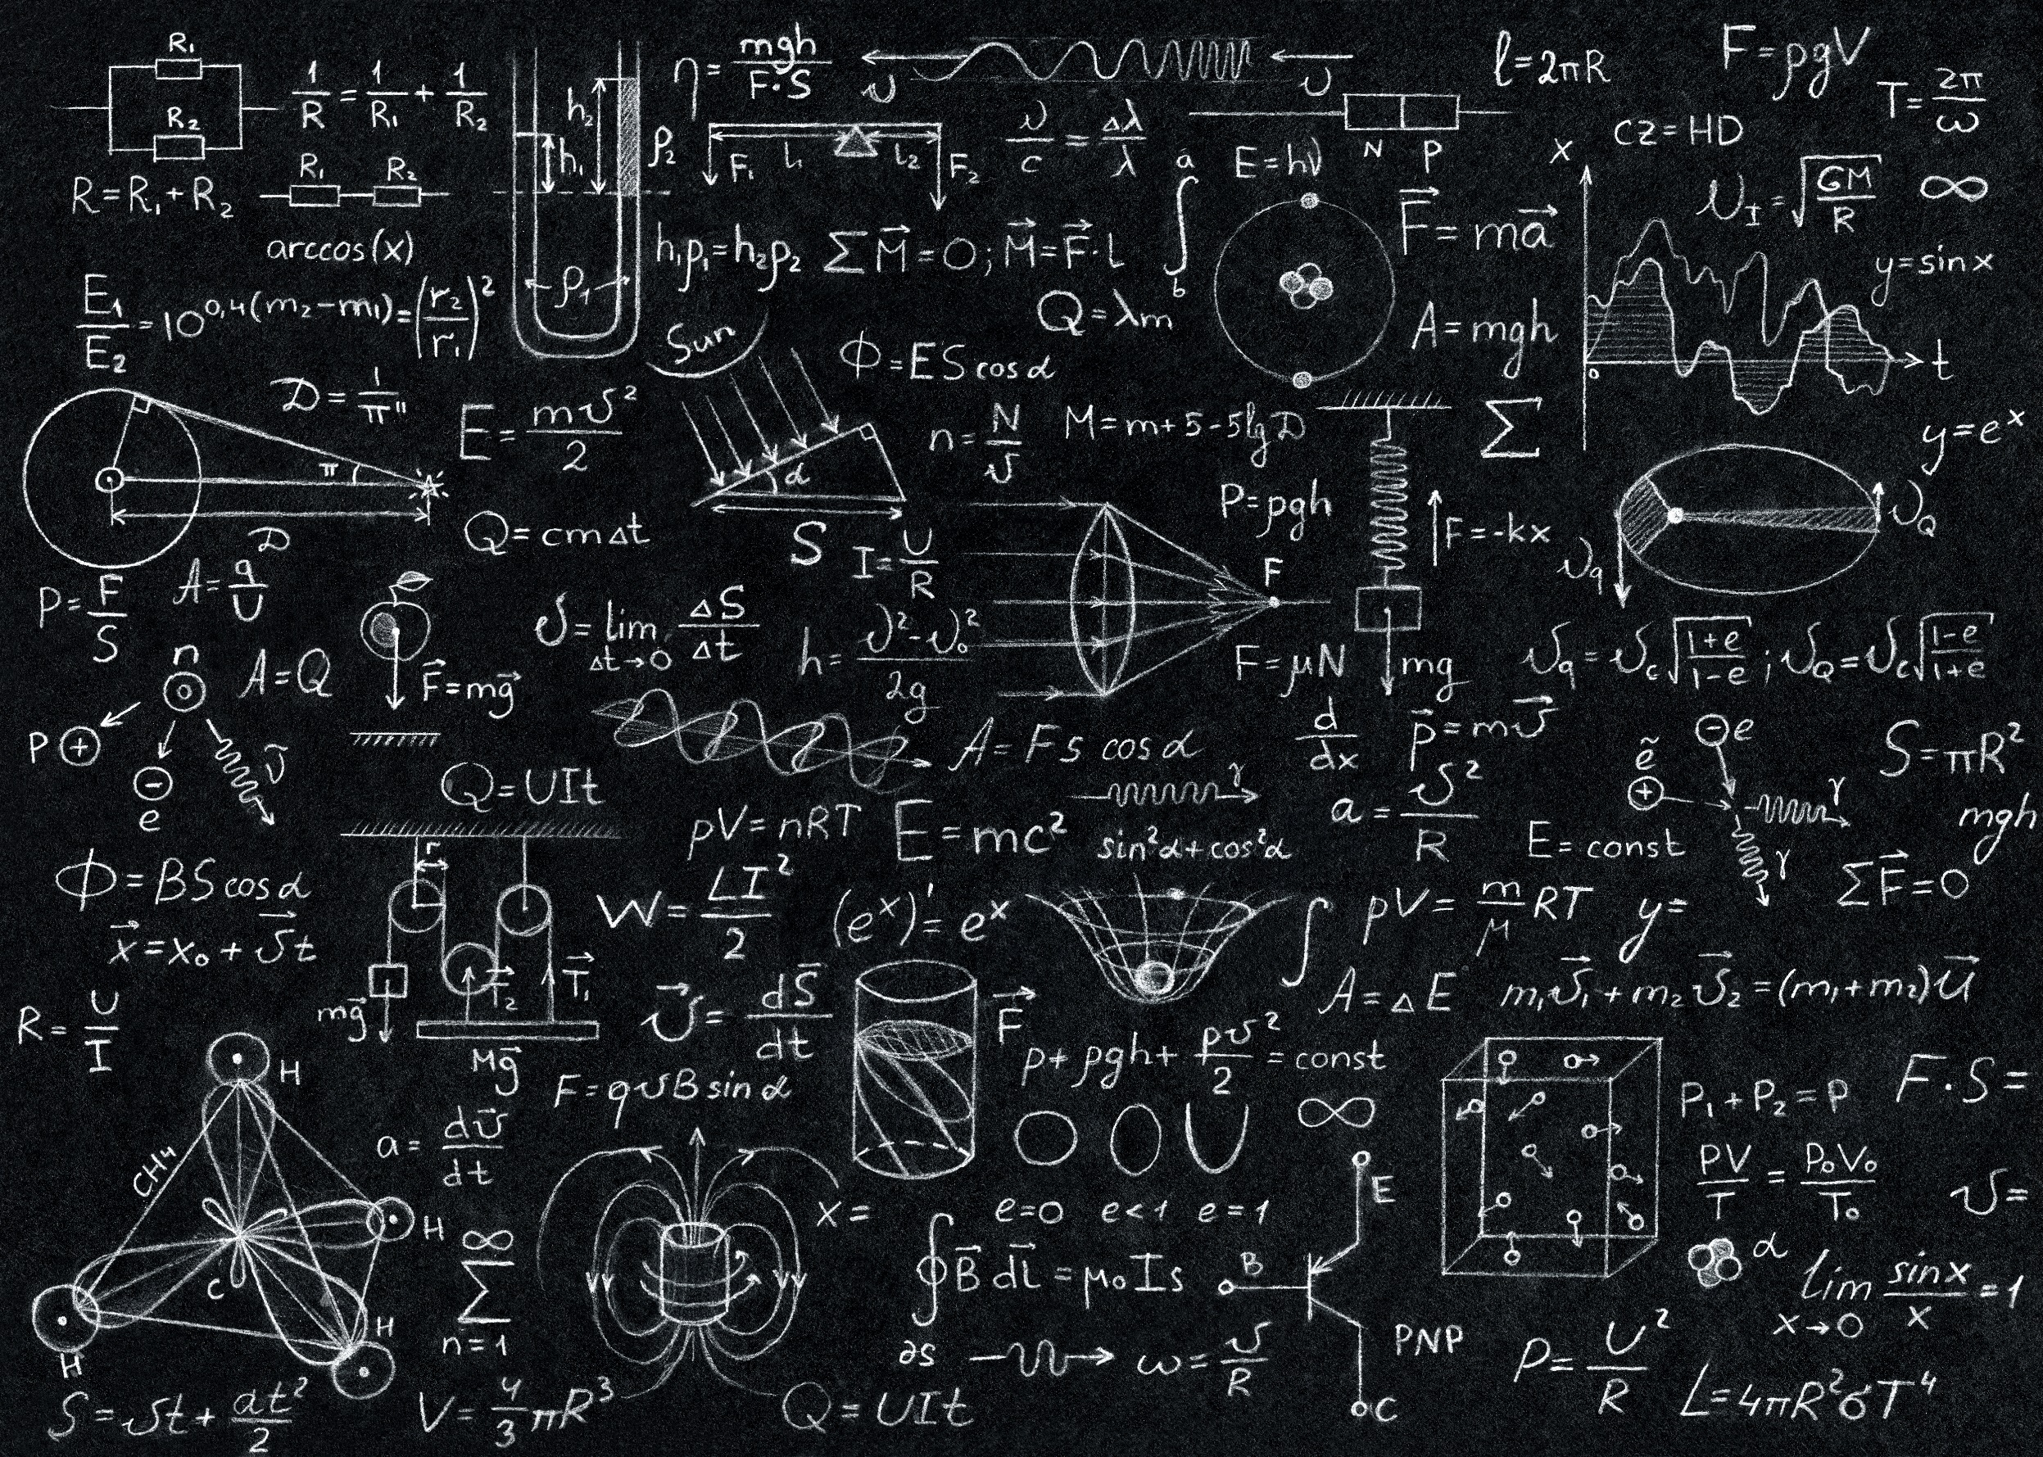
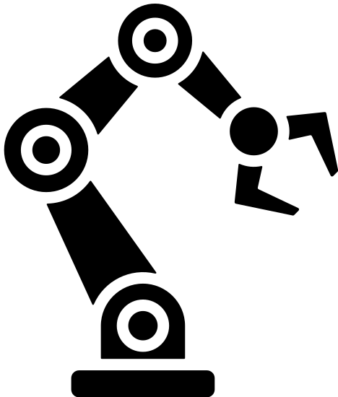
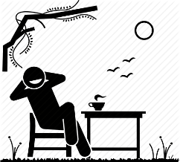
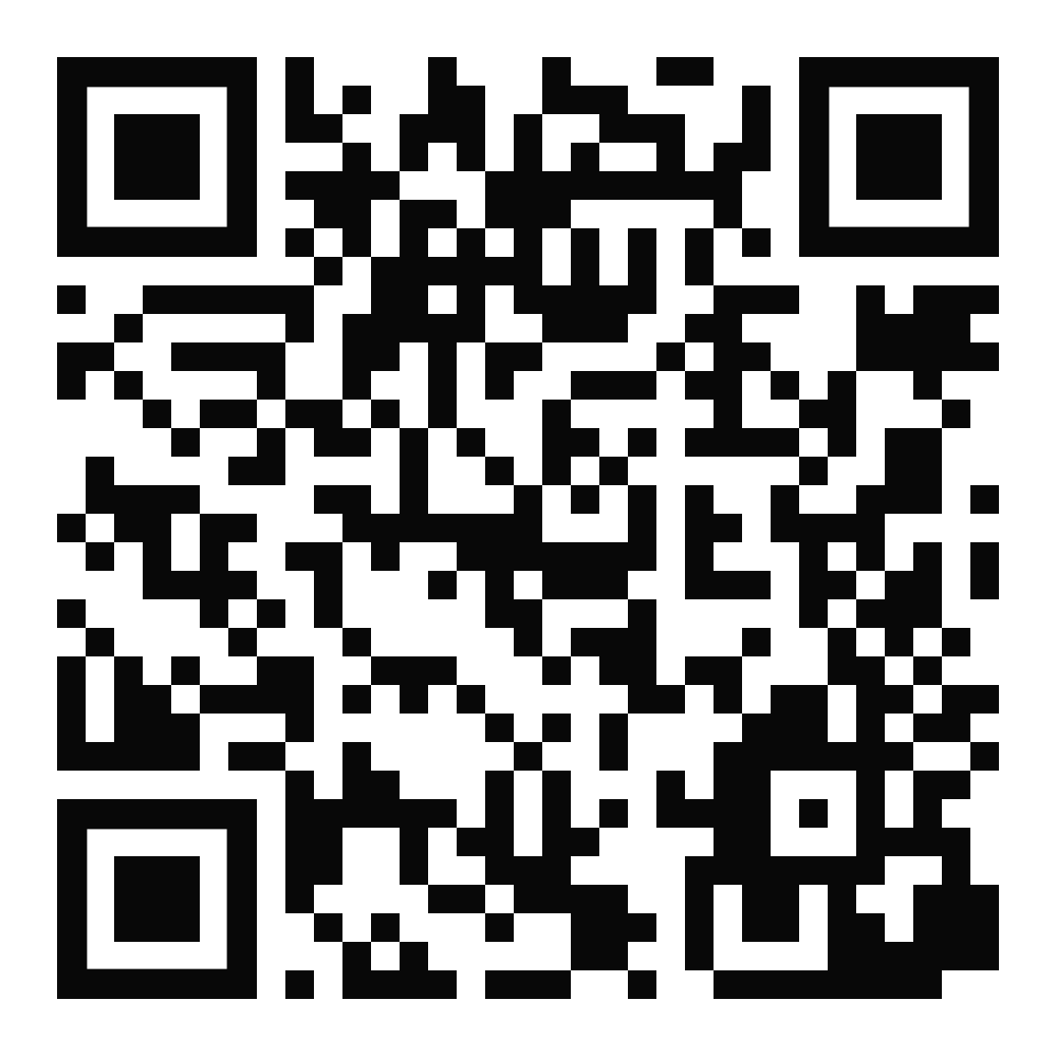
Did you know...
There are student loan forgiveness programs and scholarships for science and math teachers.¹
Teachers rate their lives better than all other occupation groups, trailing only physicians. ⁴
You can get a job almost anywhere in the U.S. or abroad as a science or math teacher. ⁵
At year 15, the middle 50% of teacher salaries ranges between $65,000 and $110,000 (IQR), nationally.^{2,3,6}
Behind every advance in medicine or technology is a teacher who left a lasting impression.
Teachers earn additional pay of $1,000 - $8,000 (IQR) for optional activities like coaching, running afterschool clubs, and tutoring. ^{3,6}
Most teaching jobs have better retirement benefits than private industry. ³
Inspire Young Minds
Teach Science!
1. See Federal Student Aid at studentaid.ed.gov
2. Research conducted at the Colorado School of Mines
3. See https://nces.ed.gov/
4. See Gallup Poll data at https://news.gallup.com/poll/ 161324/physicians-lead-wellbeing-transportation-workers-lag.aspx
5. See opportunities at https://www.state.gov/key-topics-
office-of-overseas-schools/teaching-in-international-
schools-overseas/
6. IQR = interquartile range which means the middle 50%
GettheFactsOut.org

