Slide 1
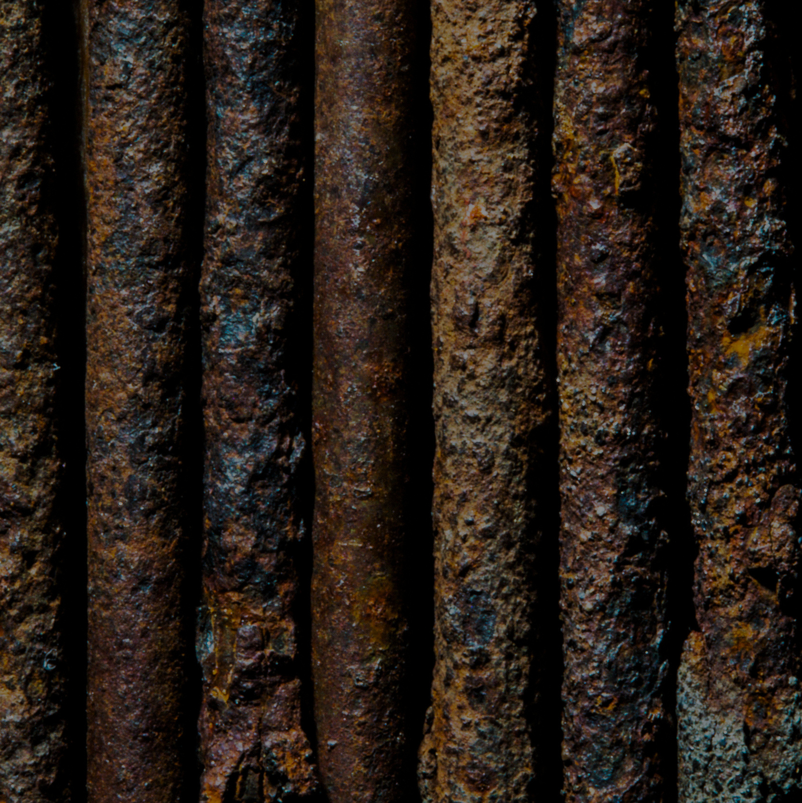
How does the weight of a new nail compare to the weight of the same nail after it rusts?
A. The rusty nail weighs the same as when it was new.
B.The rusty nail weighs more than when it was new
C.The rusty nail weighs less than when it was new

