Slide 1
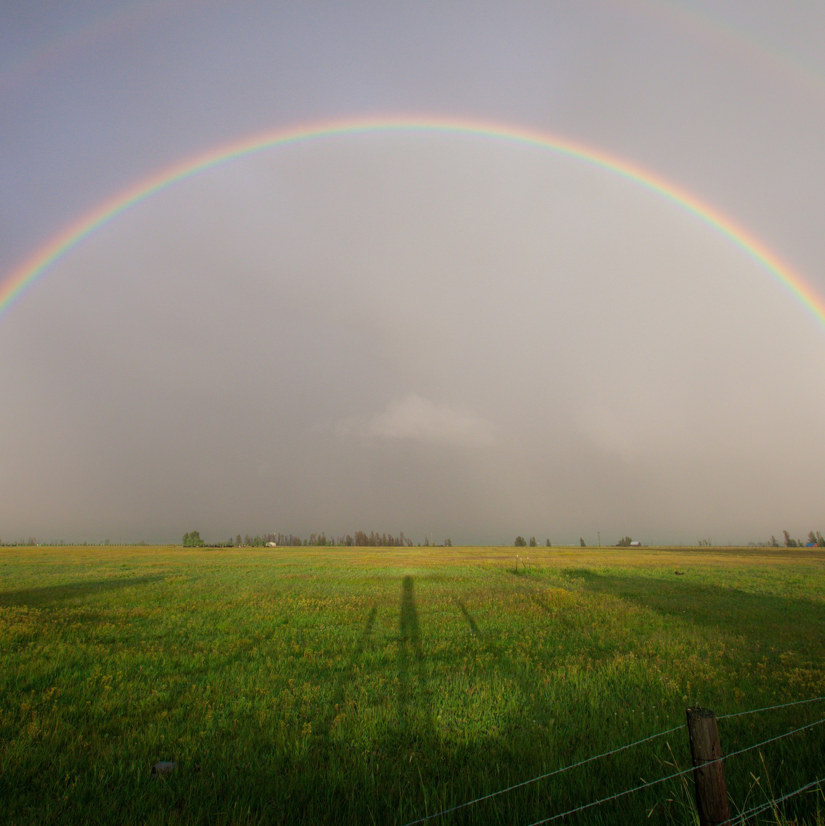
Where do bad rainbows go?
PRISM
It's a light sentence

