Slide 1
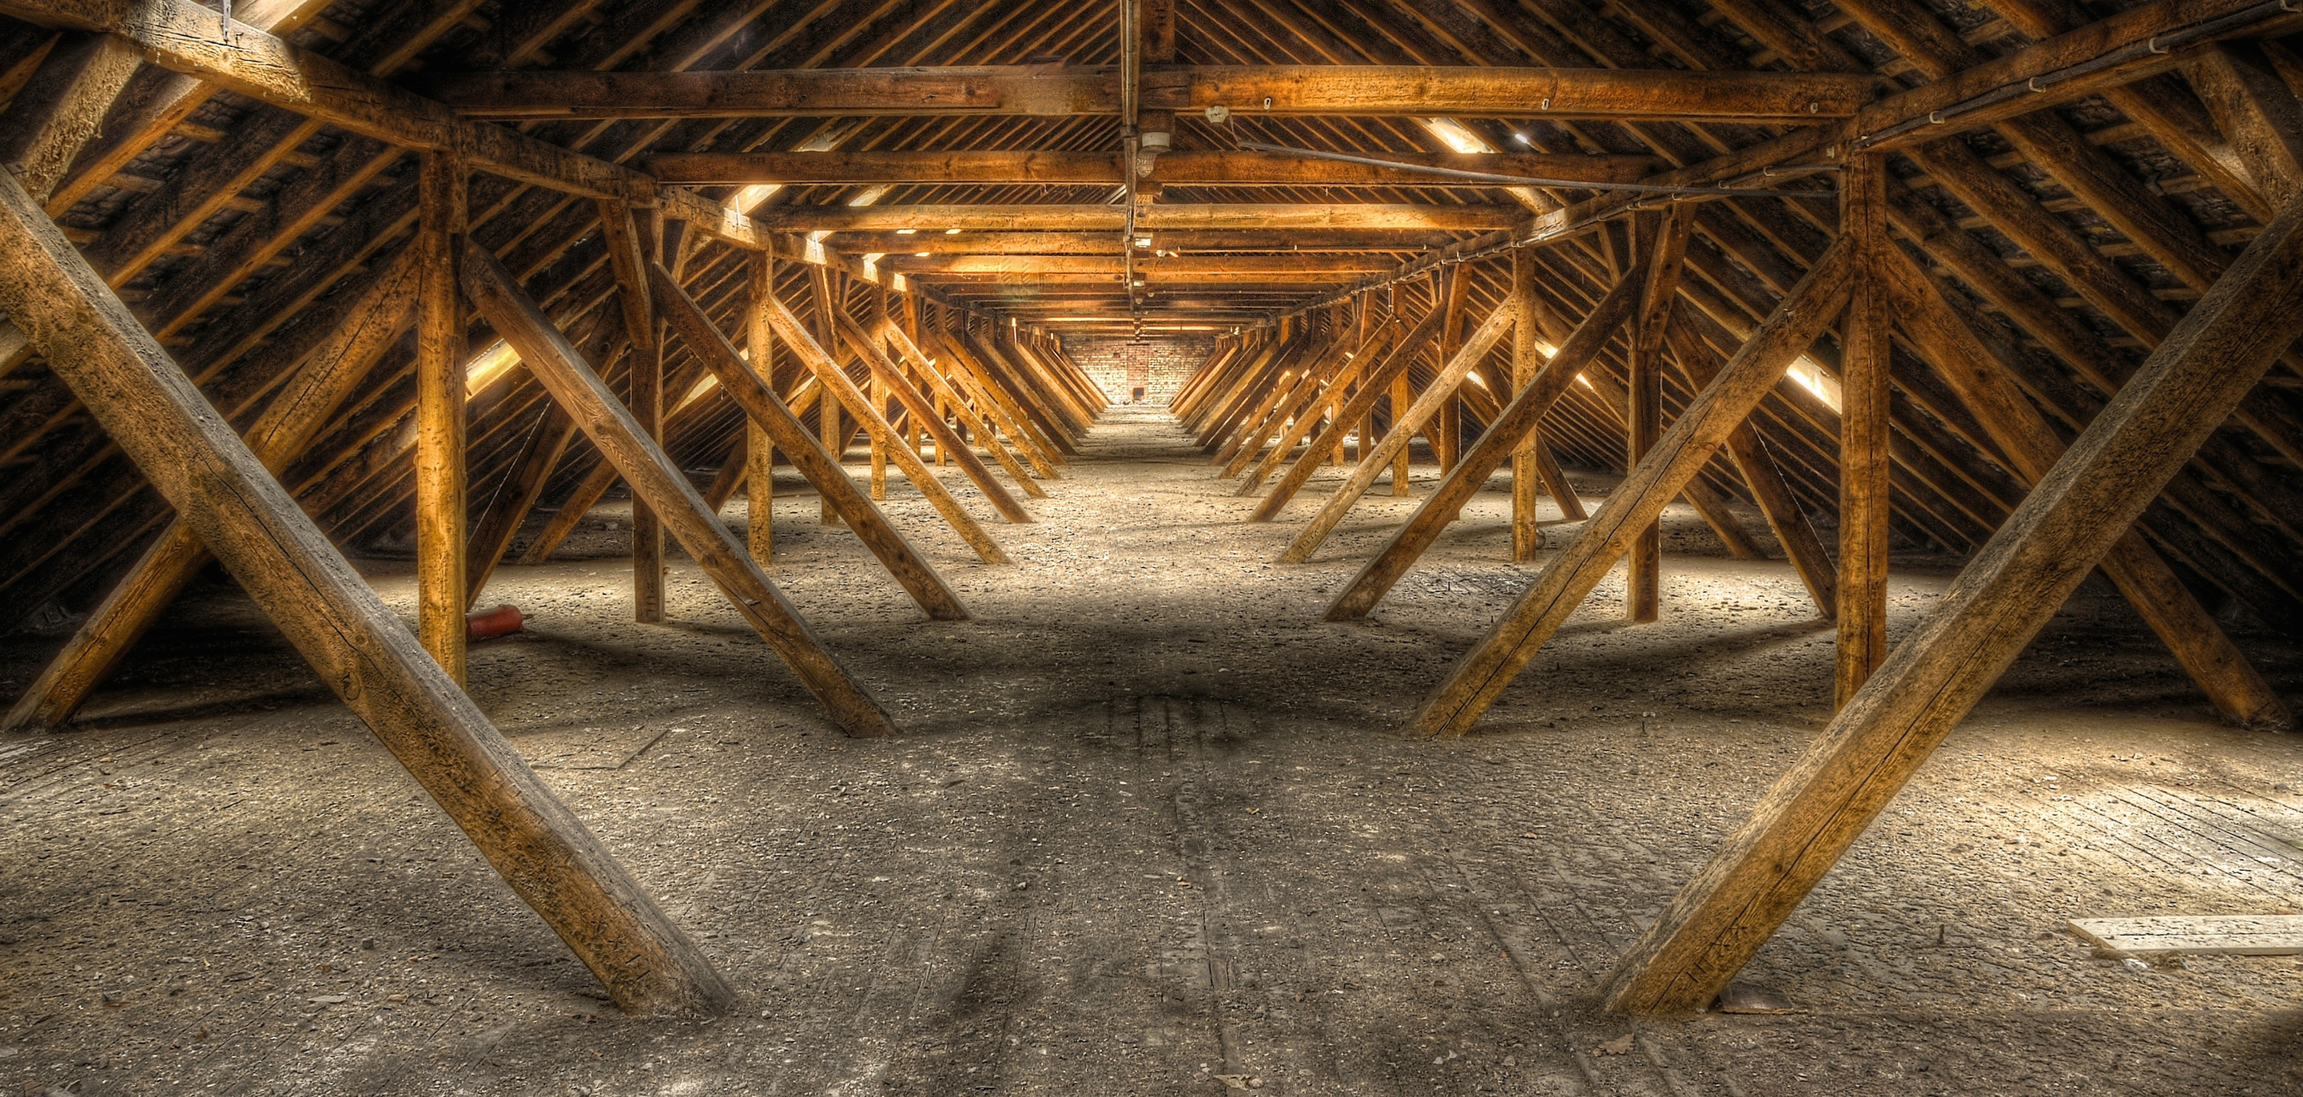



You’ve heard of
Elf on the Shelf,
but do you know about...

