Slide 1
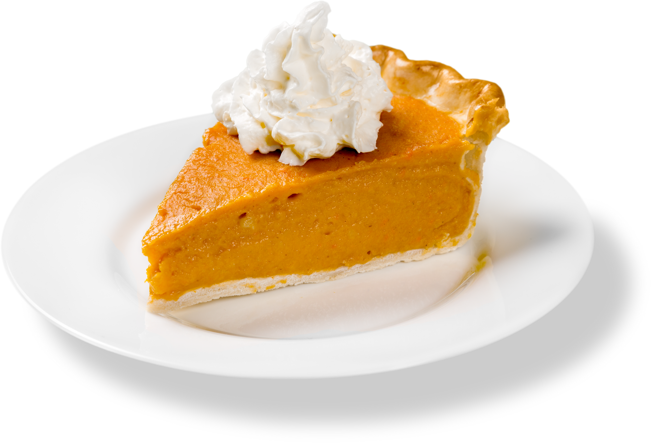

What do you get when you divide the circumference of a pumpkin by its diameter?
Pumpkin pi

