Slide 1
Instructions
These are fully editable Power Point versions of the GFO Math posters. There are three options here, each with a picture that has tested positively with both faculty and student audiences.
Please feel free to modify as you see fit for your program. Some ideas include:
  Reduce the size of the Get the Facts Out logo and URL ( GettheFactsOut.org) to make space for your program’s logo and url.
  Replace the photo with one of your local students and teachers. However, it’s best to do some user testing before you do this. We find that about 1/10 of the photos that all of our group decides they like actually test well with students. We ask if this photo increases, decreases, or has no impact on your view of grade 7-12 teaching.
  Please do not reword the facts or the tagline “inspire young minds”. In our experience it is safe to add/replace other tested GFO messaging, taglines, or data (such as local salaries). These also have been tested with students and faculty and the response is highly sensitive to wording changes.
  Please do not remove the sponsoring organization’s logos or the NSF disclaimer.
  Feel free to reach out to the research team with any questions. wkadams@mines.edu

Slide 2
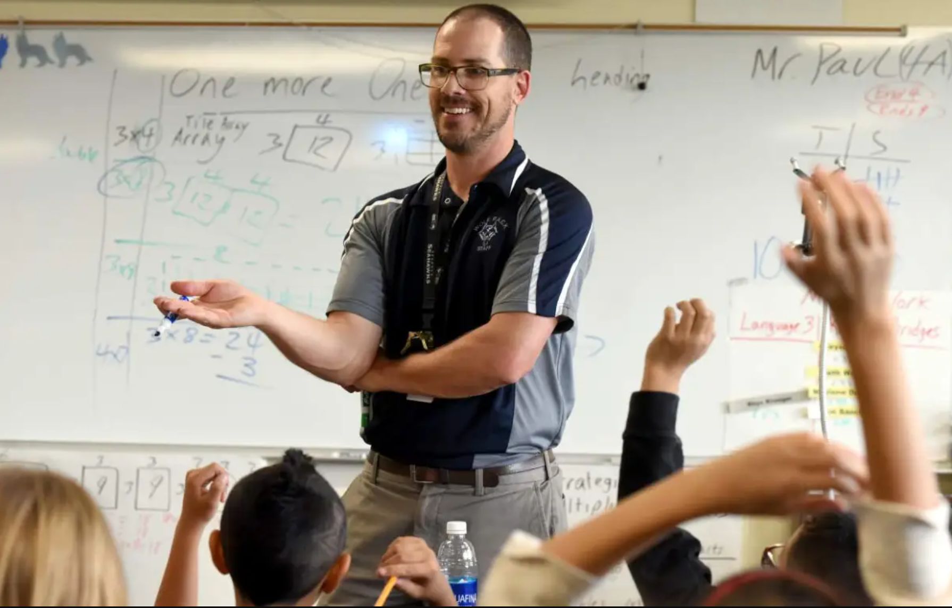













TEACH MATH!
Inspire Young Minds
DID YOU KNOW?
Teachers in the U.S. rate their lives better than all other occupation groups, trailing only physicians.
Mid-career teacher salaries typically range between $65,000 and $110,000.
Most teaching jobs have better retirement benefits than other jobs you can get with the same degree.
There are student loan forgiveness programs and scholarships for math and science teachers
You can get a job almost anywhere in the U.S. or abroad as a math or science teacher.
GettheFactsOut.org
Any opinions, findings, and conclusions or recommendations expressed in this material are those of the author(s)
and do not necessarily reflect the views of the National Science Foundation. NSF DUE #1821710 & 1821462.
Notes:
<a href="https://icon-library.net/icon/piggy-bank-icon-7.html">Piggy Bank Icon #56304</a>

Slide 3

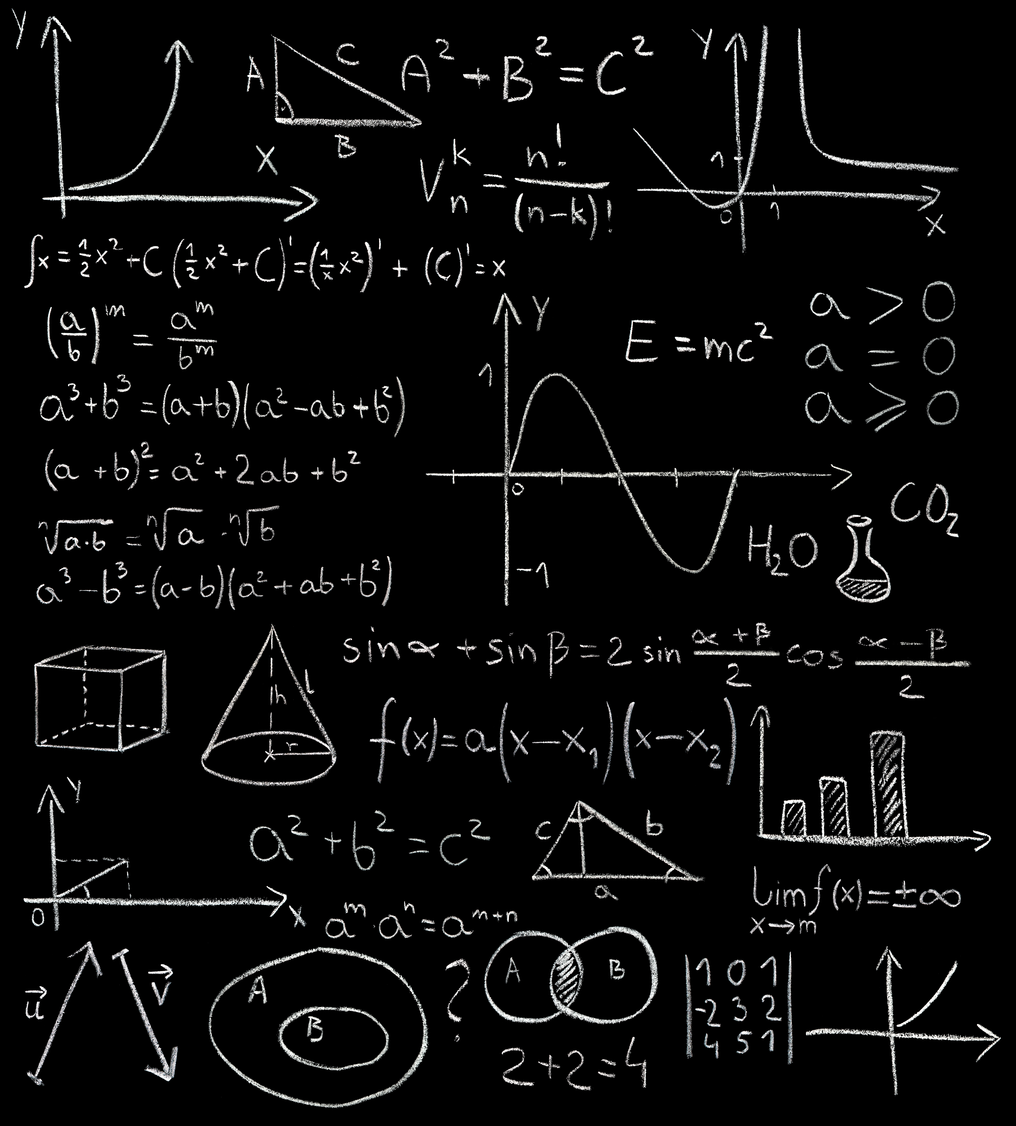
TEACH MATH!
Inspire Young Minds
DID YOU KNOW?
Teachers in the U.S. rate their lives better than all other occupation groups, trailing only physicians.
Mid-career teacher salaries typically range between $65,000 and $110,000.
Most teaching jobs have better retirement benefits than other jobs you can get with the same degree.
There are student loan forgiveness programs and scholarships for math and science teachers
You can get a job almost anywhere in the U.S. or abroad as a math or science teacher.
GettheFactsOut.org
Any opinions, findings, and conclusions or recommendations expressed in this material are those of the author(s)
and do not necessarily reflect the views of the National Science Foundation. NSF DUE #1821710 & 1821462.
Notes:
<a href="https://icon-library.net/icon/piggy-bank-icon-7.html">Piggy Bank Icon #56304</a>

Slide 4

TEACH MATH!
Inspire Young Minds
DID YOU KNOW?
Teachers in the U.S. rate their lives better than all other occupation groups, trailing only physicians.
Mid-career teacher salaries typically range between $65,000 and $110,000.
Most teaching jobs have better retirement benefits than other jobs you can get with the same degree.
There are student loan forgiveness programs and scholarships for math and science teachers
You can get a job almost anywhere in the U.S. or abroad as a math or science teacher.
GettheFactsOut.org
Any opinions, findings, and conclusions or recommendations expressed in this material are those of the author(s)
and do not necessarily reflect the views of the National Science Foundation. NSF DUE #1821710 & 1821462.
Notes:
<a href="https://icon-library.net/icon/piggy-bank-icon-7.html">Piggy Bank Icon #56304</a>

Slide 5

TEACH MATH!
Inspire Young Minds
DID YOU KNOW?
Teachers in the U.S. rate their lives better than all other occupation groups, trailing only physicians.
Mid-career teacher salaries typically range between $65,000 and $110,000.
Most teaching jobs have better retirement benefits than other jobs you can get with the same degree.
There are student loan forgiveness programs and scholarships for math and science teachers
You can get a job almost anywhere in the U.S. or abroad as a math or science teacher.
GettheFactsOut.org
Any opinions, findings, and conclusions or recommendations expressed in this material are those of the author(s)
and do not necessarily reflect the views of the National Science Foundation. NSF DUE #1821710 & 1821462.
Notes:
<a href="https://icon-library.net/icon/piggy-bank-icon-7.html">Piggy Bank Icon #56304</a>

