Slide 1
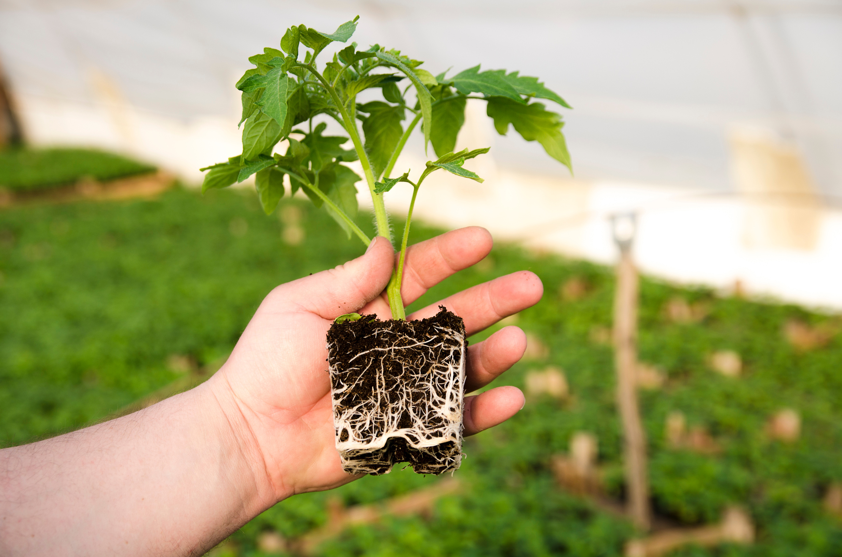

Why do plants hate math?
Because it gives them square roots.

