Slide 1
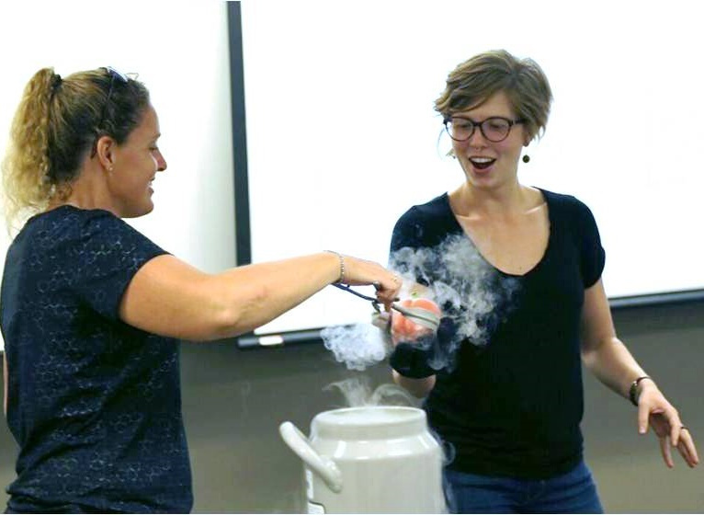

DID YOU KNOW?
Mid-career teacher salaries typically range between $60,000 and $100,000!
Notes:
2

