Slide 1
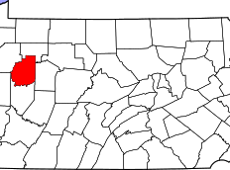
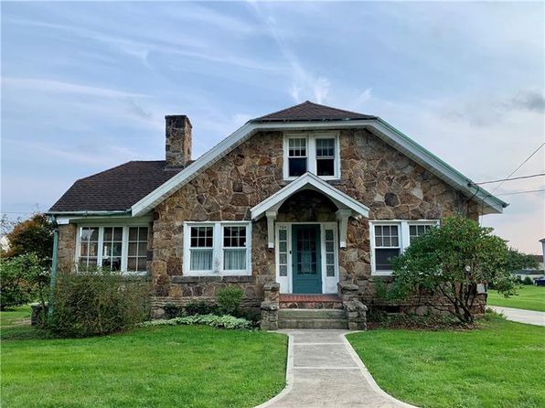
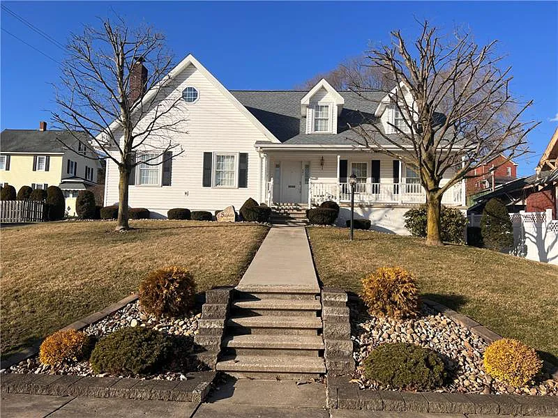
Clarion County, PA
Teachers in the US rate their lives better
than all other occupation groups, trailing only physicians.
SALARY
Base Salary
Plus
1st Year Teacher with a B.A.
15th Year Teacher with a M.A.+
$3,255 - 5,932
FOR LARGE
COMMITMENTS
like head coach, debate, or band
The average annual wage in the county: $37,908
$46,932 - $52,468
$70,983 - 75,768
Data from 2022-2023
$750 -1,740
HOUSING
FOR SMALL COMMITMENTS
like robotics club or yearbook
Median home value is $119,555
A salary of $49,700 can buy a home like this:
A salary of $73,300 can buy a home like this:
Fair Market rent for a 2-bedroom apartment is $724
$180,000
$350,000
With a 5% down payment, spending 36% of their income on housing
With a 20% down payment, spending 36% of their income on housing
RETIREMENT
Most teaching jobs have better retirement benefits than other jobs you can get with the same degree.
Teacher average retirement age
GettheFactsOut.org
59
63
All careers average retirement age
Created by AM .03.10.23
Any opinions, findings, and conclusions or recommendations expressed in this material are those of the author(s) and do not necessarily reflect the views of the National Science Foundation. NSF DUE 1821710 & 1821462.

