Slide 1
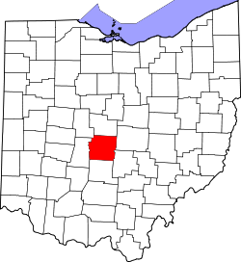
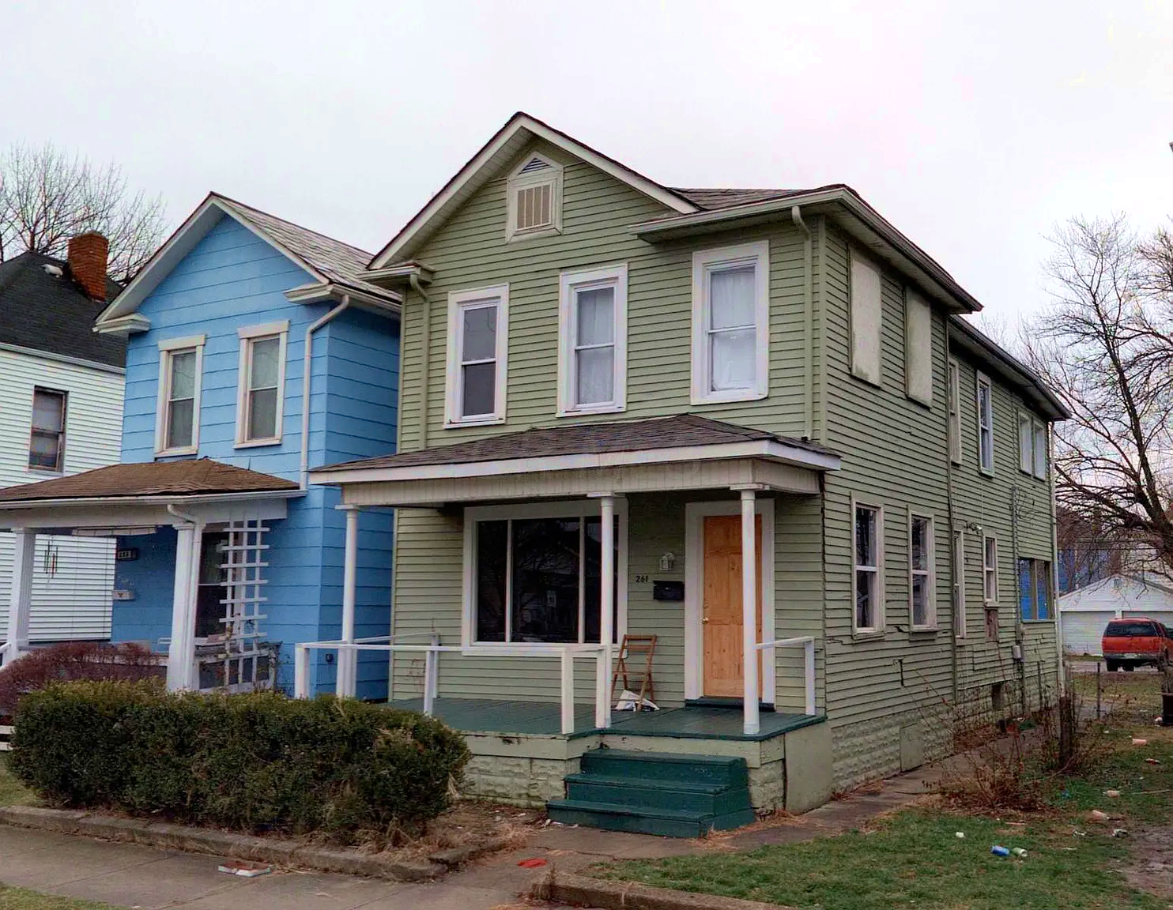
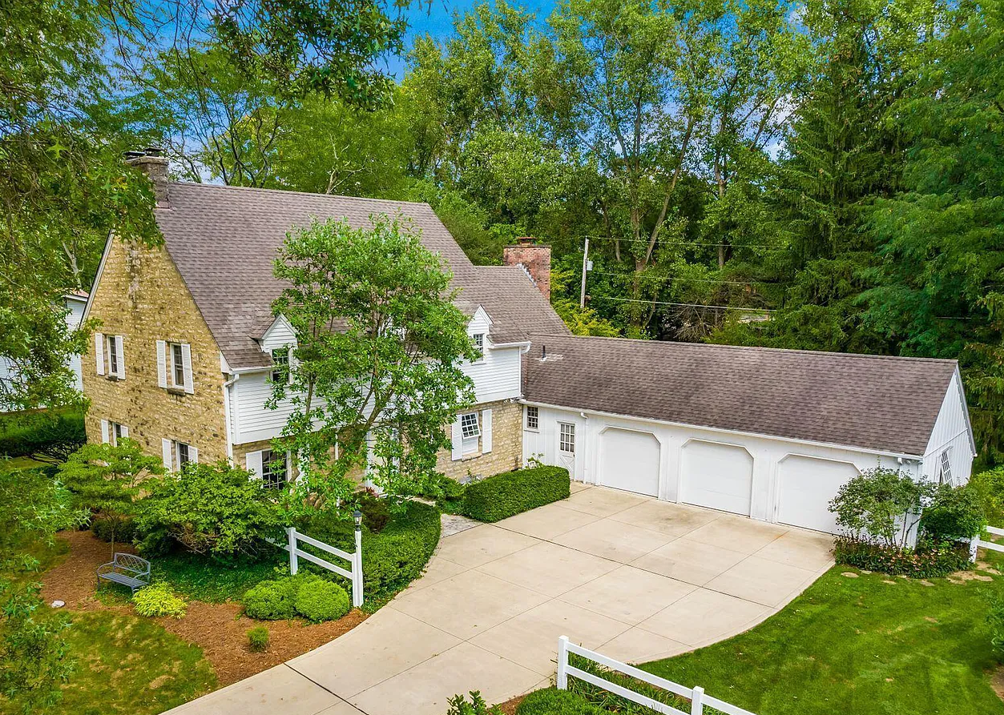
A Teacher’s Life by the Numbers!
3
Franklin County, OH
1st Year Teacher with a B.A.
15th Year Teacher with a M.A.+
Teacher Salaries
$45,978 - $54,095*
$91,174 - $104,754*
*Data from 2022-2023
Plus extra duty pay for coaching and club sponsorship
What does that mean for a professional in this area?
The average annual wage is $65,312
Median home value is $284,070
Fair Market rent for a two-bedroom apartment is $1,031
A salary of $50,000 can buy a home like this*:
A salary of $100,000 can buy a home like this*:
$200,000
$450,000
*With a 5% down payment for 1st year teachers and 20% down for mid-career and while spending 36% of their income on housing
Visit our Website! GettheFactsOut.org
This material is based upon work supported by the National Science Foundation under Grant Nos. 1821710 & 1821462. Any opinions, findings, and conclusions or recommendations expressed in this material are those of the author(s) and do not necessarily reflect the views of NSF.
Created by DM 12.6.22

