Slide 1
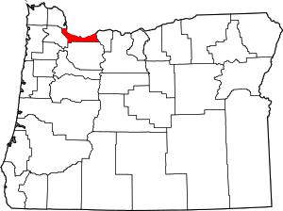
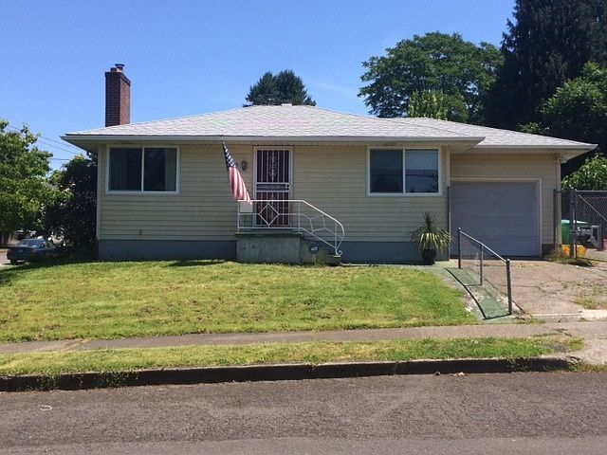
A Teacher’s Life by the Numbers!
3
Multonomah County, OR
1st Year Teacher with a B.A.
15th Year Teacher with a M.A.+
Teacher Salaries
$41,620 -$49,731*
$93,093 - $93,589*
*Data from 2021-2022
Plus extra duty pay for coaching and club sponsorship
What does that mean for a teacher in this area?
The average annual wage is $70,356
Median home value is $549,531
Fair Market rent for a two-bedroom apartment is $1,536
1st Year Teachers can buy a home like this*:
Mid-Career Teachers can buy a home like this*:
$140,000
$399,000
*With a 5% down payment for 1st year teachers and 20% down for mid-career and while spending 36% of their income on housing
Visit our Website! GettheFactsOut.org
This material is based upon work supported by the National Science Foundation under Grant Nos. 1821710 & 1821462. Any opinions, findings, and conclusions or recommendations expressed in this material are those of the author(s) and do not necessarily reflect the views of NSF.
Created by AMB 4.12.22

