Slide 1
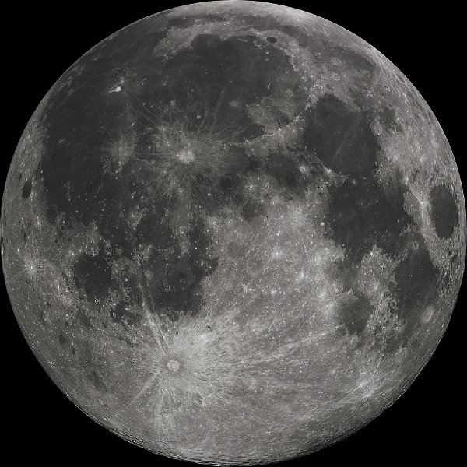
Moon Jokes
What was the name of the first satellite to orbit the Earth?
The moon
What do you call a moon out of orbit?
A Lunatic!
Did you hear about the bones they found on the moon?
It seems like the cow did not make it.
Did you hear about the great new restaurant on the moon?
The food is excellent, but there’s no atmosphere.
How do you know when the moon is going broke?
When it's down to its last quarter.
What did the moon say to its therapist?
I'm just going through a phase..

