Slide 1
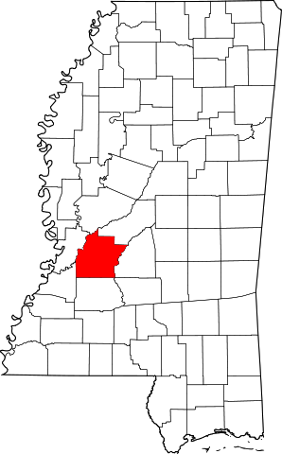
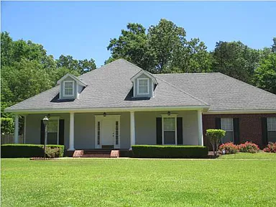
A Teacher’s Life by the Numbers!
3
Hinds County, MS
1st Year Teacher with a B.A.
15th Year Teacher with a M.A.+
Teacher Salaries
$43,023 - $45,000*
$54,897 - $56,742*
*Data from 2022-2023
Plus extra duty pay for coaching and club sponsorship
What does that mean for a professional in this area?
The average annual wage is $49,348
Median home value is $127,558
Fair Market rent for a two-bedroom apartment is $932
A salary of $44,000 can buy a home like this*:
A salary of $55,000 can buy a home like this*:
$175,000
$275,000
*With a 5% down payment for 1st year teachers and 20% down for mid-career and while spending 36% of their income on housing
Visit our Website! GettheFactsOut.org
This material is based upon work supported by the National Science Foundation under Grant Nos. 1821710 & 1821462. Any opinions, findings, and conclusions or recommendations expressed in this material are those of the author(s) and do not necessarily reflect the views of NSF.
Created by DM 11.28.22

