Slide 1
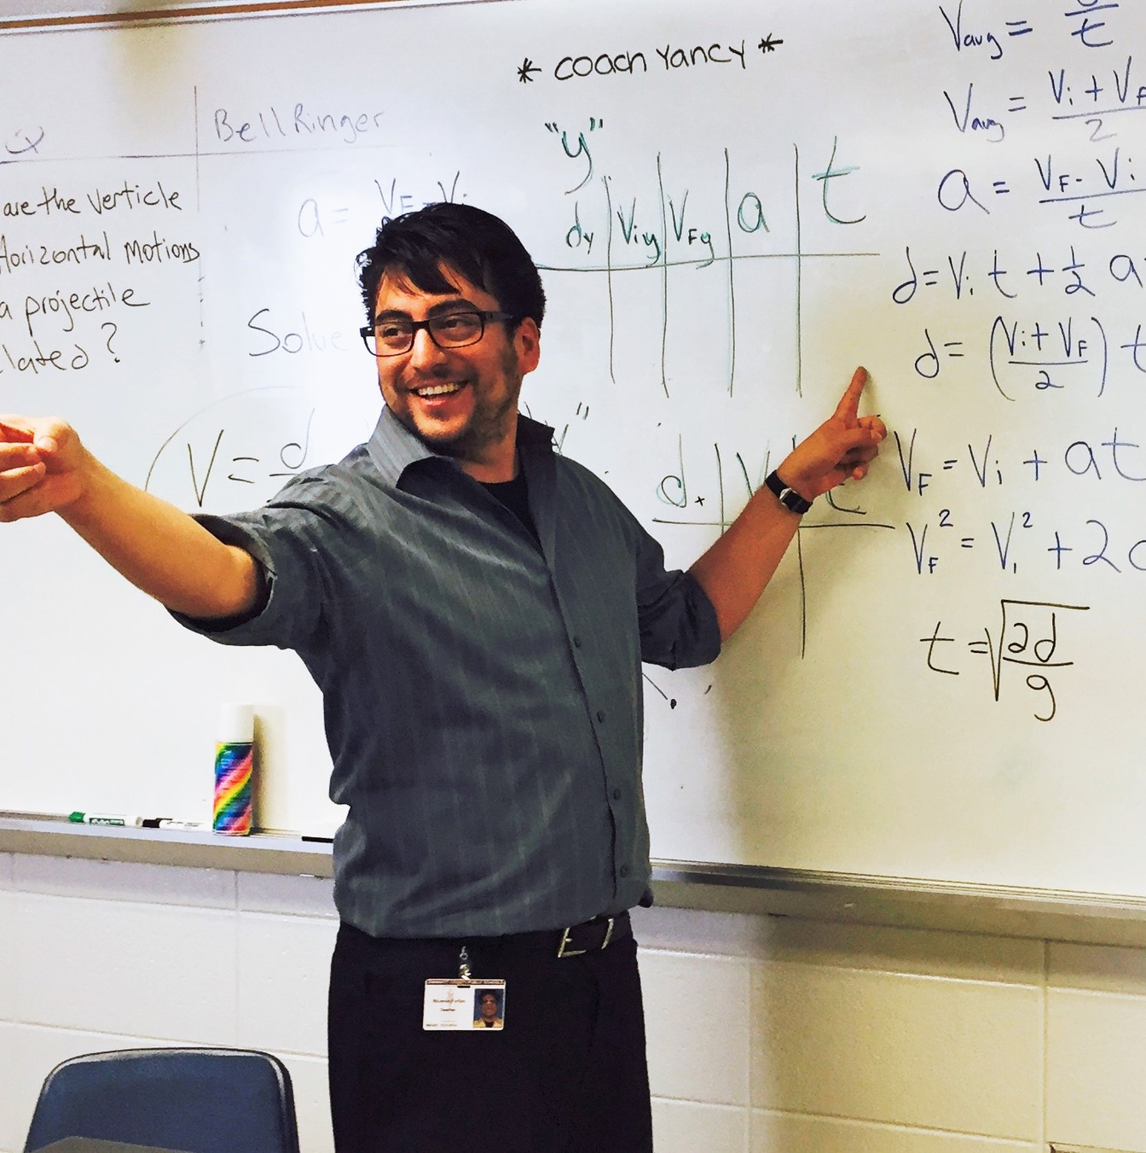

DID YOU KNOW?
There are student loan forgiveness programs and scholarships
for teachers.

