Slide 1
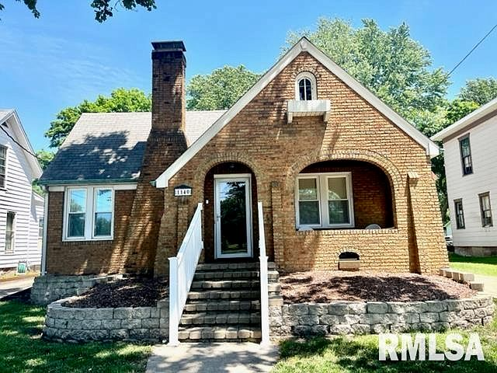
A Teacher’s Life by the Numbers!
3
Cass, Morgan, and Scott County, IL
1st Year Teacher with a B.A.
15th Year Teacher with a M.A.+
Teacher Salaries
$37,715-$39,478*
$58,366- $59,315*
*Data from 2022-2023
Plus extra duty pay for coaching and club sponsorship
What does that mean for a professional in this area?
The average annual wage is $43,004
Median home value is $105,547
Fair Market rent for a two-bedroom apartment is $707
A salary of $37,715 can buy a home like this*:
A salary of $58,366 can buy a home like this*:
$129,999
$244,400
*With a 5% down payment for 1st year teachers and 20% down for mid-career and while spending 36% of their income on housing
Visit our Website! GettheFactsOut.org
This material is based upon work supported by the National Science Foundation under Grant Nos. 1821710 & 1821462. Any opinions, findings, and conclusions or recommendations expressed in this material are those of the author(s) and do not necessarily reflect the views of NSF.
Created by BA 8.5.22

