Slide 1
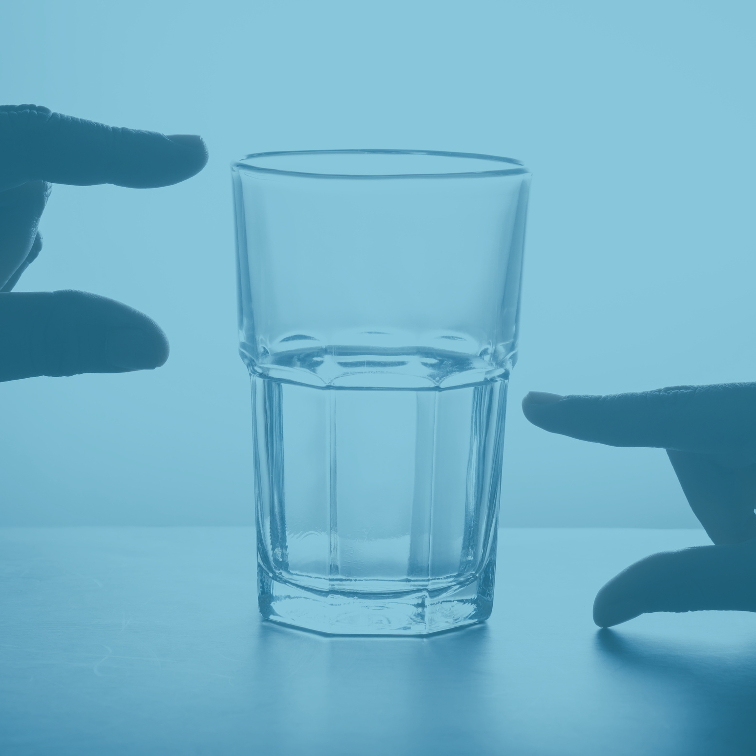
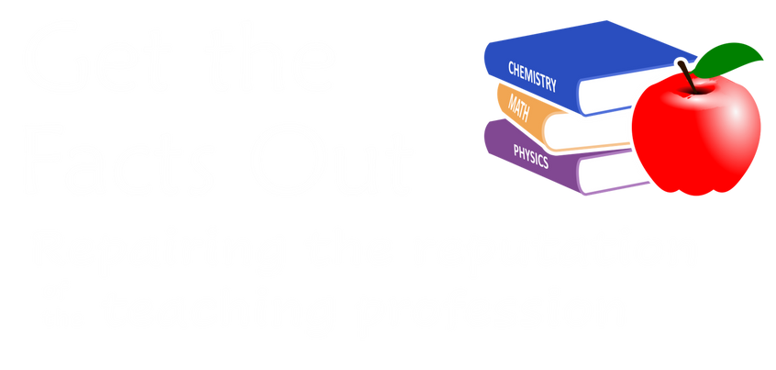
Optimist or Pessimist?
The optimist sees the glass half full.
The pessimist sees the glass half empty.
The Chemistry teacher sees the glass completely full...
half with liquid and half with air.

