Slide 1
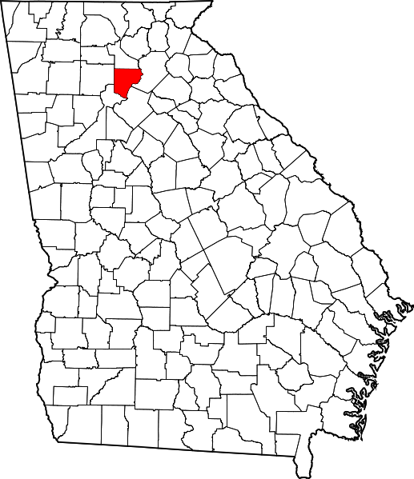
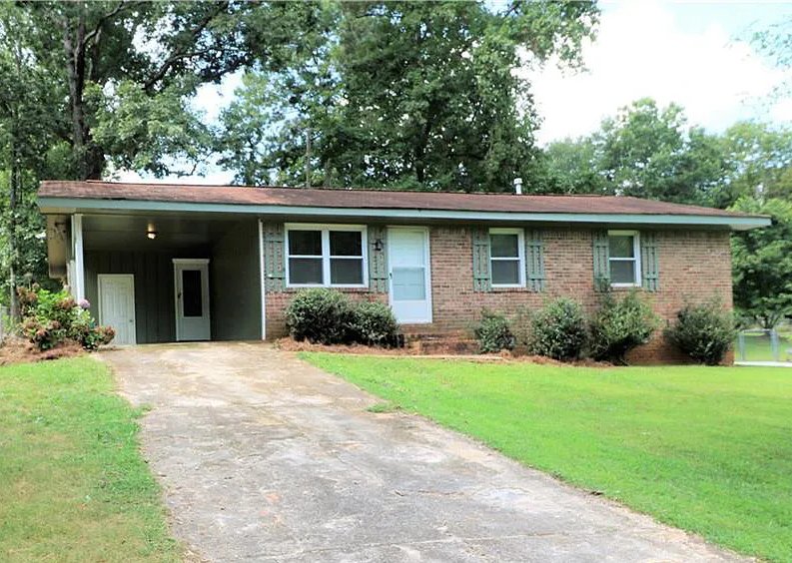
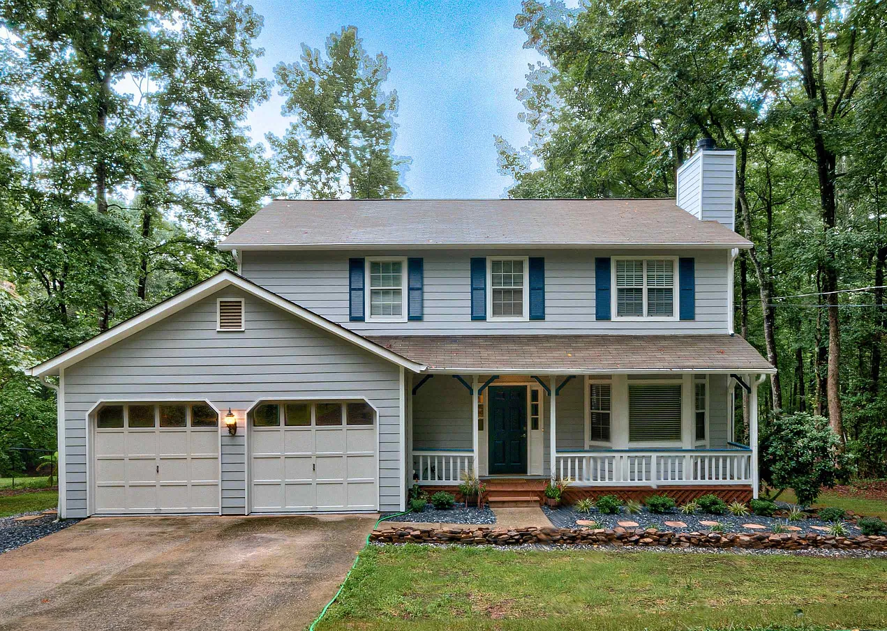
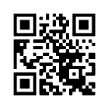
A Teacher’s Life by the Numbers!
3
Forsyth County, GA
1st Year Teacher with a B.A.
15th Year Teacher with a M.A.+
Teacher Salaries
$51,769 - $52,900*
$76,518*
*Data from 2022-2023
Plus extra duty pay for coaching and club sponsorship
What does that mean for a professional in this area?
The average annual wage is $53,872
Median home value is $597,013
Fair Market rent for a two-bedroom apartment is $1,185
A salary of $52,000 can buy a home like this*:
A salary of $76,000 can buy a home like this*:
$200,000
$375,000
*With a 5% down payment for 1st year teachers and 20% down for mid-career and while spending 36% of their income on housing
Visit our Website! GettheFactsOut.org
This material is based upon work supported by the National Science Foundation under Grant Nos. 1821710 & 1821462. Any opinions, findings, and conclusions or recommendations expressed in this material are those of the author(s) and do not necessarily reflect the views of NSF.
Created by DM 11.15.22

