Slide 1
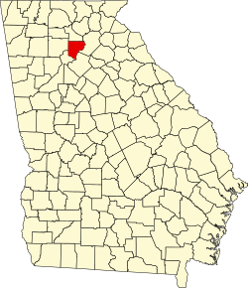


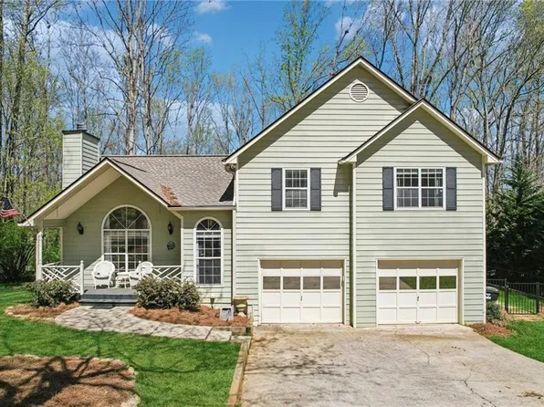
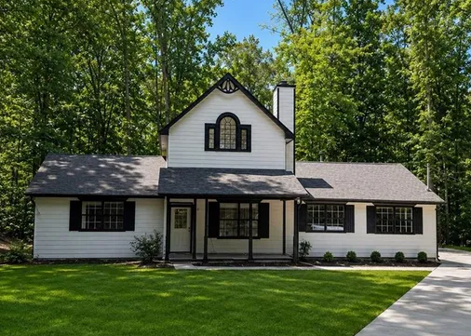


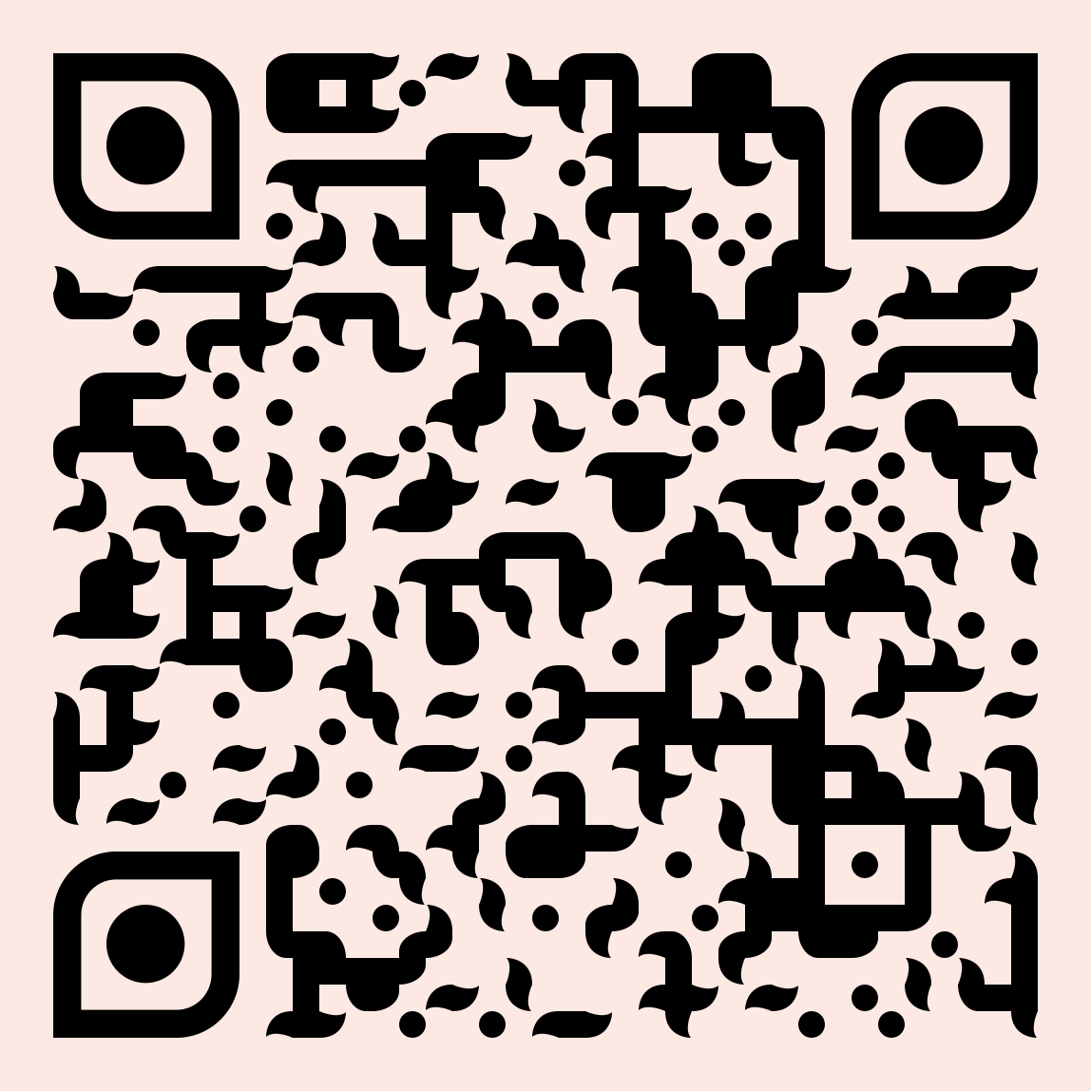




Forsyth County, GA
Teachers in the US rate their lives better
than all other occupation groups, trailing only physicians.
SALARY
Base Salary
Plus
The average wage of all full-time workers in the county: $66,352*
1st Year Teacher with a B.A.
15th Year Teacher with a M.A.+
$1,299 - $9,665
FOR LARGE
COMMITMENTS
like head coach, debate, or band
$56,784
$77,317 - $78,327
$999 - $8,582
Data from 2025-2026
FOR SMALL COMMITMENTS
like robotics club or yearbook
HOUSING
A salary of $56,800 can buy a home like this:
A salary of $77,800 can buy a home like this: 
Median home value: $619,467*
Fair Market rent for a 2-bedroom apartment: $1,830*
$252,000
$400,000
With a 5% down payment, spending 36% of their income on housing
With a 20% down payment, spending 36% of their income on housing
RETIREMENT
Most teaching jobs have better retirement benefits than other jobs you can get with the same degree.
59
Teacher average retirement age
GettheFactsOut.org
4 years earlier
63
All careers average retirement age
Created by CD 7.29.26
*U.S. Bureau of Labor and Statistics, Zillow, U.S. Department of Housing and Urban Development
Any opinions, findings, and conclusions or recommendations expressed in this material are those of the author(s) and do not necessarily reflect the views of the National Science Foundation. NSF DUE 1821710 & 1821462.

