Slide 1
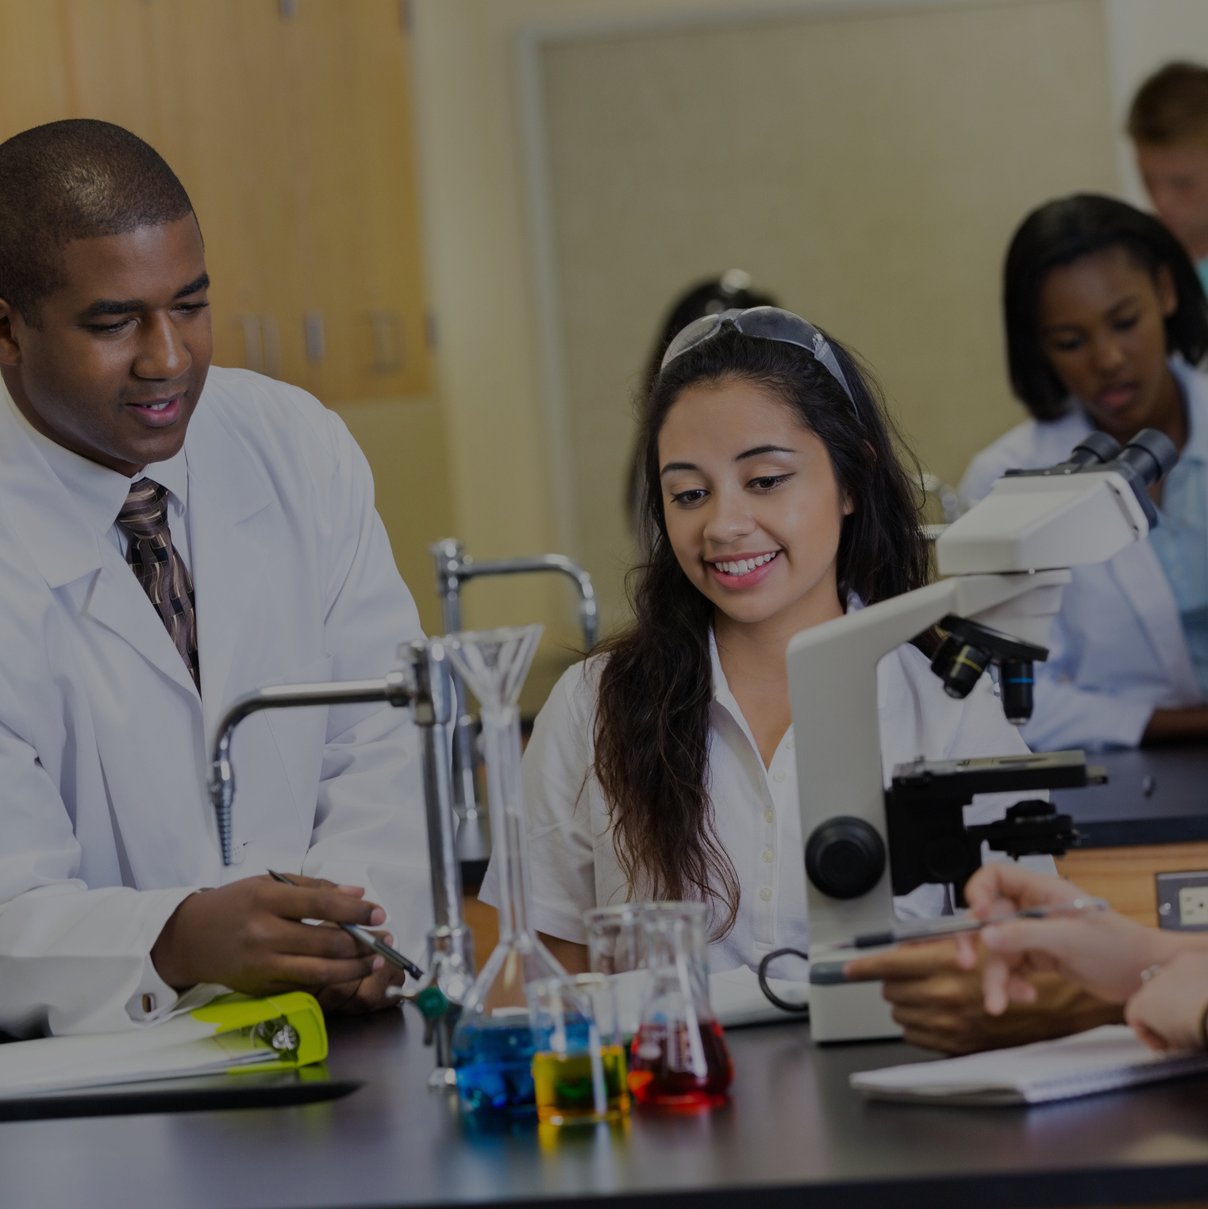

How did the science teacher freshen their breath?
...with experi-mints

