Slide 1
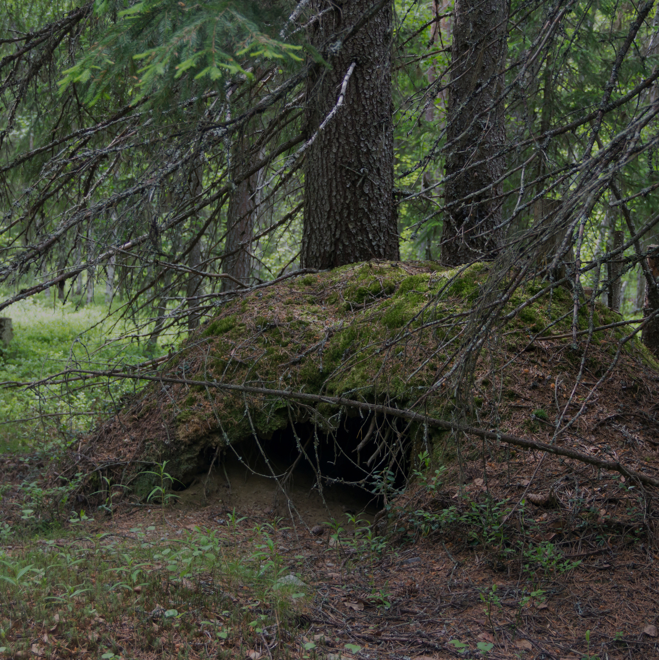
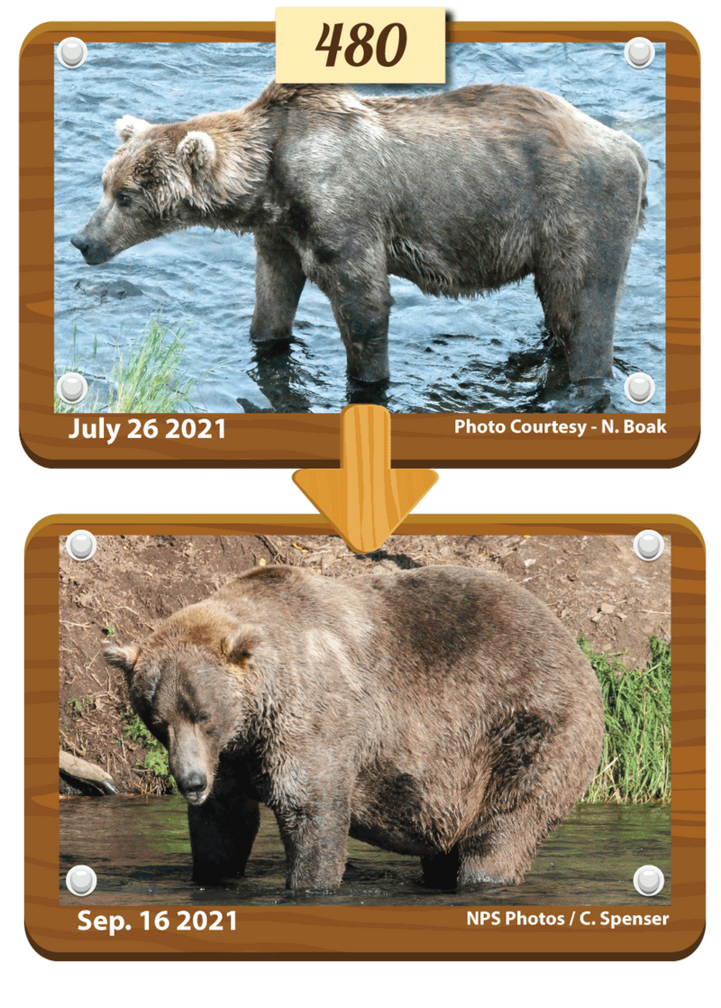
Fat Bear Week
When a bear hibernates for the winter, physically how does the largest fraction of mass exit the bear’s body?

