Slide 1
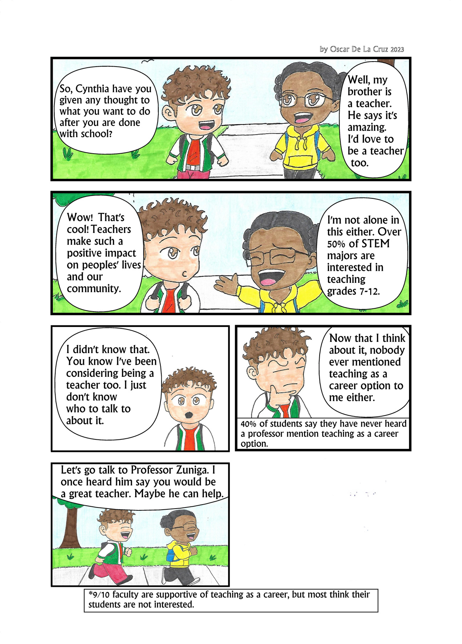









To talk about teaching, GFO has created customizable posters, slides, and handouts:
Any opinions, findings, conclusions or recommendations expressed in this material are those of the author(s) and do not necessarily reflect the views of the National Science Foundation. NSF DUE #1821710 & 1821462.

