Slide 1
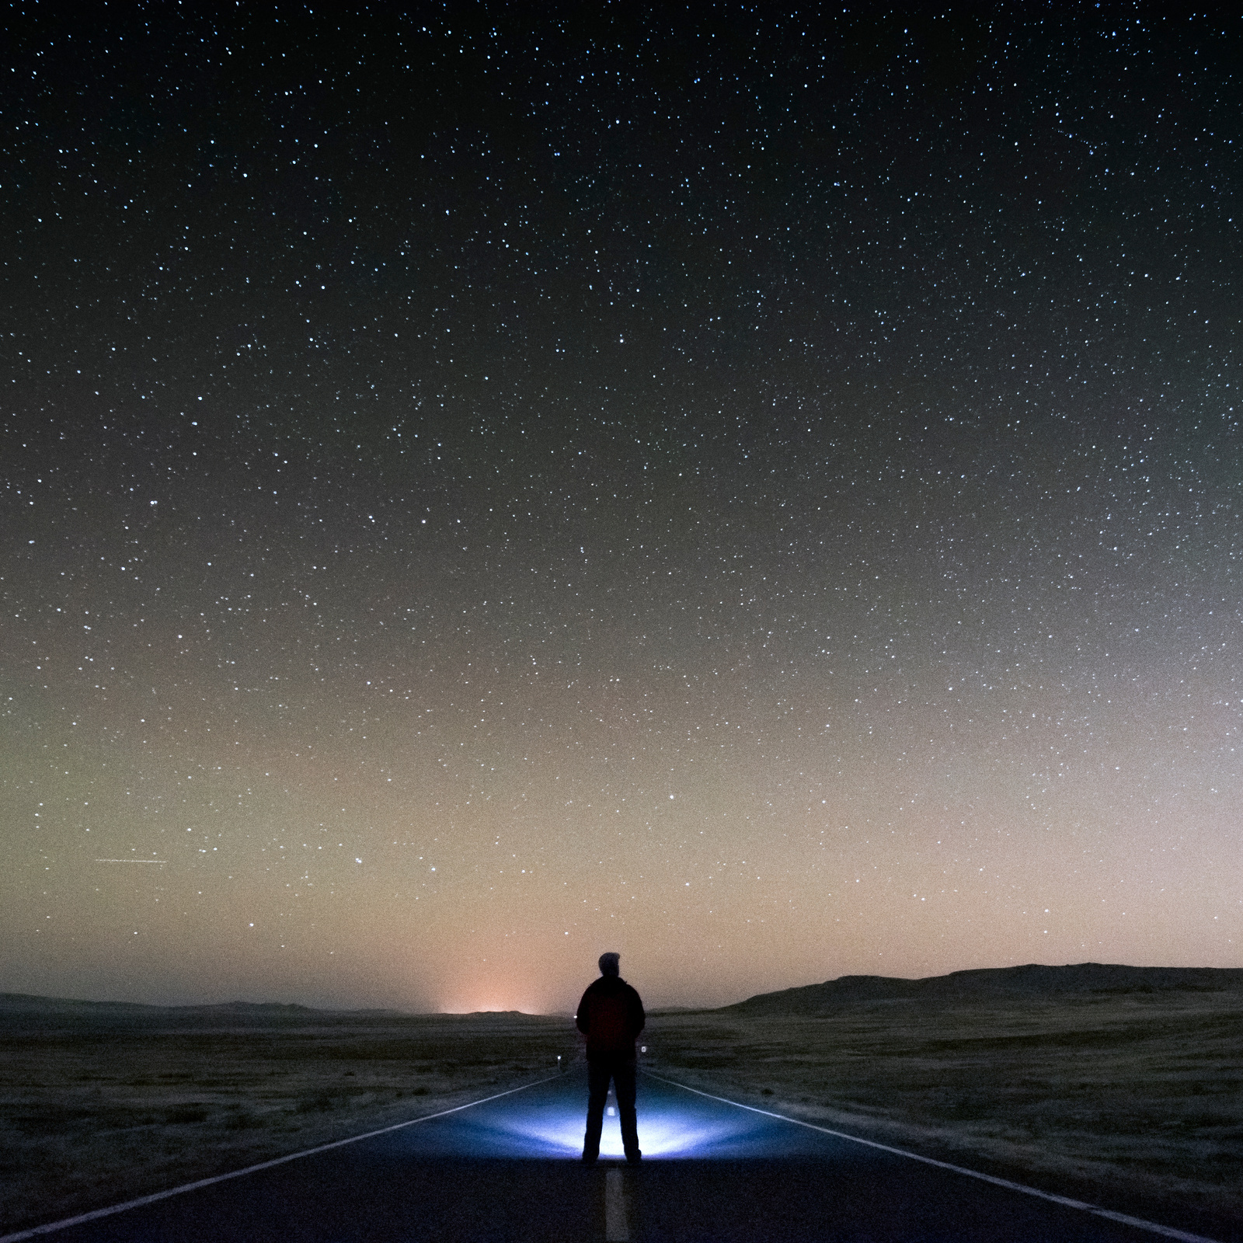
We've been having some pretty existential explorations of ourselves lately and we are pretty certain that we do not know what we do not know.
Furthermore, we're not entirely sure we know what we know.
We feel pretty confident
in these statements.

