Slide 1
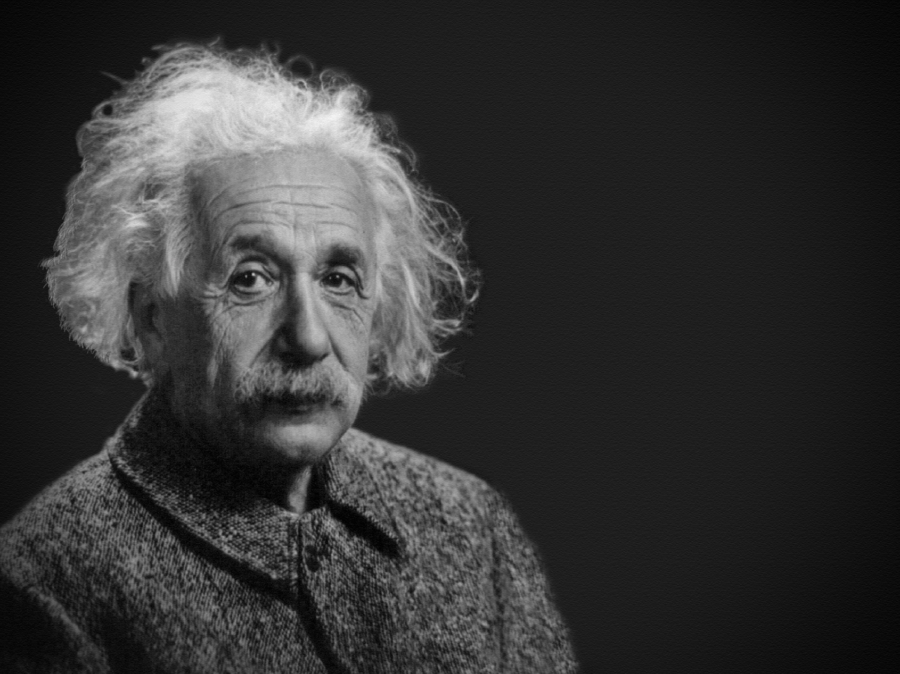

Einstein developed
a theory
about space.
And, boy, it was about time, too!

