Slide 1
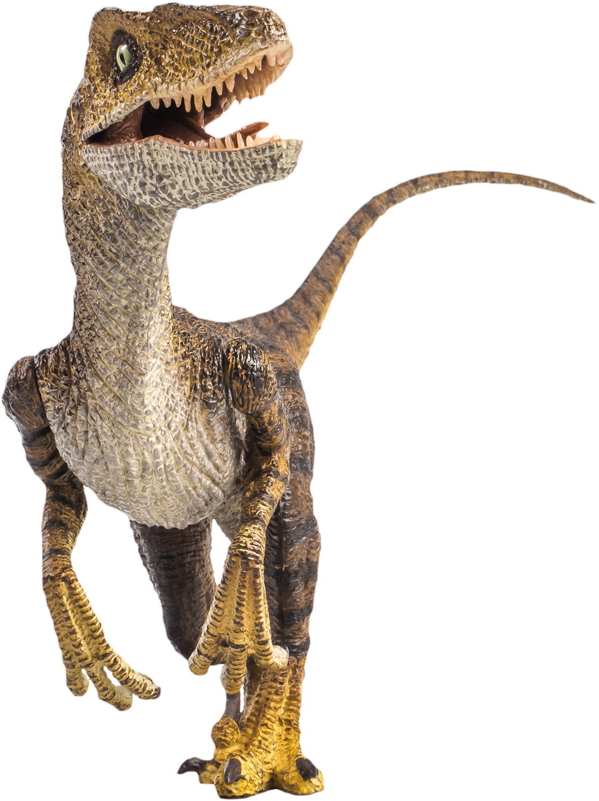

DINO PHYSICS 101
VELOCIRAPTOR
DISTANCERAPTOR
TIMERAPTOR

