Slide 1
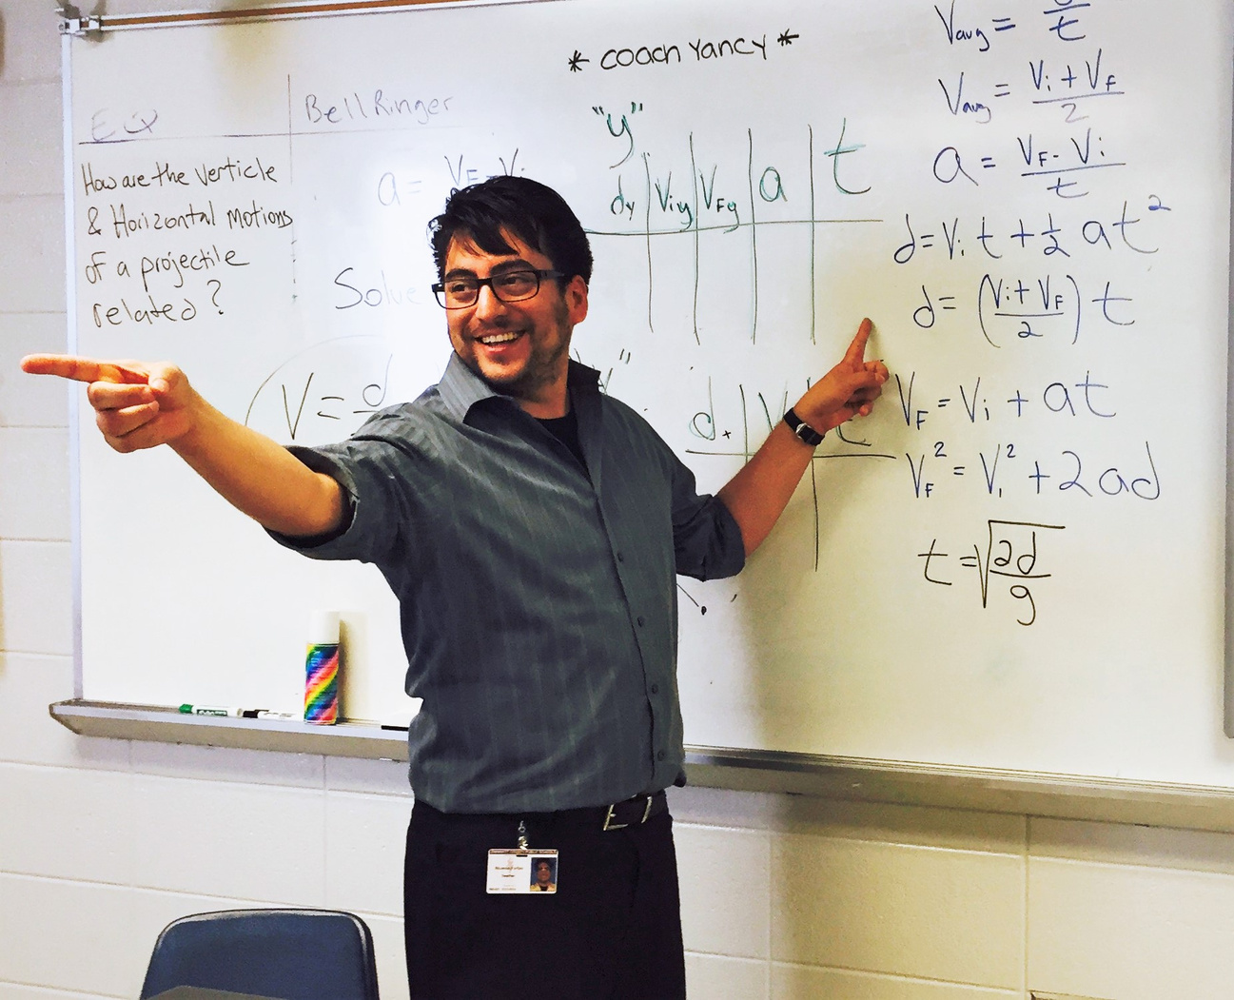
DID YOU KNOW?
At year 15, the middle 50% of teacher salaries ranges between $68,000 and $114,000, nationally.
Notes:
2

