Slide 1
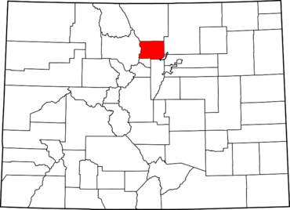
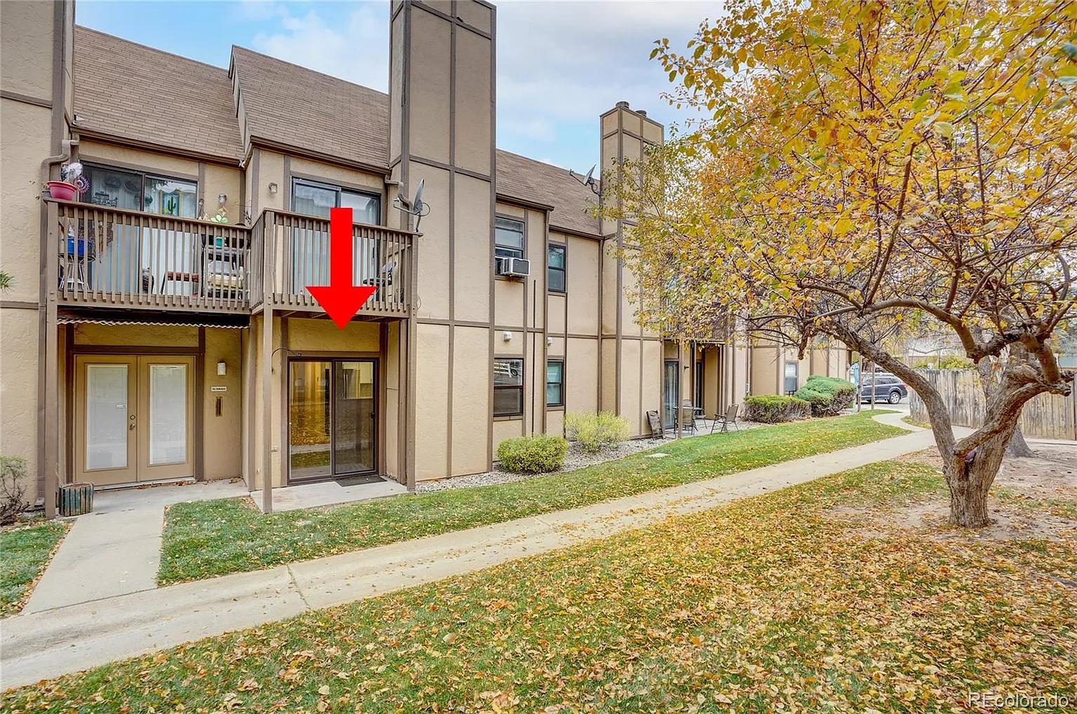
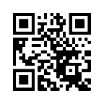
A Teacher’s Life by the Numbers!
3
Boulder County, CO
1st Year Teacher with a B.A.
15th Year Teacher with a M.A.+
Teacher Salaries
$49,250 - $62,742*
$79,305 $115,375*
*Data from 2022-2023
Plus extra duty pay for coaching and club sponsorship
What does that mean for a professional in this area?
The average annual wage is $81,224
Median home value is $775,576
Fair Market rent for a two-bedroom apartment is $1,724
A salary of $55,000 can buy a home like this*:
A salary of $100,000 can buy a home like this*:
$190,000
$400,000
*With a 5% down payment for 1st year teachers and 20% down for mid-career and while spending 36% of their income on housing
Visit our Website! GettheFactsOut.org
This material is based upon work supported by the National Science Foundation under Grant Nos. 1821710 & 1821462. Any opinions, findings, and conclusions or recommendations expressed in this material are those of the author(s) and do not necessarily reflect the views of NSF.
Created by DM 11.7.22

