Slide 1

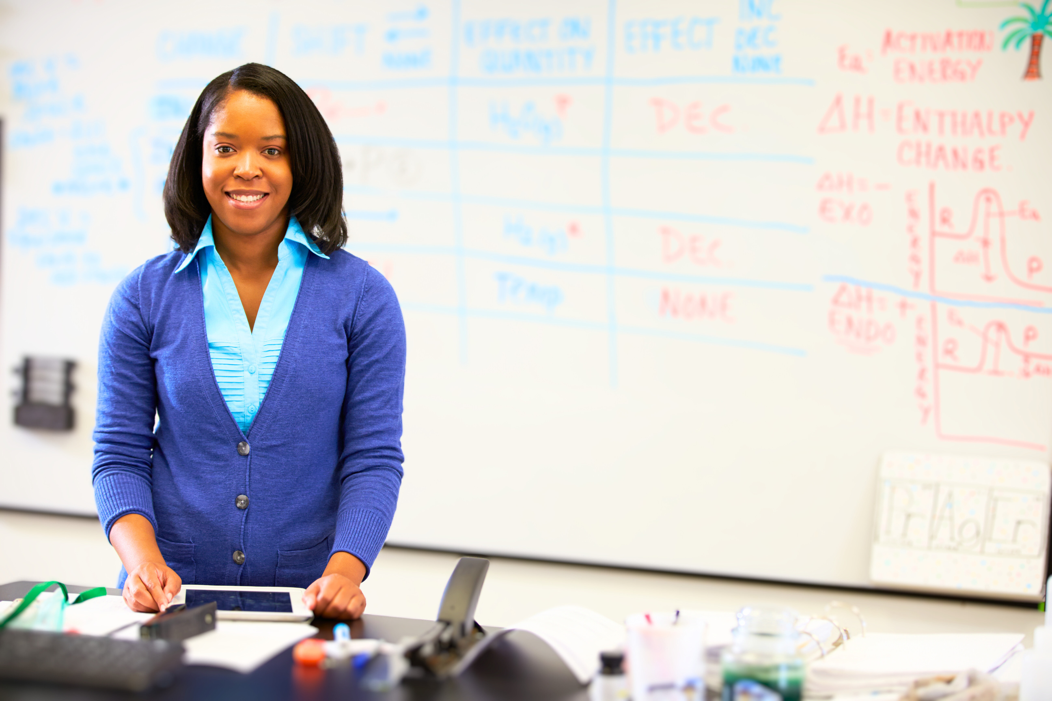
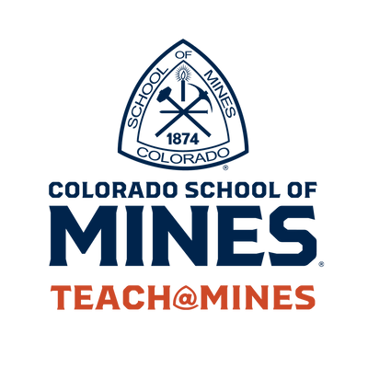


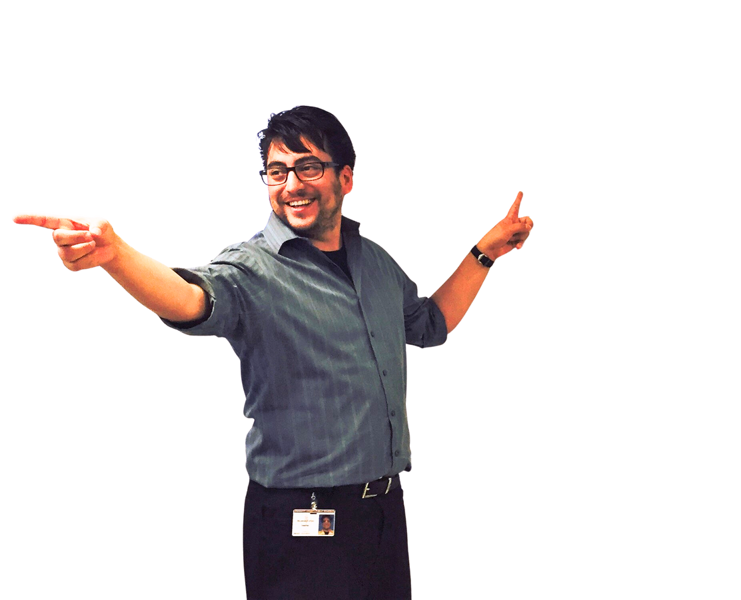




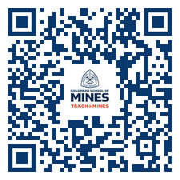
JOB SATISFACTION
CHANGE THE
WORLD
LOAN FORGIVENESS
GREAT SALARY
RETIRE EARLY
9 MONTH CONTRACT
TEACH@MINES IS
The only CO university offering CS teacher licensure
The only
program in Colorado focused exclusively on training STEM teachers
Minor in Teaching
Rated in the
top 5 physics teacher prep programs
in the US
BS in Engineering:
STEM Teaching Focus
MS in STEM Education
ENGINEERS MAKE BRIDGES
ARTISTS MAKE PAINTINGS
SCIENTISTS MAKE ROCKETS
TEACHERS MAKE
THEM ALL
is part of
University Honors and
Scholars Programs

