Slide 1
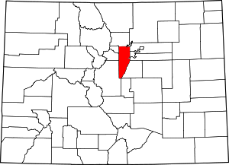
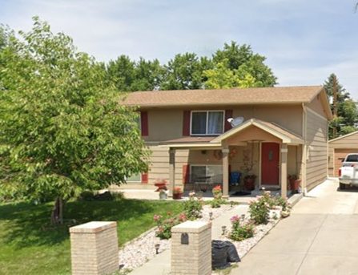
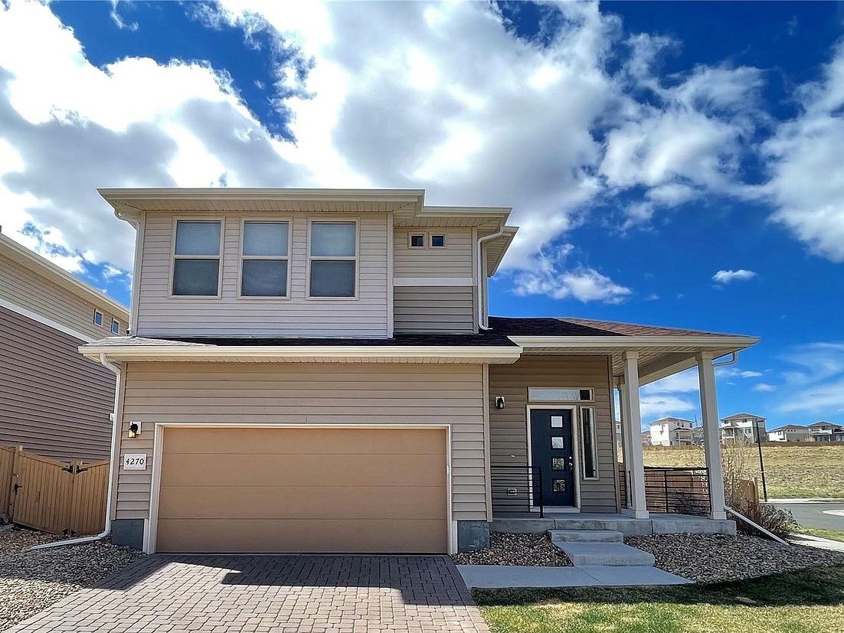
A Teacher’s Life by the Numbers!
Jefferson and Denver County, CO
1st Year Teacher with a B.A.
15th Year Teacher with a M.A.
Teacher Salaries
$43,274-$51,083*
$83,146- $88,945*
Plus extra duty pay for coaching and club sponsorship
*Data from 2021-2022
What does that mean for a professional in this area?
The average annual wage is $78,971
Median home value is $673,743
Average rent for a two-bedroom apartment is $1,605
A salary of $47,000 can buy homes like these*:
A salary of $86,000 can buy homes like these*:
$232,000
$490,000
*With a 5% down payment for 1st year teachers and 20% down for mid-career and while spending 36% of their income on housing
Visit our Website! GettheFactsOut.org
This material is based upon work supported by the National Science Foundation under Grant Nos. 1821710 & 1821462. Any opinions, findings, and conclusions or recommendations expressed in this material are those of the author(s) and do not necessarily reflect the views of NSF.
Updated by AMB 6.30.22

