Slide 1
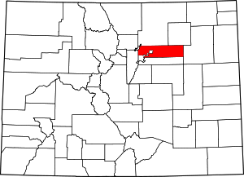
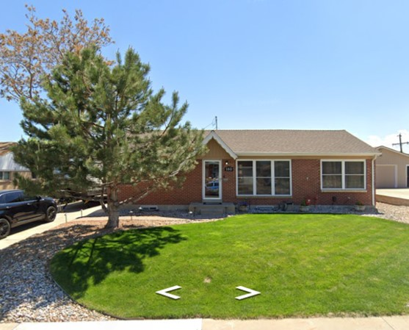
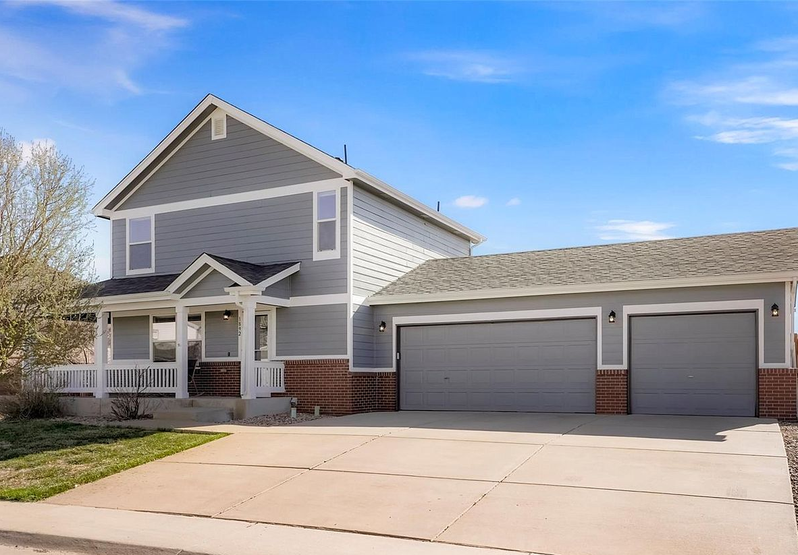
A Teacher’s Life by the Numbers!
Adams County, CO
1st Year Teacher with a B.A.
15th Year Teacher with a M.A.
Teacher Salaries
$43,077-$57,862*
$81,566- $95,356*
Plus extra duty pay for coaching and club sponsorship
*Data from 2021-2022
What does that mean for a professional in this area?
The average annual wage is $59,280
Median home value is $544,458
Average rent for a two-bedroom apartment is $1,605
A salary of $50,000 can buy homes like these*:
A salary of $88,000 can buy homes like these*:
$225,000
$471,000
*With a 5% down payment for 1st year teachers and 20% down for mid-career and while spending 36% of their income on housing
Visit our Website! GettheFactsOut.org
This material is based upon work supported by the National Science Foundation under Grant Nos. 1821710 & 1821462. Any opinions, findings, and conclusions or recommendations expressed in this material are those of the author(s) and do not necessarily reflect the views of NSF.
Updated by AMB 6.30.22
Notes:
190K for first and 359K for mid

