Slide 1
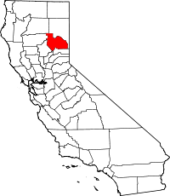
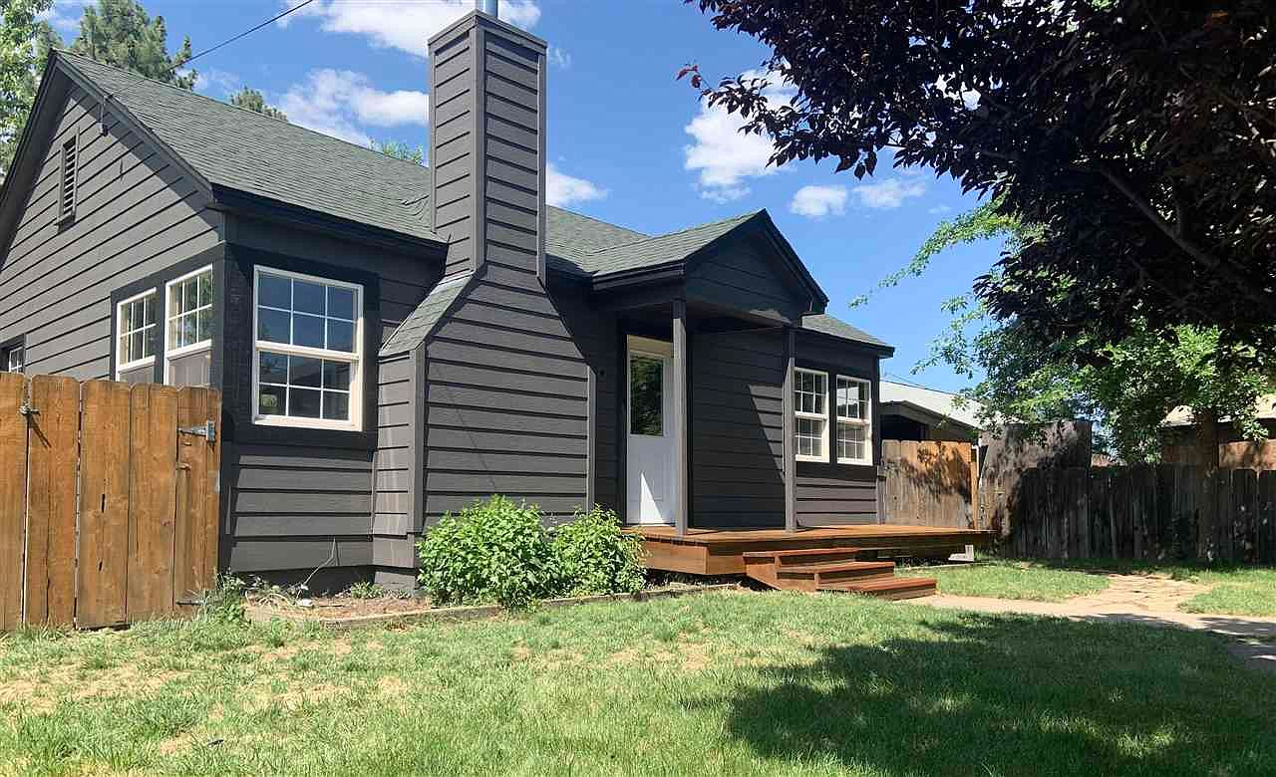
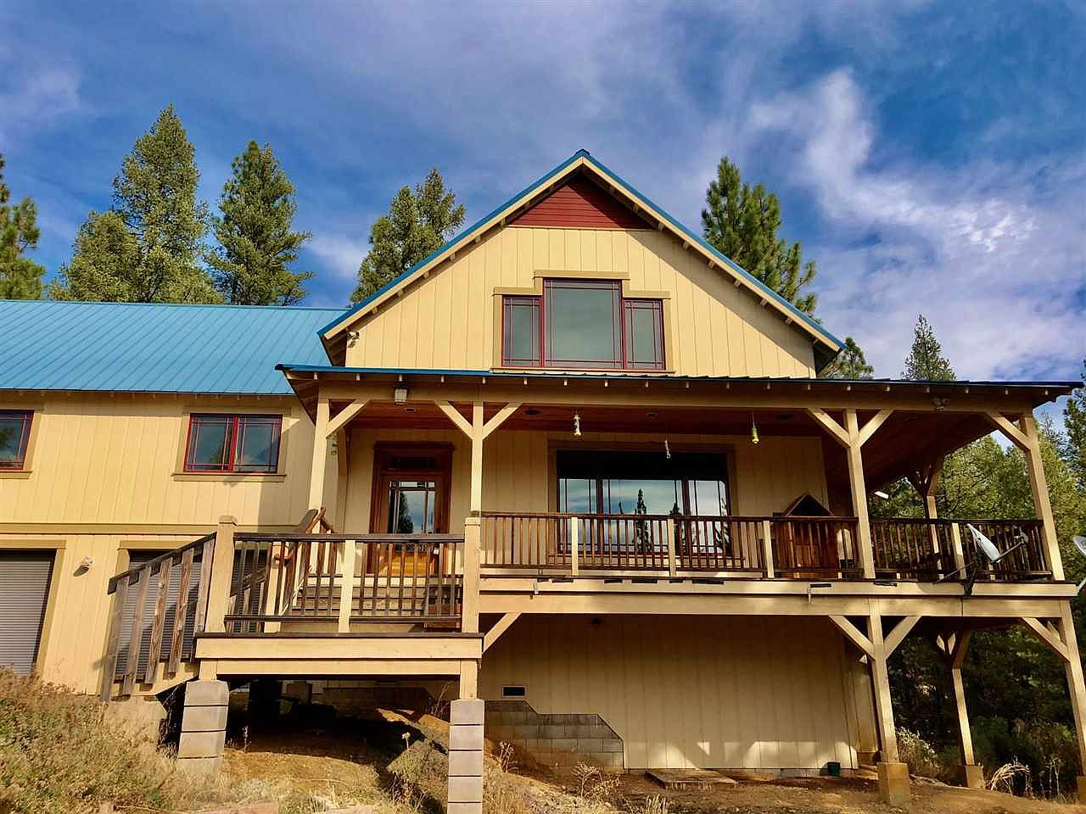
A Teacher’s Life by the Numbers!
3
Plumas County, CA
1st Year Teacher with a B.A.
15th Year Teacher with a M.A.+
Teacher Salaries
$39,797-$41,666*
$74,625- $79,055*
*Data from 2020-2021
Plus extra duty pay for coaching and club sponsorship
What does that mean for a teacher in this area?
The average annual wage is $47,476
Median home value is $360,433
Fair Market rent for a two-bedroom apartment is $937
1st Year Teachers can buy a home like this*:
Mid-Career Teachers can buy a home like this*:
$215,000
$464,000
*With a 5% down payment for 1st year teachers and 20% down for mid-career and while spending 36% of their income on housing
Visit our Website! GettheFactsOut.org
This material is based upon work supported by the National Science Foundation under Grant Nos. 1821710 & 1821462. Any opinions, findings, and conclusions or recommendations expressed in this material are those of the author(s) and do not necessarily reflect the views of NSF.
Created by AMB 3.16.22

