Slide 1
Pre-Presentation Checklist
Presentation Outcomes
The audience will have positive attitudes towards teaching as a profession.
The audience will engage in ideas about teaching as a profession after the presentation (e.g., by reflecting, sharing, and engaging in conversation).
The audience will feel better prepared to make an informed choice about their career options, including teaching.
Before you begin
Update the slides with 1. your logo and contact info; 2. local teacher salary data, and; 3. retirement data.
What should you do as a presenter?
Create a safe and fun space for students to engage, from the start.
Share the positive aspects of teaching as a profession that are supported by data.
Avoid voicing misperceptions about teaching as a profession.
If students express misperceptions about teaching as a profession, provide fact-based corrections.
Avoid providing airtime for anecdotal aspects of teaching as a profession (which are often negative and not supported by data).
What should a presentation look like?
5-30 minutes in class; 15-30 minutes in other venues (club meetings, information session, ice cream social; see Reach Students on our website).
Key message of Get The Facts Out is emphasized: Teachers in the U.S. rate their lives better than all other occupation groups, trailing only physicians.
Accurate information about teaching as a profession is provided, including life satisfaction, salary, retirement, and student loan forgiveness.
Comparison to industry and college faculty is provided.
Information on teacher salaries and retirement have been updated with local data.
After the workshop
If not already done, register your activity in order to receive credit and survey results.
Fill out the self-assessment worksheet to document and plan for next time.

Slide 2

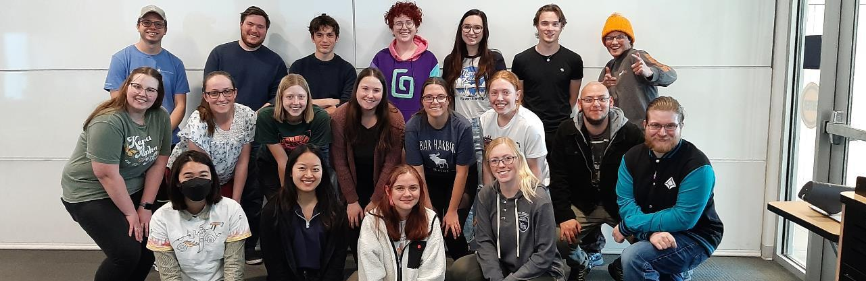



Busting Myths about the Teaching Profession
Any opinions, findings, and conclusions or recommendations expressed in this material are those of the author(s) and do not necessarily reflect the views of the National Science Foundation. NSF DUE #1821710, 1821462, & 2337285.
Repairing the reputation of the teaching profession
Notes:
Average length of this Get the Facts Out presentation: 30 min (15 minute also available at https://getthefactsout.org/presentation-students)
PLACE YOUR OWN TEACHER PREPARATION PATHWAY LOGO AND A PICTURE OF YOUR PROGRAM’S STUDENTS. Please don’t remove the GFO logo, NSF disclaimer and NSF logo. The GFO Logo can be made smaller if you’d like. https://getthefactsout.org/resource-usage-and-copyright-permissions/
Welcome students; introduce speakers
Suggested modifications:
Place your own teacher preparation pathway logo and a picture of your program’s students. (you are welcome to keep these students if you prefer)
List the names of your presenter(s)

Slide 3



Please complete the pre-quiz
surveymonkey.com/r/GFOStudent
Sign in: tinyurl.com/yyumqo9o
Notes:
Updated 9/21/26
NOTE TO PRESENTERS: This link includes the pre-quiz and post-quiz that are very helpful in framing the presentation. I always joke that, “we’re starting by giving you a quiz. This will help you get some idea of the facts I’ll be sharing with you today and after the presentation, you should have the answers to these questions” The quiz only takes a couple of minutes so provide instructions for a cue. If you’re on Zoom, ask them to put “done” in the chat. It’s a bit harder in person, but ask them to look at you or raise their hand. I’ve had best luck with look at me.
I’m finding much stronger results when using the pre/post quiz. When thinking about how the brain works, this helps your audience focus on the ideas you’ll be discussing and it sparks their curiosity. Also it engages them and helps them cleanse their brain of whatever possessed it when they walked in the door. Finally, it helps you see how things went afterwards. Our evaluator will send you your results within a week or two after your presentation.
The second link is a sign in sheet that collects names and emails. It’s the only email collection we have in this presentation.

Slide 4
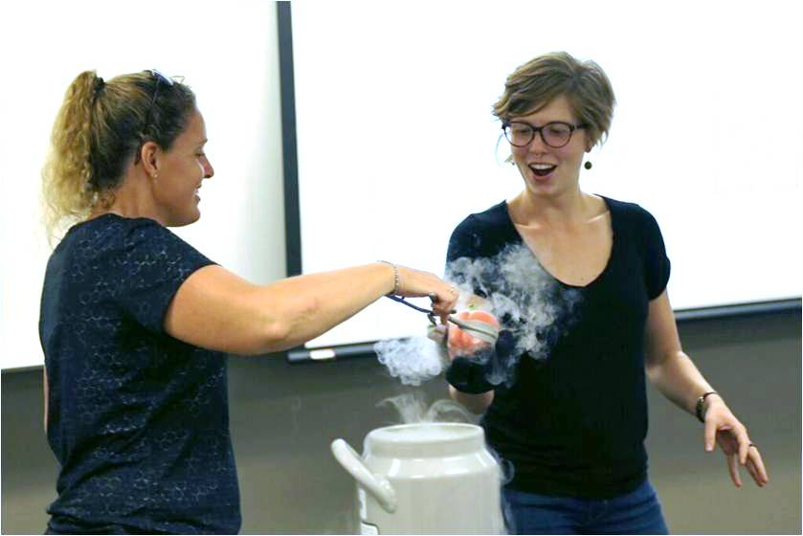
Our Mission
Inspire young minds. Teach science, math, or CS!
Notes:
“Before we get into the details, here is the mission of our work in a nutshell: We want to take Mines students who have a passion for STEM subjects along with an interest in teaching and provide a pathway that poises them to make an impact on education and eventually STEM itself. We understand that this won’t be of interest to all Mines students, nor should it be because our society needs other STEM professionals in addition to STEM educators. But any Mines students who do decide to pursue a career in teaching are bound to have a significant impact. “
Suggested modification: Replace picture with one of your teachers doing demos or some other exciting thing. We have found pictures of smiling teachers (teaching) and students is important. Students react poorly to fake looking stock photos.
The statement “ Inspire young Minds. Teach science or math!” has tested positively across the nation in our focus groups. “Blow Minds! Teach Science or Math.” Tested extremely well everywhere but the East coast where it is considered a reference to drug use.

Slide 5
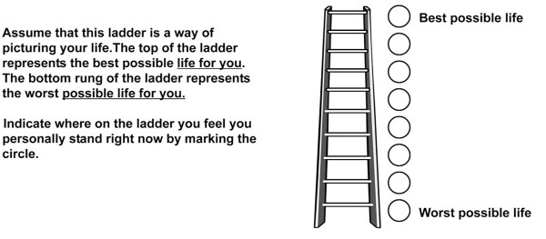
Rate your life
Best possible
life (10)
On which step of the ladder would you say you personally feel you stand at this time?
Worst possible
life (0)
Notes:
Updated 9/21/26
Ask students to silently rate their lives. After 20 seconds or so, ask them to talk to their neighbor about what they think might be things that people think about when rating their lives. Please don’t share your rating, that’s too personal, but talk about what you think others might consider when choosing the step they currently stand on. Give less than a minute (this could go on for a lot longer but within 30 seconds or a minute, a lot of good ideas surface)

Slide 6
Rate your life
Best possible
life (10)
On which step to you think you will stand about five years from now?
Worst possible
life (0)
Notes:
Updated 9/21/26
Now where do you think you’ll stand in 5 years from now? Provide 15 seconds for this.

Slide 7
National Survey
Top
Best possible
life (10)
On which step of the ladder would you say you personally feel you stand at this time?
7 or greater for Q1 & 8 or greater on Q2
Q1
Middle
The Cantril Self-Anchoring Scale†
Q2
On which step do you think you will stand about five years from now?
4 or less for Q1 & Q2
Worst possible
life (0)
Bottom
Notes:
Updated 9/21/26
“Lots of survey groups use this type of question to see how people are doing in different parts of the country or the world, or they’ll look at different age groups. When they do this, they combine the results from the two questions weighting the first question the most. The most important thing is to see how people feel now but the 2nd question does provide some indication of their perceived future opportunity and that’s important too.”
“In this case Gallup wanted to divide the responses by job/occupation and they asked this question of 172,000 U.S. workers.”
“They broke the ladder into three parts. Note that top is a smaller area than the bottom. They look at the fraction who rated themselves at the top and then subtract off those who rate themselves at the bottom to sort of normalize the number. They ignore anyone who was in the middle.”
QUESTION: After explaining the ladder sections, bring up the question about where teachers stand. Often students are thinking about individuals and provide a step. It helps to have mentioned the Gallup survey as I described above. Then ask again “where do you think teachers are in general compared to other professions? Do they rate their lives higher, the same, or lower than people in other occupations?” I’ve seen a huge range of responses from students. Faculty and teachers tend to say higher.
Reference: https://news.gallup.com/poll/122453/understanding-gallup-uses-cantril-scale.aspx

Slide 8
Did you know…
Teachers in the United States rate their lives better than all other occupation groups, trailing only physicians.
Percentage shown is the % of respondents ranking their lives at the top of the ladder minus the % ranking their lives at the bottom of the ladder.
Notes:
Updated 9/21/26
When they analyzed the results by job/occupation group, they find that teachers rate their lives better than all groups, trailing only physicians.”
College faculty, Engineers, and scientists are in the “Professional” category or “Manager, executive, or official” categories.
Note: It may seem like the wording of the title statement could be shortened a bit but our testing finds uniformly positive responses to the above wording and we did not have as strong of responses when we modified the wording.
References:
https://news.gallup.com/poll/161324/physicians-lead-wellbeing-transportation-workers-lag.aspx
https://www.amacad.org/sites/default/files/publication/downloads/2021_Humanities-Indicators_Workforce.pdf
Additional Triangulation Data from 2022 – 2026
Data from the long running General Social Scale finds that 92% of teachers state that they are “satisfied with their jobs” slightly surpassing the 87% rate for workers overall. Teachers have consistently been more positive or consistent with other workers for the past 50 years. https://www.chadaldeman.com/p/raw-data-teachers-are-satisfied-with
2025 data from EdWeek finds that teacher moral by state is positive overall at +18 on a scale of -100 to 100.
https://www.edweek.org/state-of-teaching/teaching-learning/what-teacher-morale-looks-like-in-every-state/2025/03
Bureau of Labor Statistics data continues to show the Education public has the lowest quit rates of any occupation (tied with Government Public Sector)

Slide 9
Question
Why do you think teachers rate their lives so highly compared to other professionals?
Professional Well-being is defined as:
A state of wholeness that results from bringing balance into life, work, people and money.
Notes:
Updated 9/21/26
People will suggestion things like they can make an impact, their students, etc… Less often but fairly regularly you’ll hear schedules (either summer or school day) and financial related items from people who are better informed (teaching relative).

Slide 10

Teacher Well-being
Work-life balance
Student and colleague relationships
Financial stability
Notes:
Updated 9/21/26
For the past several years we have been working to understand why teachers rate their lives so highly. We’ve minded data from lots of different sources and collected some of our own. What we’ve found is that teachers have
better work-life balance than other jobs you can get with the same degree,
We see this in three areas
Flexible summers to recharge and spend time with friends and family or pursue other interests
Negotiated 3 and 4 day weekends and holiday breaks because teachers work hard and these regular extended breaks give them a chance to recharge. This also allows their schedule to align with their kids (if they have children)
Students go home between 2:30 – 3:15 (depending on the school) allowing for some time to accomplish things during business hours.
as you noted relationships with students and their colleagues, and
financial stability.
Today we’ll unpack all of this and look at data on each of these areas.

Slide 11
What factors go into a person’s sense of well being?
Gallup-Healthways measured:
Emotional Health
Healthy behaviors
Access to basic necessities
Physical health
Work environment
Might also include
Sense of meaning in our lives
Financial stability
Leisure time
Intellectual and emotionally stimulating work
Schedule (quality of it and the predictability of it)
Opportunity to learn new skills/knowledge
Relationships
…
Notes:
After students tell you what they think the reasons are you can now show them what Gallup asks to better understand these ratings and then we’ve included what we hear from our audiences as what is important in the 2nd column.
Background note: The Gallup categories listed in the 1st column are posited to help explain the well-being index but there was no indication that these were found via research. That’s why we also suggest some others that might matter in a person’s analysis of their own well-being that have come from our audiences the past two years.

Slide 12
Day-to-Day Satisfaction
Students: relationships and Learning
Work schedule
Teaching is challenging/scientific
Colleagues
Learning new content
Autonomy of the Classroom
What provides you with day-to-day satisfaction?
A listing of 60 total items were compiled by STEM teachers.
These 60 items fell into six categories.
Notes:
Updated 9/21/26
100% of teachers agreed with each one of these. List them and say them all.
Second: Point out that the student category included a list of over 30 different ways students made the job satisfying
“We asked a room full of science and math teachers to tell us, “What provides you with day-to-day satisfaction?” They were asked to silently write things down. Then we swapped the responses between tables and asked each table to only keep those that resonated with everyone at the table. When we looked at the 60 responses that rose to the top, they seemed to fall into six different themes.
Over half talked about their students both relationships with students and watching them learn: the light bulb moment or seeing them grow over the semester or years.
Next was their day-to-day work schedule: They can take care of other life things during business hours from 3:30 – 5 which other jobs typically can’t; their work schedule aligns with their kids including holidays and breaks.
Teaching is challenging/scientific: ‘Teaching is a science; teachers constantly use their STEM skills as teachers!’
Colleagues: - Strong relationships between fellow teachers, “other committed teachers make amazing coworkers and friends”
Learning content: Always learning new and emerging areas of my content (eg. physics), “Teaching provides the drive/reason to explore new and challenging areas of my content.”
Autonomy of the classroom: Teachers get to decide what happens in their room. There’s a lot of responsibility but it’s nice to be able to make all of the decisions (within basic guidelines) in my room.

Slide 13
Starting salaries
Which is closest to the typical starting salary for K-12 teachers in your area?
  $32,000
  $45,000
  $52,000
  $65,000
  $72,000
Notes:
Updated 9/21/26
I ask this but do not share the results because we’ll get there in two more slides.
Ans: C, D or E depending on the district
[Don’t tell them the answer until the slide with teacher salaries]
NEW! You can request GFO to find data for your area: https://tinyurl.com/data-request

Slide 14
Mid-career salaries
After 15 years of teaching and earning a master’s degree, which is closest to the typical K-12 teacher salary in your area?
  $45,000
  $60,000
  $75,000
  $90,000
  $110,000
Notes:
Updated 9/21/26
I ask this but do not share the results because we’ll get there in two more slides.
Ans: C, D or E depending on the district
[Don’t tell them the answer until the slide with teacher salaries]
NEW! You can request GFO to find data for your area: https://tinyurl.com/data-request

Slide 15

Teacher Salaries
School year contract
 | BA yr 1
Westminster Public Schools (26-27) | $65,299-$69,186
Boulder County Public Schools (26-27) | $63,075-$70,403
Denver Public Schools (26-27) | $58,666 -$70,302
St. Vrain Valley Schools (26-27) | $65,300- $69,575
186-day contract -> $65,000 = $43.70/hr
+ Extra Pay
Notes:
Updated 8/20/26
2026/2027 salary schedules
“Here are starting salaries for some districts in our area. You can see that starting salaries range from $59K - $70K. Teachers have a school year contract that is typically 186 days. That means a starting teachers hourly wage is about $43 per hour. Teachers also get paid for any extra work they do outside of teaching classes. I’ll show you more on that in a minute.”
RECOMMEDATION: Please use local teacher salary data. We have found that when you don’t, it’s met with much skepticism and does not help the audience see why teachers rate their lives highly all across the country. You can look on the Teacher Salary Data section of the GFO website for your area: https://getthefactsout.org/teacher-salary-data/ If you do not see your area, please fill out a requestso that GFO can find data for your area: https://tinyurl.com/data-request

Slide 16
Teacher Salaries
School year contract
 | BA yr 1 | BA yr 5 | MA yr5
Westminster Public Schools (26-27) | $65,299-$69,186 | $68,759 - $72,643 | $75,515 - $110,039
Boulder County Public Schools (26-27) | $63,075-$70,403 | $69,977 -$75,759 | $76,707 - $99,710
Denver Public Schools (26-27) | $58,666 -$70,302 | $67,663 - $78,532 | $74,532 - $89,057
St. Vrain Valley Schools (26-27) | $65,300- $69,575 | $72,225 - 75,395 | $75,625 - $84,050
186-day contract -> $85,000 = $57.10/hr
+ Extra Pay
Notes:
Updated 8/20/26
2026/2027 salary schedules
“After 5 years of teaching in the district you can see there are pre-determined steps or increases in salary that a teacher receives. There are also often cost of living raises to these schedules that get negotiated later. We also show teachers with an MA or MS in this table because over half of teachers earn a masters’ degree before they are 30. Most people don’t know that there are programs all over the country designed for practicing teachers to earn their MA while teaching full time. Our districts provide an increase for additional education which you can see on this table.
Denver notes: DPS pays+ $2K math + $2K Title I school. I did not include it but there’s also $880 - $5500 for leadership role and $3K for high priority schools. Also there’s $1000/year student loans paid for up to 6 years.

Slide 17
Teacher Salaries
School year contract
 | BA yr 1 | BA yr 5 | MA yr5 | MA yr 15
Westminster Public Schools (26-27) | $65,299-$69,186 | $68,759 - $72,643 | $75,515 - $110,039 | $110,052-$120,041
Boulder County Public Schools (26-27) | $63,075-$70,403 | $69,977 -$75,759 | $76,707 - $99,710 | $111,995 -$119,772
Denver Public Schools (26-27) | $58,666 -$70,302 | $67,663 - $78,532 | $74,532 - $89,057 | $93,051 -$110,434
St. Vrain Valley Schools (26-27) | $65,300- $69,575 | $72,225 - 75,395 | $75,625 - $84,050 | $96,535 - $103,725
186-day contract -> $110,000 = $73.90/hr
+ Extra Pay
Notes:
Updated 8/20/26
2026/2027 salary schedules
“Here are salaries at Mid-Career for our area. You can see some very sizeable increases have built over the years. This is a combination longevity and loyalty reward. Part is due to experience but also to reward those who stay with the district. “
“The range shown here is for someone who just earned their MA right at Year 15, that’s the lower number, and the higher number is someone who earned their MA a few years ago and have since taken more courses. The higher number is for someone who has taken quite a few more courses 15 -20 over the years since they earned their masters.”

Slide 18
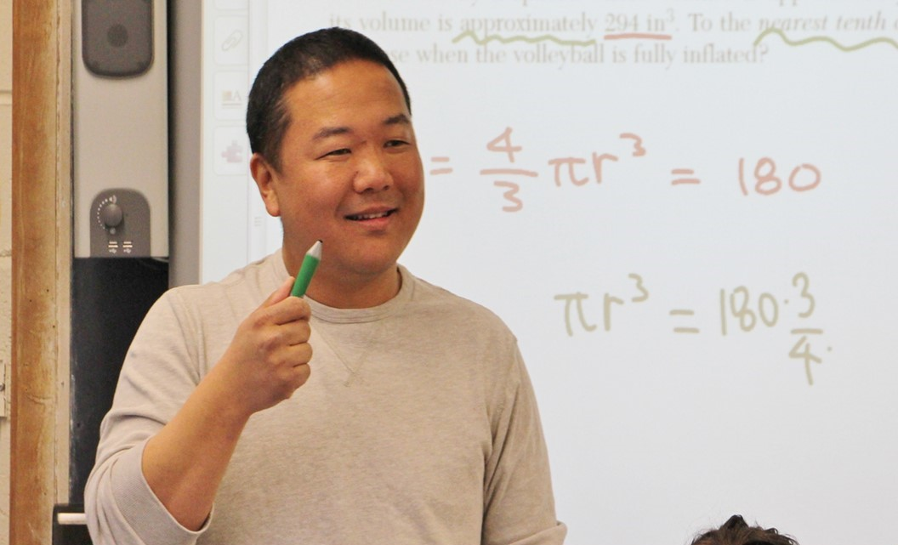
Did you Know…
At year 15, the middle 50% of mid-career teacher salaries ranges between $72,000 and $119,000, nationally
…range shown is IQR: 25th – 75th percentile
Notes:
8/20/26
GFO has collected data across the U.S. from over 400 districts and analysis of this data finds the above. We also dug into NCES (National Center for Educational Statistics) data and found that their data for the 20-21 school year shows a middle 50% range of $62K - $103K adjusted at a 3% inflation increase gives $72K-$119K. Per NCES from 2021 – 2026 the average teacher salalry when up 3% - 4.1% per year.

Slide 19
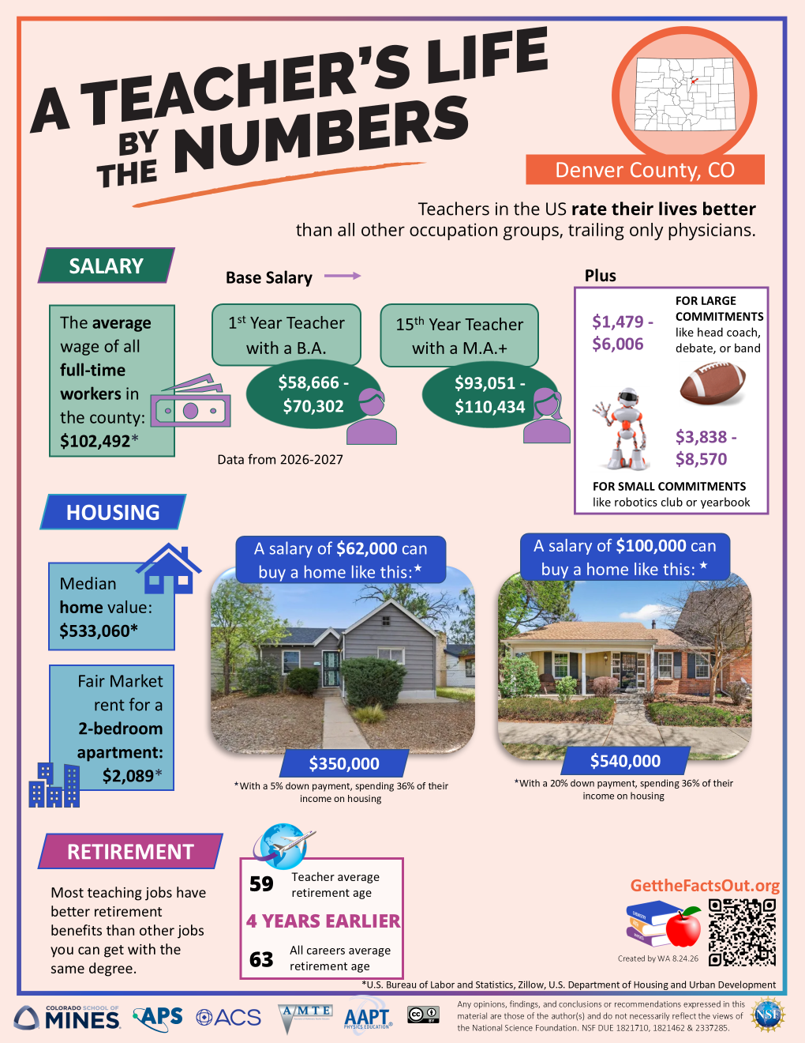
Notes:
8/20/26
“This is an infographic that shows teacher salaries in the area and an example home of what a 1st year teacher can afford in the area and what a mid-career teacher can afford. We also can see the average wage for all employees in the area. You can see that mid-career teachers are making a fair amount more than over half of the people in the community/parents of their students. The median home value and fair market rent are also shown.”
GFO research has found that across the country Mid-career (yr 15) salaries are typically higher than the median annual income in each local area. In fact, in many areas outside of the biggest cities, teacher starting pay is about the same as the mid-career salaries in those city, town, and rural areas.

Slide 20



Teacher Salaries
+ Extra Pay Stipends/bonuses
Did you know…
Teachers get additional pay of $1,500-$14,000 per year for optional activities like coaching, running after-school clubs, and tutoring.
Notes:
8/20/26
“All of the salaries that we just discussed are “base salaries” Just the minimum teachers receive. But most teachers do more than that. When teachers coach, sponsor clubs, sub for another teacher, tutor, all of that comes with negotiated stipends/bonuses. The middle 50% range for these activities is $1 - $8K per year. Some teachers like to do multiple activities and tell us that it’s not unreasonable to add $12 - $18K to their salary doing these types of activities.”
For example the 2026-2027 St. Vrain coaching salary schedule ranges from a low of $4,245 to a high of $14,676

Slide 21
Administrator Salaries
St. Vrain Valley Schools
 | Calendar* | Minimum | Maximum
Asst. Principal - High | 215 Days | $117,379 | $162,095
Director – Innovation Programs | 248 Days | $130,839 | $180,683
Principal - High | 225 Days | $144,299 | $199,269
Asst Superintendent – Innovation Center | 248 Days | $190,861 | $263,571
Superintendent | 248 Days | $360,000 | +vehicle and health ins
* Classroom Teacher Calendar: 186 days
Notes:
Updated 8/20/26 - 2026/2027 salary schedules
“If you would like to help lots of teachers, and therefor hundreds of students per year, by supporting the building and all the teachers’ work in the building, consider becoming an administrator or direct a STEM innovation center.
After several years of teaching experience, you can move into administration if you like.
These contracts are a bit longer 225 Days is 45 / 52 weeks per year. Plus you still have leave (annual, sick, bereavement, etc..) during the 45 weeks. “
Side point: It’s good to have people with a range of backgrounds in administration and it’s less common to have STEM since there are fewer STEM teachers, they are in high demand, and those that are there often don’t have a formal STEM background.
St. Vrain Superintendent has a $700 auto allowance per month plus 100% health insurance for their family.

Slide 22
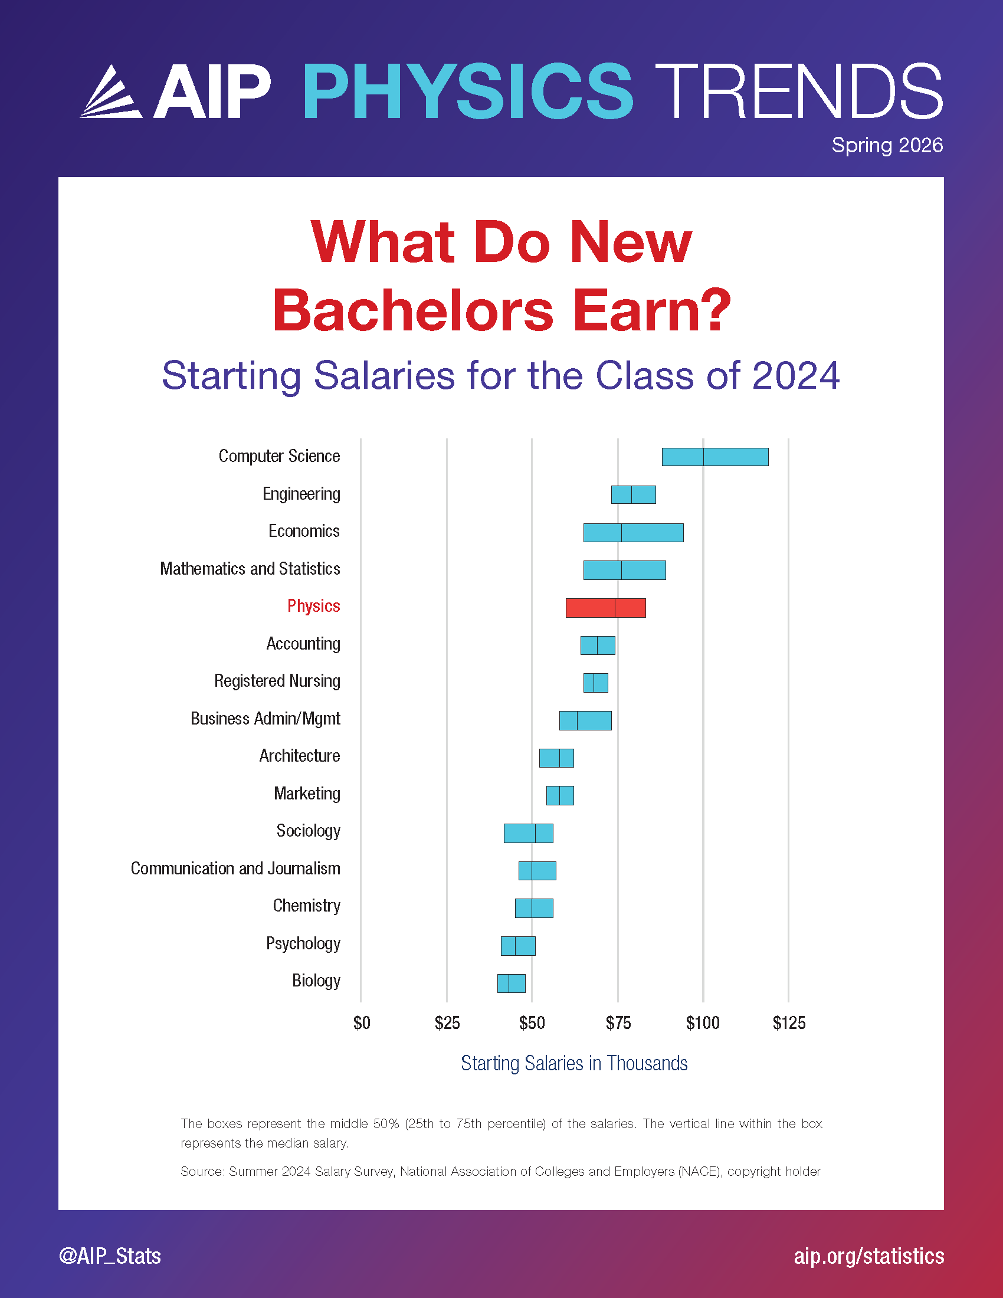
Typical starting salaries of bachelor degree recipients, Class of 2024
Engineering
Mathematics and Statistics
Physics
Teaching
Chemistry
Note: Teaching is a 9-month position, all others are 12-month
Biology
Notes:
Updated 8-24-26
Starting salary for a BS new teacher shows 25th – 75th percentile from our GFO data mining project of 120 districts near 50 universities working with GFO. Range also includes adding in two extra curricular responsibilities only on the higher end.
Suggested modification: Replace with a local district that your graduates are most likely to be employed. The orange text and bar is added on top of the picture via typical power point tools.

Slide 23
Grade 7-12 Teaching vs. College Permanent Teaching Faculty
vs.
Notes:
Updated 8-24-26 (AIP calculator uses 2021 data)
Maybe you’re interested in teaching, but are considering what level? Here we show starting and mid-career salaries for both grade 7-12 teachers and teaching faculty at colleges and universities.
The 7-12 Teacher salaries are base salary without any supplemental pay.
7-12 beginning teachers are typically 22 -24 years old compared to 27-30 years old for year 1 Ph.D. college faculty. Similarly the Year 15 data is for teachers before they are 40 while college faculty are in their mid-40’s.
The college salaries are national averages from the AIP salary calculator for folks with PhD’s in full-time teaching roles that are not tenure track. (Tenure track positions are different types of jobs that have big components of their evaluation based on research and publication.) These positions rarely have opportunity for supplemental pay.
The grade 7-12 data is the average from our data collection of 120 school districts located around the ~50 universities that are currently working with GFO.
You may want to update this data if you’re in one of the higher paying states such as California, Chicago, New York, New Jersey etc…
If you look at the graph you will see that in the beginning years, Secondary Teachers (base salary) and Teaching faculty at colleges make similar salaries.
If you look at year 15, Middle School and High School teachers have received regular pay increases outpacing the typical Teaching faculty. The difference is even more pronounced if you include the supplemental pay that K-12 teachers regularly earn.
The only area where we really see college outpacing high school teachers is for the tenured-track faculty predominantly in departments that grant a PhD in the discipline. (Tenured-track faculty are faculty that have minimal teaching responsibility and focus mainly on research, writing papers and acquiring grants)

Slide 24


Did you know…
You can get a job almost anywhere in the U.S. or abroad as a science or math teacher.
Notes:
This Did you know has tested positively across the nation in our user-testing focus groups.
Math and science teachers are in high demand and there are open positions in every area of our nation. The reason for this is that there are middle schools and high schools in every neighborhood in every town in every state. But there are only a handful of colleges and universities that prepare teachers. These universities are just not graduating enough science and math teachers to fill the positions in all of these schools! This is good for you because that means you can decide the area of the country or even out of the country that you’d like to live and find a teaching job within commuting distance. You can’t do that as an engineer. There aren’t enough jobs in this state for all of the graduates here at Mines. People take jobs all over the U.S. College faculty positions are even rarer and there’s a large surplus of PhDs hoping to find a faculty position in that handful of colleges that we mentioned that are not producing enough teachers☺
There is also high demand for math and science teachers to teach abroad in English speaking schools. Students often think this is referring to teaching English but it is actually referring to math and science teaching jobs. https://www2.ed.gov/about/offices/list/ous/international/usnei/international/edlite-overseas-primsec.html

Slide 25

Did you know…
Most teaching jobs have better retirement benefits than other jobs you can get with the same degree.
Teachers in the U.S. retire at age 59 compared to age 63 for all occupations.
Notes:
This Did you know has tested positively across the nation in our user-testing focus groups.
“Teachers in the US retire on average at age 59 a full 4 years sooner than the average American. That’s because teachers have state sponsored pension plans and these have been negotiated over the years as part of the teachers benefits / pay package”

Slide 26

Retirement Benefits
Colorado schools offer PERA
retirement benefits
Begin teaching at 22 years old, full retirement benefits at 57
  pension = 87.5% of highest earned income (e.g. earned $120,000 before pension will be $105,000)
Notes:
Updated 9/21/26
Suggested modifications: Update to match retirement plans for public school teachers in your state. See https://bit.ly/2Z1cF9j for data on every state.
Slide presentation: Describe in general how a pension works. “In Colorado teachers are eligible for retirement at after 35 years or age 65. If they started teaching at 22, they would receive 87.5% of their teacher salary in retirement for the rest of their life, no matter how long they live. This pension comes with raises (each year or two) which help keep up with inflation.
Background info:
If you become a public school teacher, your retirement plan will most likely be a pension plan managed by your state. If you work for a private company (big or small), your retirement plan will most likely be a 401K retirement account. The difference is that a pension is a defined benefit plan which means the benefit you receive after retirement is known when you first start teaching and doesn’t depend on the stock market, for example. A 401K retirement account is considered a defined contribution plan, which means that your employer will contribute a certain amount each paycheck (3% on average) to your 401K retirement account. However, the amount of the payout when you retire is an educated guess based on the amount you save and the performance of your savings.
After retirement, teachers receive a set amount, with regular cost of living raises, for the remainder of their lives, no matter how long they live. With a 401K a person must estimate their life expectancy and set up a payout based on that expectancy. The amount of their retirement benefit varies depending on the success of their investments over time.
Each state’s pension plan is slightly different. In 35 states a retired teacher has their pension plus social security; in the other 15 states a retired teacher has their pension but no social security. In the states without social security, the pension payments are typically higher. For example, in Colorado a teacher is vested after five years of teaching and will be eligible to retire after 25 years of teaching. Which means a person who begins their teaching career immediately after earning their college degree at age 22 will be eligible to retire at age 57. In Colorado their pension will be 87.5% of their highest earned income. A retiree can increase this amount to more than 87.5% by working longer than 25 years.

Slide 27
Retirement Benefits
How does this PERA pension plan compare in value to the typical industry 401K?
  PERA less valuable by $10,000 / year
  PERA less valuable by $5,000 / year
  PERA equivalent to typical 401K
  PERA more valuable by $5,000 / year
  PERA more valuable by $10,000 / year
Notes:
Slide animated to give less distraction while explaining how the question is framed
Ans: E
We calculated the value of PERA by determining how much a teacher would have to save every year and invest in the typical stock market mutual fund to match the benefit from PERA upon retirement. Based on the average life-span and retirement at 57, this amount is $21,600.
Suggested modification: Update with information from your state. See https://bit.ly/2Z1cF9j for data on every state.

Slide 28
Retirement Benefits
How does this PERA pension plan compare in value to the typical industry 401K?
  PERA less valuable by $10,000 / year
  PERA less valuable by $5,000 / year
  PERA equivalent to typical 401K
  PERA more valuable by $5,000 / year
  PERA more valuable by $10,000 / year
Notes:
Slide animated to give less distraction while explaining how the question is framed
Ans: E
We calculated the value of PERA by determining how much a teacher would have to save every year and invest in the typical stock market mutual fund to match the benefit from PERA upon retirement. Based on the average life-span and retirement at 57, this amount is $21,600.

Slide 29
Retirement Benefits
Colorado schools offer PERA
retirement benefits
Begin teaching at 22 years old, full retirement benefits at 57
  pension = 87.5% of highest earned income (e.g. earned $120,000 before pension will be $105,000)
Other jobs: Yearly investment of $19,000/year or $1,580/month
Notes:
Updated 8/24/26
“If you were not a teacher and you wanted to match the pension, you would need to invest $19,000 per year at 8% /yr for those 35 years. That would give you the same pension until you are 85. After that, you’d be out of money”
Background Info:
Another way to compare a public school teacher’s defined benefit plan to a private company employee’s defined contribution plan is to calculate how much money a person working for a private company would have to save each month to have a retirement benefit equal to the Public School teacher’s pension. Using the average rate of return for the stock market over the past 30 years, we can calculate that a person would need to invest $19,000 per year at a rate of 8% per year for 35 years if they aim to retire at 57 with a pension equal to a typical Colorado school teacher. If the retiree lives longer than the average life expectancy, then they’ll need to have saved more than $19,000 per year or $1,580 per month to have their retirement last through their lifetime.

Slide 30
Salary + Retirement Benefits Teaching vs. Industry
Teaching
Lockheed Martin - ME
Salary + Retirement Benefits
(Pension value – 11% contribution)
Year 1: $65K+ $12K = $77K
Mid: $110K+$7K = $117K
Other
Fewer days on contract
Better than average health insurance
Retire in late 50’s
Salary + Retirement Benefits
(6-10% employer contribution)
Year 1: $67K + $7K = $74K
Mid: $96K + $10K = $106K
Notes:
Updated 8/24/26
This is comparison is between teaching in Denver and working as a Mechanical Engineer at Lockheed Martin, a major local employer.
Lockheed Martin contributes 6% (will match up to 10 if you contribute 8) towards an employee’s retirement. We used the value of the local pension, PERA to determine the “employer contribution”. When talking with districts, we understand that they pay 22% into PERA for each employee
In CO, teachers contribute 11% of their paychecks towards their PERA.
Retirement values shown above are the total employer contribution. So for PERA its value is $19,000. Subtract the teacher contribution of 11% and what is left is $12K for first year teachers and $7K for mid-career teachers.
Engineering
10-40 days off (higher numbers due to Flex Fridays (every other Friday Off))
Teaching
74 for 5 day per week districts and 109 for 4 day per week districts.
Summers: Point out the variety of jobs (including STEM jobs), or not, that teachers can have in the summer. Also can do research via RET’s and other opportunities.
Additional Evidence that teaching pays as well (or better) than other careers you can get with the same degree. There’s a large 10-year study of teachers that recently came out showing that STEM graduates who decided to go into the private-sector instead of teaching made less on average than teachers. The only group that made more than classroom teachers were K-12 administrators (e.g. principals). https://www.aei.org/articles/the-truth-about-teacher-pay/

Slide 31
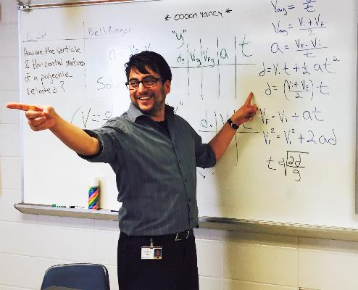
DJ
Did you know…
There are student loan forgiveness programs and scholarships for math and science teachers.
Federal loan forgiveness $17,500
TEACH Grants of $4,000 for undergrad and/or graduates
Notes:
Updated 8/24/26
This statement has tested positively across the nation in our user-testing focus groups. It regularly rates the highest out of all the statements we tested.
There are Federal loan forgiveness programs and grants for math and science teachers.
FEDERAL: Direct or FFEL loans are available to all college students based on need and independent of their majors. If a person decides to teach an individual may receive $17,500 in loan forgiveness on these types of loans after working as a highly qualified math/science teacher for 5 consecutive years in a low-income school. Unfortunately, college-level teaching does not qualify.
STATE: There are state loan forgiveness and scholarship programs for K-12 teachers. You can find information about these programs here: https://getthefactsout.org/state-loan-forgiveness/
DISTRICT: Many districts offer loan forgiveness as an incentive. For example Denver Public Schools offer $1,000 per year for up to 6 years of loan forgiveness.
TEACH grants are federally funded grants for anyone eligible for federal loans who are also enrolled in a participating teacher prep program. It’s free money if you teach for four years within 8 years of teaching program completion. Must teach in a low-income school. If obligation is not met, it becomes a DIRECT loan. If you are getting loans for school and have any interest in teaching, there is no downside.
Perkins loans were disbursed through the academic year17/18. Therefor this forgiveness program only impacts those who currently have Perkin’s loans.
There were also available to students of any major. If a Perkins awardee becomes a teacher, a percentage of their loan is forgiven for each year they teach, with total forgiveness after 5 years. Interest is also deferred while teaching.
Want to know more about Federal Student Aid? https://studentaid.ed.gov/sa/

Slide 32
Colorado State Incentives
Educator Recruitment and Retention Fund: $7,500 for hard to fill areas alt license, or current para, or CTE teacher.
Rural Teaching Fellowship/Stipend: $10,000/$4000 for pre-service teachers in a rural 1-year/1 semester student teaching.
Alternative Licensure Stipend: Up to $6,000 for rural teachers getting their alternative license
Rural Inservice Educator Stipend: Up to $6,000 for teachers to enroll in a program to qualify for concurrent enrollment instruction or add an endorsement.
National Board Certified Rural Teacher Stipend: $2,250 for teachers pursuing NBCT certification.
Notes:
Updated 8/24/26
Update this slide by copying and pasting the info for your state found on the GFO loan forgiveness and scholarships by state page: https://getthefactsout.org/state-loan-forgiveness/

Slide 33
Summary of Teacher Benefits
Teachers in the United States rate their lives better than all other occupation groups, trailing only physicians.
Starting pay ~$65K (9-month, base salary)
At year 15, the middle 50% of teachers nationally earn $72K - $119K (9-month salary)
Retire at age 57 on average with a pension.
There are student loan forgiveness programs for math and science teachers.
You can get a job almost anywhere in the U.S. or abroad as a science or math teacher.
Notes:
Summarize the benefits.
Suggested modifications: Update the starting and mid career salaries with data from this current academic year from school districts in your area where students are most likely to get a job (usually this means the nearby big districts)
Update the Retirement info with stats from your state or replace with “Most teaching jobs have better retirement benefits than other jobs you can get with the same degree.”

Slide 34
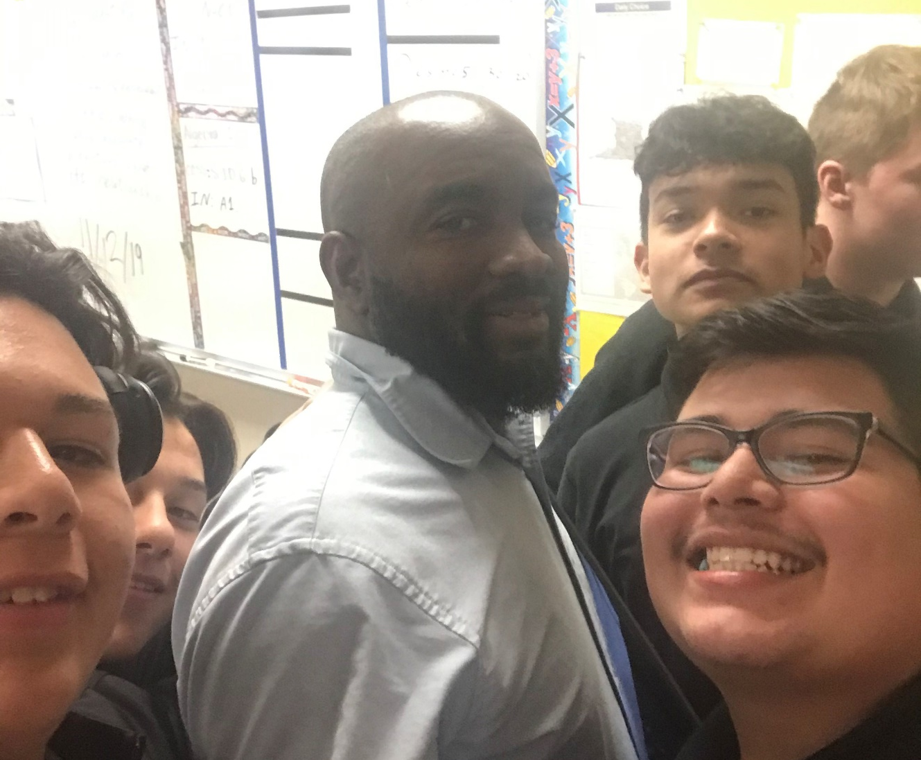
DL
Did you know…
Behind every advance in medicine or technology is a teacher who left a lasting impression.
Notes:
This Did you know has tested positively across the nation in our user-testing focus groups.
The photo is a math teacher at Christel House Academy (South) in Indianna, Vaughn Laptiste, a strong advocate for teaching as a profession.

Slide 35
Please complete the post-quiz
surveymonkey.com/r/GFOStudent
Notes:
Updated 9/21/26
This link takes students to the same place that the link at the beginning o the presentation. If they left their browser window open, the survey is already in the right place and they can just pick up where they left off.

Slide 36

Become a Teacher!
Teach@Mines offers:
  Courses
  Advising
  Teaching Minor (18 credit hours)
  BS Engineering w/ STEM Teaching Focus Area
  Licensure with any BS or Licensure with an MS in STEM Education
Notes:
Place slides here about your program and local opportunities.
We recommend ending the presentation with clear next steps for those who are interested.

Slide 37

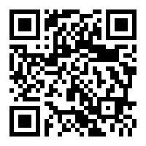
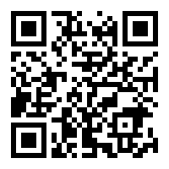
Teach@Mines
Website
mines.edu/teacherprep/
Advising
mines.edu/teacherprep/advising/

Slide 38
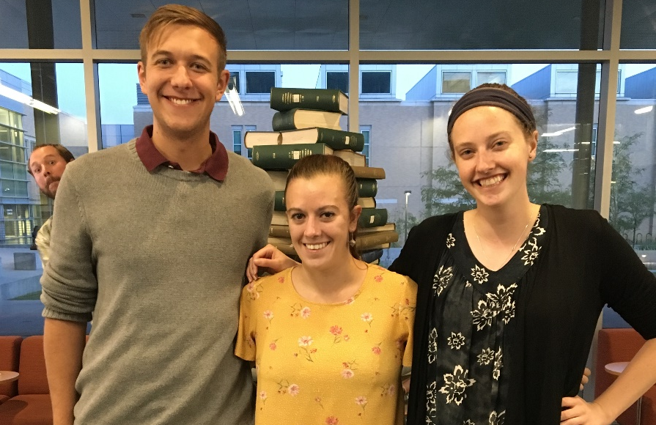
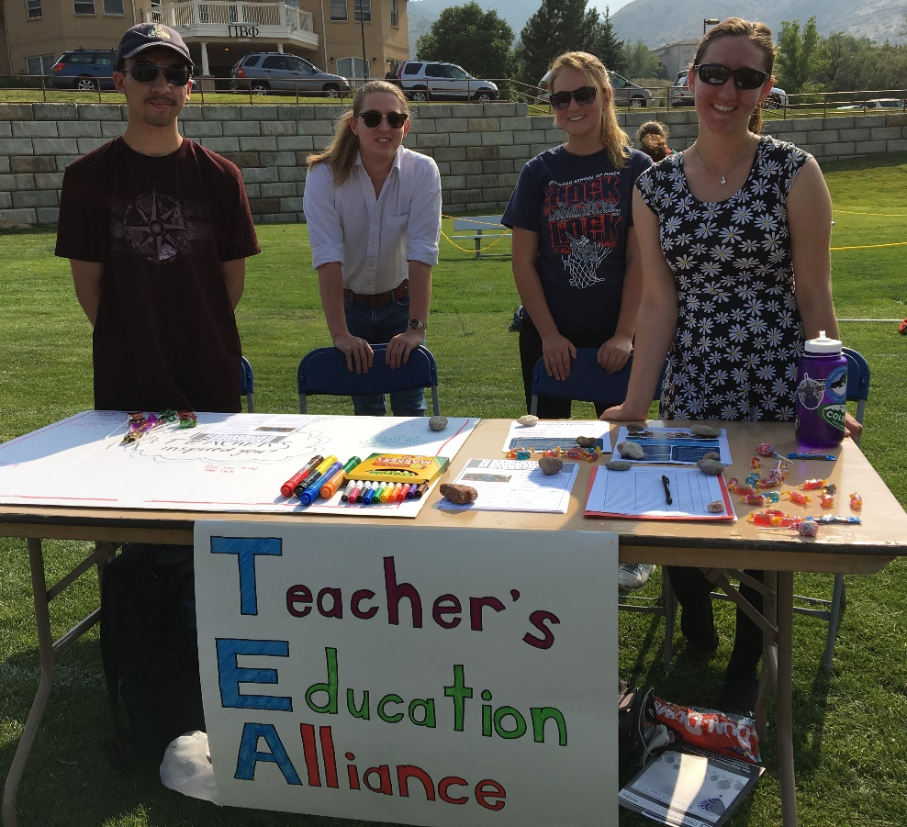
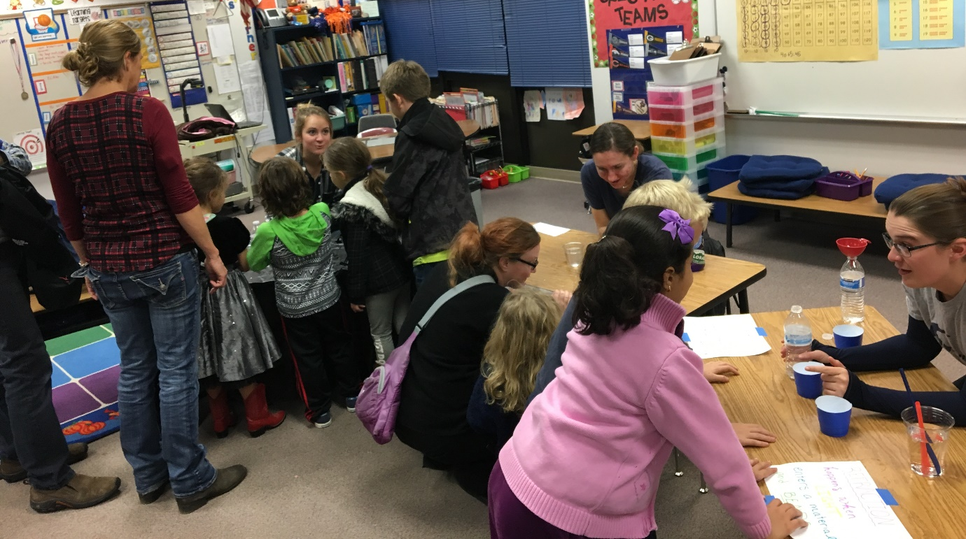
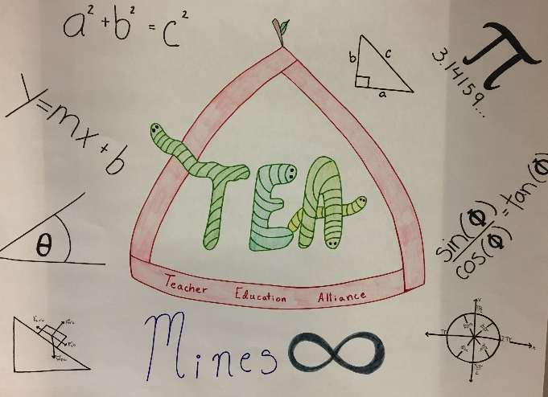
Notes:
Suggested modification: Replace with pictures from your students.

Slide 39
Register your presentation
Become a GFO Champion!
This will allow us to:
1. Give you credit for the presentation
2. Place you on our GFO map!
3. Send your survey results.
Thank you so much!
Register your activity
(Click Here)

Slide 40
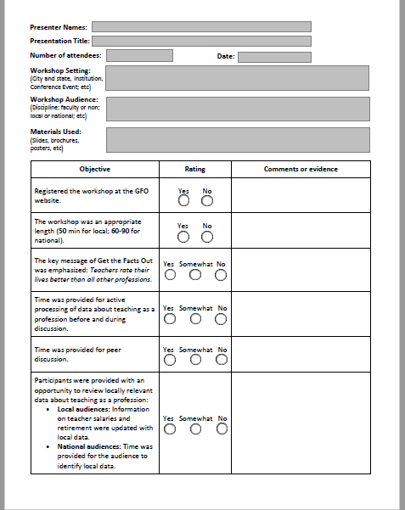
Presentation Reflection
The presentation reflection form, linked at right, allows you to reflect on your presentation and plan improvements for next time.
We ask that you click the ‘Submit’ button at the bottom of the sheet, or email it to gfo@uteach.utexas.edu. The information on the sheet won’t be used to evaluate individual presentations, but to collect data so that GFO can better support presenters.
Thank you so much!
Reflection PDF (Click Here)

