Slide 1
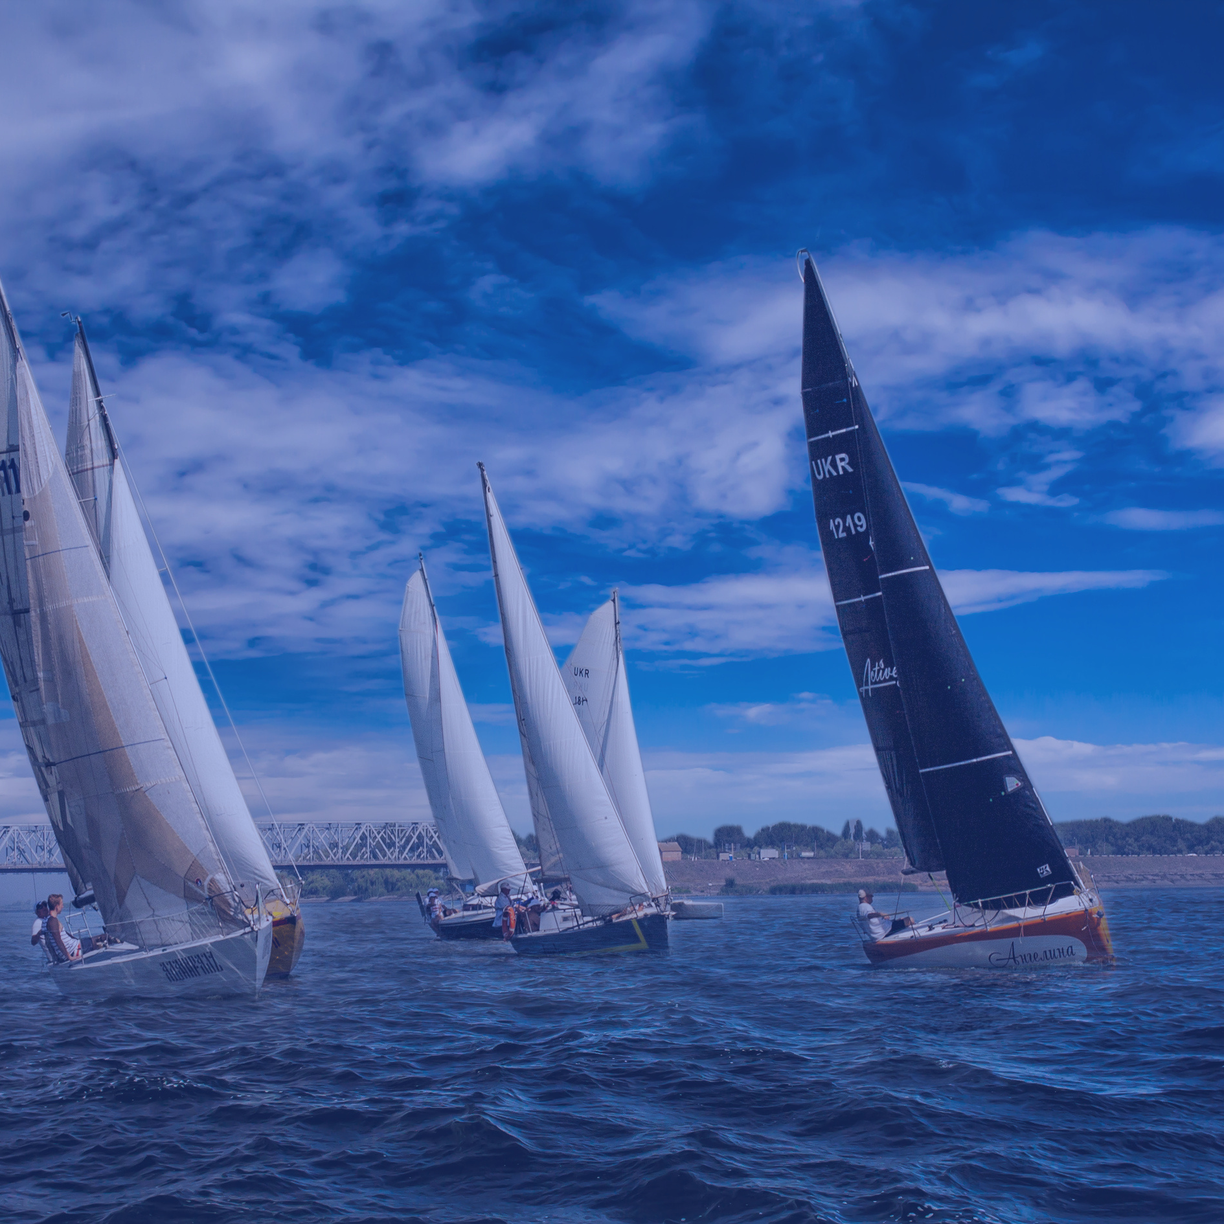
Boat Race
Two sail boats decide to race between two towns 40 miles apart along the coast.
Boat A travels at 20miles/hour the entire way.
Boat B travels half the distance at 10 miles/hour, sees they’re behind and travels at 30 miles/hour the rest of the trip.
Who wins?
A. Boat A
B. Boat B
C. It’s a tie

