Slide 1
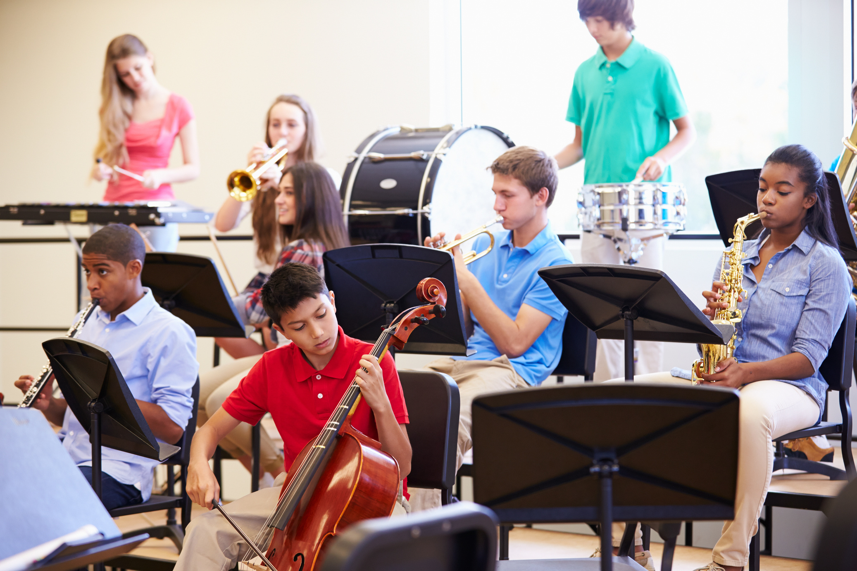








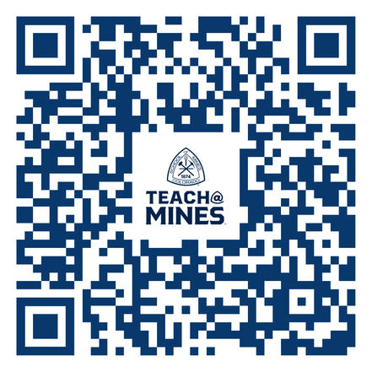
TEACH@MINES
PLAY
FOREVER
JOB SATISFACTION
LOAN FORGIVENESS
GREAT SALARY +
THOUSANDS MORE FOR COACHING
9 MONTH CONTRACT
TEACH
@MINES
IS
The only
program in Colorado focused exclusively on training STEM teachers
Minor in Teaching
Rated in the
top 5 physics teacher prep programs
in the US
BS in Engineering:
STEM Teaching Focus
MS in STEM Education
ENGINEERS MAKE BRIDGES
ARTISTS MAKE PAINTINGS
SCIENTISTS MAKE ROCKETS
TEACHERS MAKE
THEM ALL
is part of
University Honors and
Scholars Programs

