Slide 1
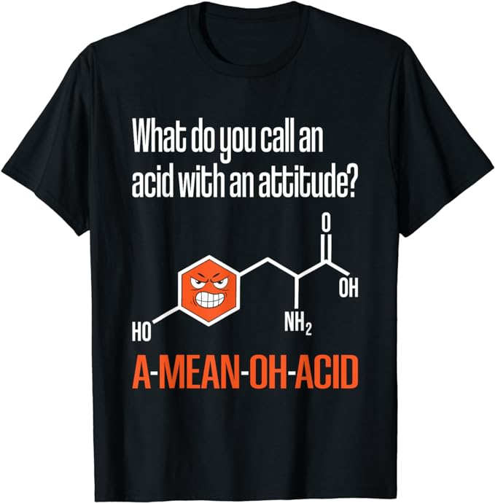

What do you call an
acid with an attitude?

