Slide 1
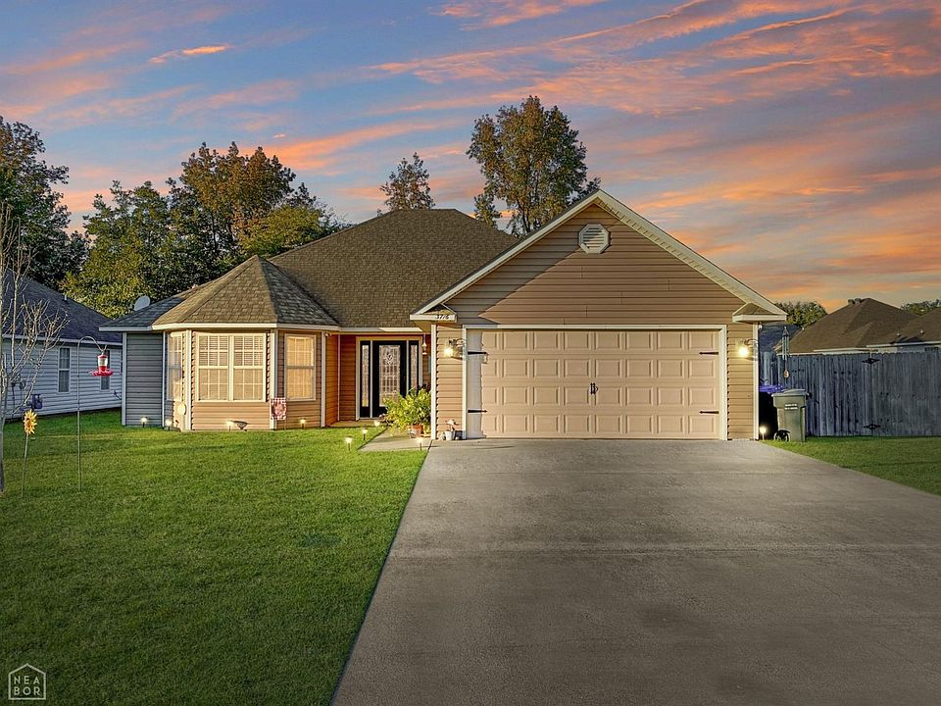
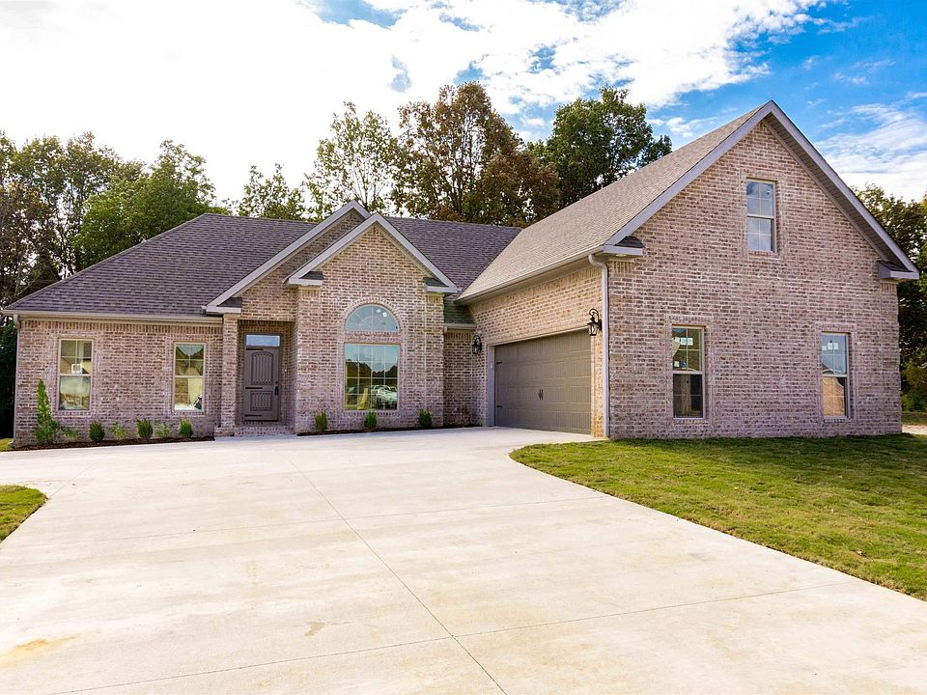
A Teacher’s Life by the Numbers!
Craighead and Independence County, AR
1st Year Teacher with a B.A.
15th Year Teacher with a M.A.
Teacher Salaries
$36,500-$43,945*
$52,011 - $56,825*
Plus extra duty pay for coaching and club sponsorship
*Data from 2021-2022
What does that mean for a teacher in this area?
The average annual wage is $41,912
Median home value is $135,004
Average rent for a two-bedroom apartment is $738
1st Year Teachers can buy houses like these*:
Mid-Career Teachers can buy houses like these*:
$220,000
$370,000
*With a 5% down payment for 1st year teachers and 20% down for mid-career and while spending 36% of their income on housing
Visit our Website! GettheFactsOut.org
This material is based upon work supported by the National Science Foundation under Grant Nos. 1821710 & 1821462. Any opinions, findings, and conclusions or recommendations expressed in this material are those of the author(s) and do not necessarily reflect the views of NSF.
Created by BA 11.03.21

