Slide 1
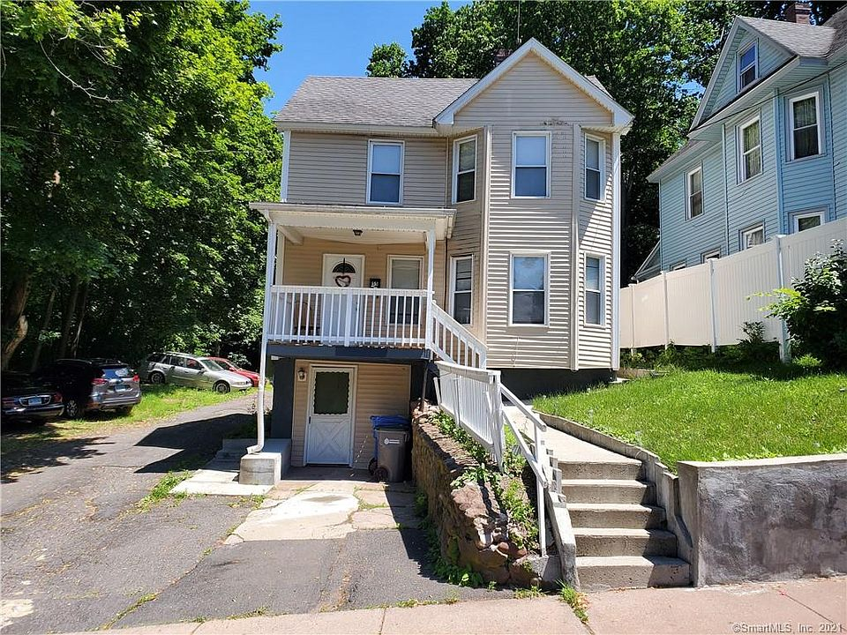
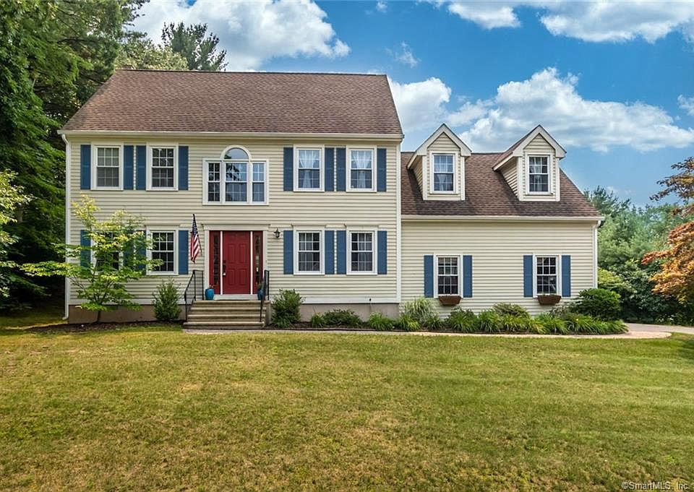
A Teacher’s Life by the Numbers!
Hartford County, CT
1st Year Teacher with a B.A.
15th Year Teacher with a M.A.
Teacher Salaries
$43,077-$45,016*
$70,422-$95,989*
Plus extra duty pay for coaching and club sponsorship
*Data from 2020-2022
What does that mean for a teacher in this area?
The average annual wage is $71,916
Median home value is $260,718
Average rent for a two-bedroom apartment is $1,347
1st Year Teachers can buy houses like these*:
Mid-Career Teachers can buy houses like these*:
$150,000
$419,000
*With a 5% down payment for 1st year teachers and 20% down for mid-career and while spending 36% of their income on housing
Visit our Website! GettheFactsOut.org
This material is based upon work supported by the National Science Foundation under Grant Nos. 1821710 & 1821462. Any opinions, findings, and conclusions or recommendations expressed in this material are those of the author(s) and do not necessarily reflect the views of NSF.
Created by KM 8.3.21

