Slide 1
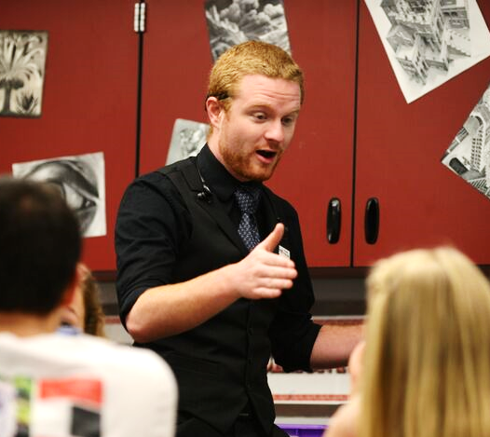
Blow minds! Teach science or math.
EARLY FIELD EXPERIENCE
OTHER TEACHER PREP COURSES
ACTIVITIES
Be a part of a real classroom at a local school
Learn cognitive science, how to spark curiosity, & how the brain works
Join the teaching club (TEA), develop science lesson for kids (PSI³), & more!
TWO PATHWAY OPTIONS for LICENSURE
RESIDENT TEACHER
TEACHER of RECORD
PREREQUISITES: BS degree, passing PRAXIS score, successful interview with PEBC, US Citizenship
STRUCTURE: 4 days/week in a classroom with a mentor teacher and approximately 8 hrs/week engaging in coursework with PEBC.
COMPENSATION: $5,000 fellowship
FEES: $500 deposit + $3,500
PREREQUISITES: Field experience, BS degree, passing PRAXIS score, successful interview with PEBC, US Citizenship, & apply for and obtain a job in a PEBC partner district
STRUCTURE: 5 days/week of classroom instruction as teacher of record in your own classroom with a mentor in the building and 8 hrs/week of coursework with PEBC.
COMPENSATION: Standard teacher salary
FEES: $9,000 split over 9 months
Teach@Mines Director: Wendy Adams (wkadams@mines.edu)
Physics: Vince Kuo (hkuo@mines.edu)
Chemistry: Renee Falconer (rfalcone@mines.edu)
Teach@Mines Advisor: Savannah Logan (sllogan@mines.edu)
Math: Gus Greivel (ggreivel@mines.edu)

Slide 2
Pathways into Education
Many ways to engage
mines.edu/teacherprep
Middle School or High School teaching
Informal outreach
College teaching
Classroom volunteer
Educational policy
Museums
Did you
know?
Teachers rate their lives better than all other occupation groups, trailing only physicians.
Did you know….
There are student loan forgiveness programs and scholarships for math and science teachers?
Most teaching jobs have better retirement benefits than private industry?
You can get a job almost anywhere in the U.S. or abroad as a science or math teacher?
Mid-career teacher salaries typically range between $60,000 and $130,000?
Behind every advance in medicine or technology is a teacher who left a lasting impression.
“I really like the ability to still explore higher level physics while being a teacher, whether it is through college level teaching (evening labs or online classes) or summer opportunities like the Quarknet group. Having summers off allows for time to go explore and still be involved with industry level physics”
T. Plantt, High school physics teacher

